Slide 1
Cosc 5/4735
Android Wear/ Wear OS

Slide 2
Debugging/connecting
Some watches can use USB debugging (through their charging cable), so just a phone/tablet.
Many don't and you have to do Bluetooth or Wi-Fi debugging.
Direction here:
https://developer.android.com/training/wearables/apps/debugging.html
Debugging this way maybe preferred, so you are not "tied" to the cable for testing
Sensors and movement can be difficult with a short cable.

Slide 3
Wear Versions (and Confusion)
Wear OS v3 (api 30 to 33+)
for watch faces use androidx.wear.watchface
play-services-wearable:18.0.0 and androidx.wear:wear:1.2.0
Wear OS v2 (api 28ish to 30)
androidx.wear 1.1.0 and com.google.android.support:wearable:2.8.1, play-services-wearable:17.0.0
Wear OS v1.0 (ap 27+ ), except at 28 and androidx.
wearable 2.3.0 but really api 24+ because com.android.support:wear
androidx wear 1.0.0 and play-services-wearable:17.0.0
with wearable:2.5.0
Android Wear v ? (api 24-27)
Wear 2.1.0 and 2.2.0 and com.android.support:wear
Android Wear v5.x (api 21-23)
Which is wear version 1.1.0 to 1.3.0+ (as of feb 2016)
Android Wear v1.0.x (api 20)
V1.0.x was very limited by comparison
It was very difficult to even create a watchface.

Slide 4
devices and emulators
You can setup a wear emulator and test most things without the need for the physical device.
But if you need the wear emulator to talk to a “phone”, then you must connect a physical device/phone to it.
Can connect to a device emulator. Odd, I know.
Directions: https://developer.android.com/training/wearables/apps/creating.html
Basically,
Install Android Wear on the device. Connect the device to the Computer where you have the wear emulator running
Start the wear app, in pairing, select Pear with Emulator in the menu.

Slide 5
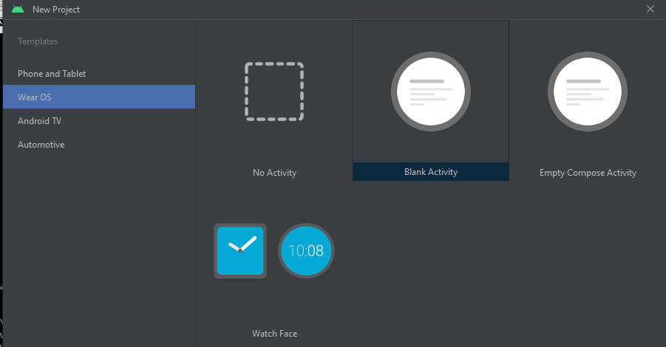
Studio
Normally you select phone/tablet.
If you are running something on the wear device (ie watch), then you need to select Wear

Slide 6
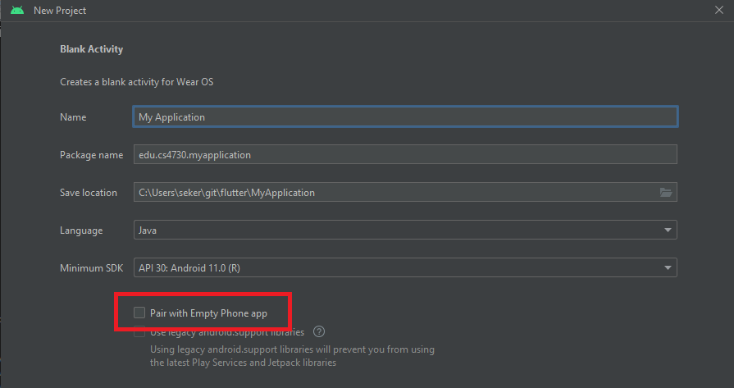
wear and phone app.

Slide 7
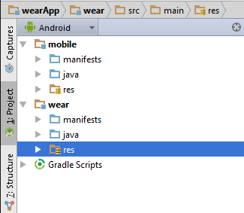
Studio (3)
If you select both then you will get “two” projects
Wear is the “watch” code
Mobile is the “phone” code

Slide 8
What is Covered
Wear is pretty large area of things we can do and we will cover:
Notifications
Basic Watchfaces
There is a lot more for watch face and information, say calendar, weather etc.
Basic app’s
Enough so you can build an app and get started.
Data Communication between wear device and android device.
Via the Google Service API

Slide 9
Notifications

Slide 10
Notifications
For many of the applications, it is as simple a sending a notification to the wearable device
As well as device.
Clearing a notification on wearable clears it on the phone as well.
You MUST use the NotificationCompat from the androidx import the following:
import androidx.core.app.NotificationCompat;
import androidx.core.app.NotificationCompat.BigTextStyle;
import androidx.core.app.NotificationManagerCompat;
import androidx.core.app.NotificationCompat.WearableExtender;

Slide 11
Simple notification
A simple one looks just like a normal notification
But the user will get on the wearable, and when they swipe left o reveal the Open action, which invokes the intent on the handheld device

Slide 12
Simple notification code
//create the intent to launch the notiactivity, then the pentingintent.
Intent viewIntent = new Intent(this, NotiActivity.class);
PendingIntent viewPendingIntent = PendingIntent.getActivity(this, 0, viewIntent, 0);
//Now create the notification. We must use the NotificationCompat or it will not work on the wearable.
NotificationCompat.Builder notificationBuilder =
new NotificationCompat.Builder(this, id).setSmallIcon(R.drawable.ic_launcher)
.setContentTitle("Simple Noti").setContentText("This is a simple notification")
.setContentIntent(viewPendingIntent);
// Get an instance of the NotificationManager service
NotificationManagerCompat notificationManager = NotificationManagerCompat.from(this);
// Build the notification and issues it with notification manager.
NotificationManager.notify(notificationID, notificationBuilder.build());

Slide 13
Simple notification result
The notification will look something this and then swipe left to an open button

Slide 14
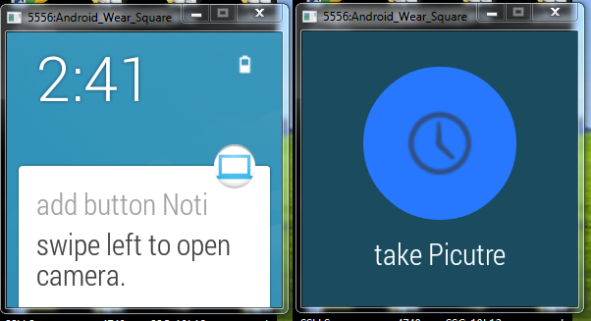
Adding your own button.
Same as before, but use the addAction(…) method.
Both the device and wearable will show the action.
.addAction(R.drawable.ic_action_time, "take Picutre", cameraPendingIntent);
Where the Camera intent launches the camera.

Slide 15
Wearable only actions.
Allows us to change the notification so it’s different from the device and wearable
Instead of addaction, we use .extend(…)
.extend(new WearableExtender().addAction(action)
Where action is already build action
NotificationCompat.Action action = new NotificationCompat.Action.Builder(R.drawable.ic_action_time,"take a Picutre", cameraPendingIntent).build();
So the take a picture action only shows on the wearable.

Slide 16
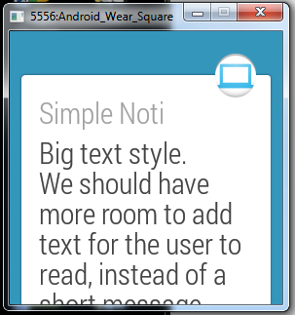
Other styles.
As with notifications, we can also use a BigTextStyle or InboxStyle (see notification inbox before).
BigTextStyles allows more text room and the notification takes up most of the space on the wearable.
BigTextStyle bigStyle = new NotificationCompat.BigTextStyle();
bigStyle.bigText(eventDescription);
And then in the builder
.setStyle(bigStyle)

Slide 17
Voice Actions
If the wear device accepts voice input, then you can also add to your notifications.
The user will talk to the wearable, because there is no keyboard.
Uses the RemoteInput class, via an intent and add it as an action.
This intent can be captured via the onCreate or onNewIntent
Note this can also be done with a broadcast receiver and intent-filter not shown here.

Slide 18
Voice Actions (2)
For the notification:
With need id/key for this, so using this:
String EXTRA_VOICE_REPLY = "extra_voice_reply";
create the remote input part for the notification.
RemoteInput remoteInput = new RemoteInput.Builder(EXTRA_VOICE_REPLY)
.setLabel("Reply").build();
Create the reply action and add the remote input
NotificationCompat.Action action = new notificationCompat.Action.Builder( R.drawable.ic_action_map, "Reply", replyPendingIntent)
.addRemoteInput(remoteInput).build();
And add the action to the notification as before.
.extend(new WearableExtender().addAction(action)

Slide 19
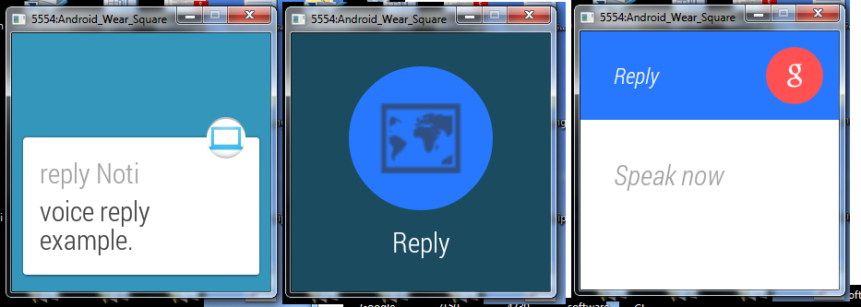
Voice Actions example

Slide 20
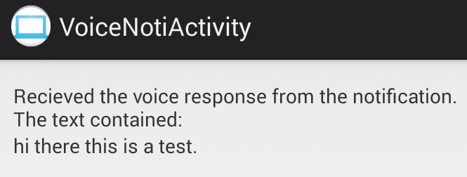
Voice Actions (3)
Now you get the intent in your activity and pull out the string of text. It uses the Id/Key from before.
Bundle remoteInput = RemoteInput.getResultsFromIntent(getIntent());
if (remoteInput != null) {
info = remoteInput.getCharSequence( EXTRA_VOICE_REPLY ).toString();
}

Slide 21
Example code
WearNotiDemo
Shows the code via a subroutine for each of the notifications that I listed.
You can run this via a wearable emulator and phone or with a wearable and phone.
Note that the wearable emulator will need the physical keyboard present checked, because there is no voice, you have to type.

Slide 22
WatchFaces

Slide 23
Studio
studio Flamingo 2022.2.1 has removed the template
see https://developer.android.com/training/wearables/watch-faces
Or use the new WatchFace Studio (by Samsung)
https://developer.android.com/training/wearables/wfs

Slide 24
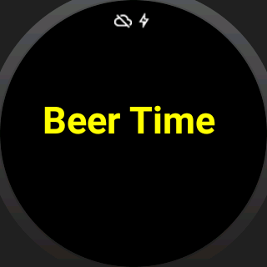
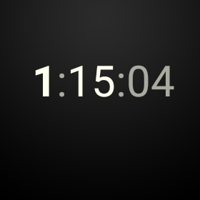
WatchFace Example code
3 example watch face are provided
BeerWatchFace
Doesn’t show the time, instead “Beer time”
Yellow in normal mode, gray in Ambient mode.
Show the min needed to get a watch face working.
Only updates once a minute.
Digital
Shows digital time,
Normal mode, shows seconds, ambient mode just hour and minute

Slide 25
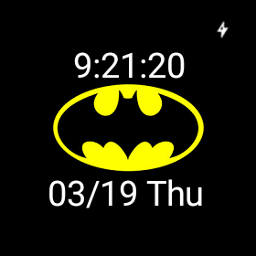
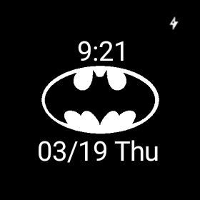
WatchFaces Example code (2)
Batman watchface
Show date and time, plus a graphic
In ambient mode, seconds are not shown and graphic is gray.

Slide 26
Wearable app

Slide 27
Wear App’s
Activity or AppCompatActivity
use a wake_lock permission to keep the screen on.
You can also use a ambientController, but only in the AppCompatActivity.
WearableActivity in 5.1 (wear2) from com.android.support:wear
setAmbient() to check the screen on.

Slide 28
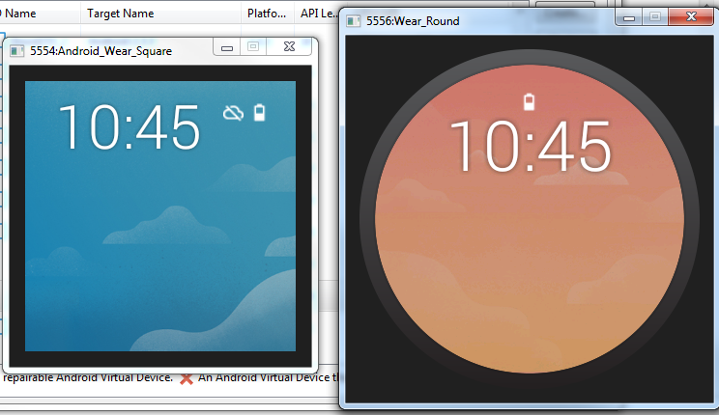
Wearable Apps
First issue: Round or Square?

Slide 29
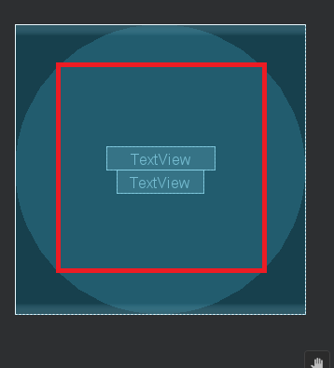
Round or Square? Both!
You can set each individually in the layout directories
layout-notround/activity_main.xml
layout-round/activity_main.xml
Or just use layout/activity_main.xml
use androidx.wear.widget.BoxInsetLayout
And in the layout inside it, use
app:boxedEdges="all"
Or pick the edges.

Slide 30
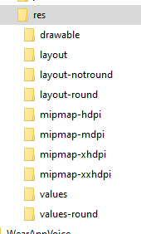
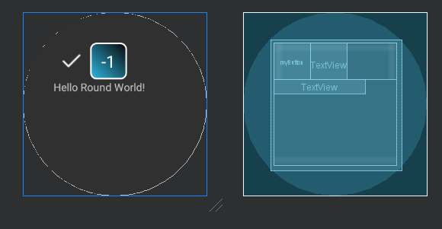
Round or Square? Both! (2)
In the activity, OnCreate:
setContentView(R.layout.activity_main);
system picks the correct one for you.
Same with strings, etc using a values and values-round directory.

Slide 31
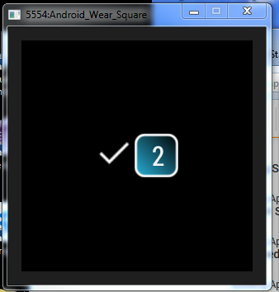
Example code
WearApp
Is my code based on ui app, where you can a random number (click the checkmark for another number).

Slide 32
Stand alone app?
In the androidManifest file add the following inside the application
<meta-data
android:name="com.google.android.wearable.standalone"
android:value="true"/>

Slide 33
Data Comminucation

Slide 34
Data Communication
We this one, we will create both a wear and mobile app.
If you are installing this with a debug key
Follow the previous step, but now there will also be an activity as well.

Slide 35
Data communication (2)
The device and wear can send messages via the DataLayer, which comes from the GooglePlay services.
In the build.gradle for both wear and mobile
compile 'com.google.android.gms:play-services-wearable:18.0.0’ (or current version)
you send the message via your “message path”, which I called, “/message_path”, but you can create your own path name.
Uses the MessageClient

Slide 36
Data communication (3)
We wanted this to be bi directional messages
So the mobile and the wear app each have a “send” method and a “receive” method.

Slide 37
Sending a message
Then you must use a thread to send the message, since this is a blocking call. (same for wear and phone device)
First get nodes (normally just the phone or wear, but could be more then on wear device) to send to.
Task<List<Node>> nodeListTask = Wearable.getNodeClient(getApplicationContext()).getConnectedNodes();
List<Node> nodes = Tasks.await(nodeListTask);
Then loop through the nodes and use this to send.
Task<Integer> sendMessageTask = Wearable.getMessageClient(MainActivity.this).sendMessage(node.getId(), path, message.getBytes());
integer result = Tasks.await(sendMessageTask);
There are a number of task success/failure we can attach, plus try catch I'm leaving off.
See the WearableDataLayer (and 2) for full code set.

Slide 38
Receiving a message
Uses a listener (same for both devices)
Setup and remove in OnResume/onPause
Wearable.getMessageClient(this).addListener(this);
Wearable.getMessageClient(this).removeListener(this);
MessageClient.OnMessageReceivedListener
@Override
public void onMessageReceived(@NonNull MessageEvent messageEvent) {
String message = new String(messageEvent.getData());
//do something with it.
}

Slide 39
Important note
Both the mobile and wear code MUST have the same applicationId in their build.gradle files
Otherwise it won’t work.

Slide 40
Example code
There is an WearableDatalayer example that sends and receives messages between a “phone” device and wearable device.
The device and wear have a send button that sends a message.
The wear devices receives the method and then will send a message back.
The mobile only receives the method.
So there isn’t an infinite loop of messages.
WearableDataLayer uses a listenerService
WearableDataLayer2 has the listeners in MainActivity (no service needed)
WearableDatalayer3 uses data commands to send/receive, which is a broadcast. Instead of the Message send/receive like the first two.

Slide 41
Wear UIs
In the androidx.wear:wear:1.2.0+ library there are number widgets just for the wear device
BoxInsetLayout which is a framelayout that understands the shape (round,square, inset), which “boxes” the widgets into a center square of a round screen (or just a box for the square screen)
CardFragment, CricledImageView, confirmationActivity, DotsPageIndicator (for a GridViewPager), WatchViewStub, WearablerecylerView, and there are more.

Slide 42
Voice
Voice Actions can be added to a wear app, like Voice Actions on a mobile device
See http://developer.android.com/training/wearables/apps/voice.html#SystemProvided for the list of intents
Declare App-provided Voice Actions doesn’t seem to work or their documentation is so bad that I can’t get it to work.

Slide 43
Speech Recognition
It works very much like the speech recognizer on the mobile devices.
Call the recognizer with an intent and it comes back via onActivityResult
Intent intent = new Intent( RecognizerIntent.ACTION_RECOGNIZE_SPEECH);
intent.putExtra(RecognizerIntent.EXTRA_LANGUAGE_MODEL, RecognizerIntent.LANGUAGE_MODEL_FREE_FORM);
startActivityForResult(intent, SPEECH_REQUEST_CODE);
And
protected void onActivityResult(int requestCode, int resultCode,
Intent data) {
if (requestCode == SPEECH_REQUEST_CODE && resultCode == RESULT_OK) {
List<String> results = data.getStringArrayListExtra(
RecognizerIntent.EXTRA_RESULTS);
String spokenText = results.get(0);
// Do something with spokenText
} }

Slide 44
References
Android’s training site
http://developer.android.com/training/wearables/apps/index.html
http://developer.android.com/training/building-wearables.html
http://developer.android.com/design/wear/principles.html
http://developer.android.com/training/wearables/apps/voice.html
http://developer.android.com/training/wearables/watch-faces/index.html
https://developer.android.com/wear/releases/index.html

Slide 45
Q
A
&

