Slide 1
Cosc 5/4735
YouTube API

Slide 2
YouTube
The YouTube Android Player API enables you to incorporate video playback functionality into your Android applications.
  The API allows you to load and play YouTube videos (and playlists) and to customize and control the video playback experience.
Note at the time of review (Jan 11, 2023), the YouTube API fail in Android 11/API 30
  It appears they finally need to update this api.

Slide 3
You will need an API key
First create a project, you will need the app package name, (note to self, not under cosc4735 account)
  Example: edu.cs4730.youtubedemo
Go to the Google Developers Console
  Create a new project, I named mine YouTube
  On the page that appears after project creation, expand APIs & auth on the left sidebar. Next, click APIs. In the list of APIs, click on YouTube Data API and enable the Youtube Data API v3 on the page that follows.
  In the sidebar on the left, select Credentials. For credentials, the API supports OAuth 2.0, the use of an API key and of a Service account. We'll use the API key option.
  Select API key from the Add Credentials dropdown menu. A popup will appear for you to specify the key type. Select Android Key. Next select Add package name and fingerprint and add the Android app's package name
    On the local computer: keytool -list -v -keystore ~/.android/debug.keystore
    The password will be android
  Click the Create button. Copy the API key generated. We will need it.

Slide 4
Create A new file/class
In the android app, create a new class called DeveloperKey.java and this code:
package edu.cs4730.youtubedemo;
public final class DeveloperKey {
public static final String YOUTUBE_API_KEY = "YOUR API KEY";
}
Or just look at my example code, which has the how to get the API key as well.

Slide 5
Get the lib
You will need to download the youtube library as well.
  https://developers.google.com/youtube/android/player/downloads/ It is 1.2.2 as I write this
  Open the zip and copy the jar from libs/
    YouTubeAndroidPlayerApi.jar and put it in your project lib directory.
    Sync gradle, so it knows the library is there.
Add internet permission to your project in the androidmanifest.xml file as well
  <uses-permission android:name="android.permission.INTERNET"/>

Slide 6
Simple version
Add the youtube widget to your layout
<com.google.android.youtube.player.YouTubePlayerView
android:id="@+id/youtube_view"
android:layout_width="match_parent"
android:layout_height="wrap_content" />

Slide 7
Simple version (2)
Java code:
  public class BasicYTActivity extends YouTubeBaseActivity implements YouTubePlayer.OnInitializedListener {
  @Override protected void onCreate(Bundle savedInstanceState) {
  …
  get the widget and then initialize with our api key. See the developerkey.java to set your key.
  youTubeView = (YouTubePlayerView) findViewById(R.id.youtube_view);
  youTubeView.initialize(DeveloperKey.DEVELOPER_KEY, this);
  }
  two necessary methods for the OnInitializedListener
  @Override
  public void onInitializationSuccess(YouTubePlayer.Provider provider, YouTubePlayer player, boolean wasRestored) {
  if (!wasRestored) {
  player.cueVideo("fhWaJi1Hsfo"); // Plays https://www.youtube.com/watch?v=fhWaJi1Hsfo
  }
  }
  We have failed to initialized the widget, if recoverable, then there will be a dialog box for the user to fix the problem, else if just fails. See example code.
  @Override
  public void onInitializationFailure(YouTubePlayer.Provider provider, YouTubeInitializationResult errorResult) {
  }

Slide 8
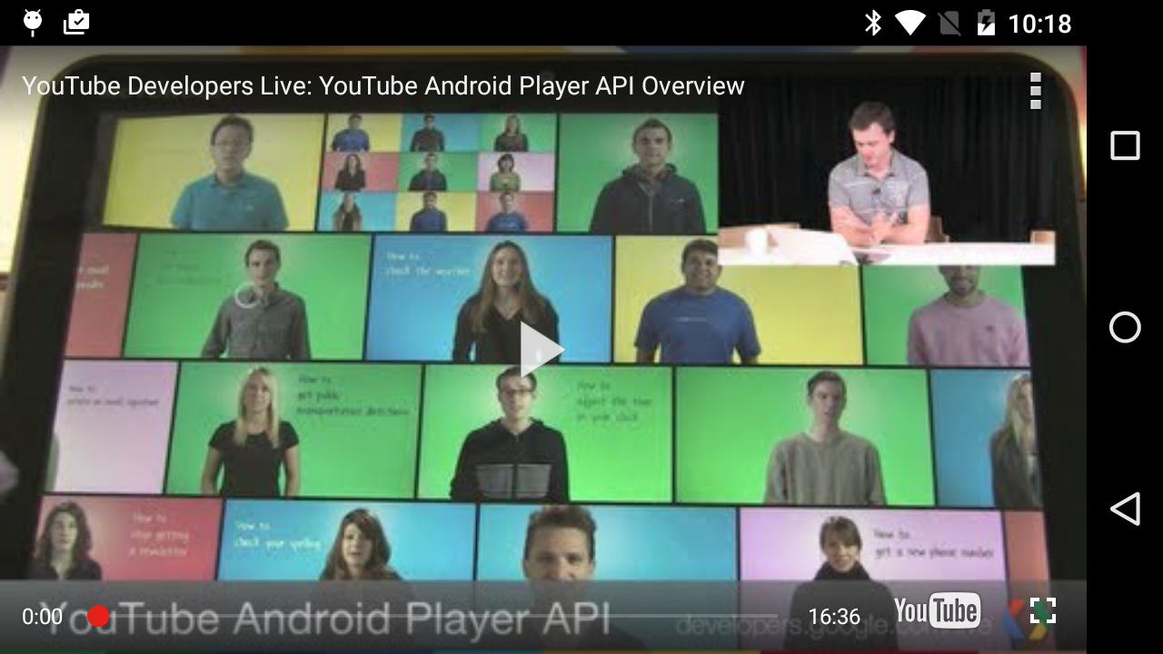
And
You app should look something like this

Slide 9
More?
There is much more. This was just a simple primer to get started.
  You can programmatically control the video, volume
  Playlist, etc.

Slide 10
Example code
There is a youtubeDemo app in the AV git
Remember, you will need to change the API key to use it.

Slide 11
Reference
Helpful references:
  https://developers.google.com/youtube/android/player/
a nice tutorial of how to implement it.
  http://www.sitepoint.com/using-the-youtube-api-to-embed-video-in-an-android-app/

Slide 12
Q
A
&

