Slide 1
Cosc 4735
Flutter
Basic UI

Slide 2
youtube.
The flutter channel has a lot "Widget of Week" or "package of week" short videos, most are 1 to 2 minutes.
https://www.youtube.com/@flutterdev/videos
Flutter package of week playlist(40 as of March 2025)
  https://www.youtube.com/watch?v=Jxw6FaA0j3I&list=PLjxrf2q8roU1quF6ny8oFHJ2gBdrYN_AK
Flutter widget of week playlist(170 as of March 2025)
  https://www.youtube.com/playlist?list=PLjxrf2q8roU23XGwz3Km7sQZFTdB996iG

Slide 3
getting started.
unlike android
  there is no xml or layout.
    it's built on the fly in your code.
  Widgets are not object or classes.
    you will need variables to store all the data and state of the widgets.
  widgets all have "state", either they are stateful or stateless
    either that are static and don't change stateless
    or stateful, where they have data that changes and when it does or there is user interaction. the widget will need to be redrawn (actually more then just the widget) based on the data or interaction.

Slide 4
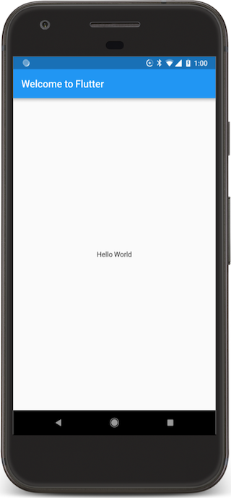
Hello word app.
This is an example of a simple hello world app (complete)
import 'package:flutter/material.dart';
void main() => runApp(MyApp());
class MyApp extends StatelessWidget {
@override
Widget build( BuildContext context) {
return MaterialApp(
title: 'Wecome to Flutter',
home: Scaffold(
appBar: AppBar(
title: Text('Welcome to Flutter' ),
),
body: Center(
child: Text('Hello World'),
),
), ); } }

Slide 5
State?
This is where the concept of Stateful and Stateless widgets comes from.
  A StatelessWidget is just what it sounds like—a widget with no state information.
    StatelessWidgets are useful when the part of the user interface you are describing does not depend on anything other than the configuration information in the object.
  A StateFulWidget changes and has a "state". If you updated the data or dynamically change the UI with new information, then you use a statefulWidget
    Example A radiobutton group is stateful, since we need to know which on is checked
    If you want to update a Textfield with new information, you need a statefulwidget.
      Also, a textfield doesn't have state. IE, it doesn't know what is stored in it.

Slide 6
Stateless widget
The hello world app before was stateless.
  It didn't change, no data was updated, and no widgets were interacted with.
So likely you primary/root widget will also be stateless, which calls a stateful widget.
The title of your app, theme, etc doesn't change.
entry point of your app
void main() { runApp(MyApp()); }
class MyApp extends StatelessWidget { // root widget
// This widget is the root of your application.
@override
Widget build(BuildContext context) {
return MaterialApp(
title: 'Flutter Demo',
theme: ThemeData(
primarySwatch: Colors.blue,
),
darkTheme: ThemeData.dark(),
home: MyHomePage(title: 'Flutter Demo Home Page'),
); } }

Slide 7
Widget? android vs web vs flutter.
An android widget even the simple ones like a textview are heavy weight objects, with many methods and hold data.
flutter widgets are all lightweight, have no real methods and hold no data. This the same idea as web pages.
  That is the important part to keep in mind. the flutter view of a text, doesn't know what text it "displaying".
  We, the programmer, must keep of all this information, in our own variables.
  keep this in mind as we start looking at stateful widgets.

Slide 8
Scaffold.
There is no xml layout. It's built by the Widget (stateless or stateful)
  via override the Widget build method.
  It uses "Scaffold" that is how to display the app.
  the home: needs a Scaffold object that is used to draw
    Back in the helloworld app, it was all one piece.
    In the stateless widget 2 slides back,
      home: MyHomePage(title: 'Flutter Demo Home Page') which must return a Scaffold
      which is done in the statefulWidget code by overriding the build method.

Slide 9
Basic view of the stateful widget
two parts, first the object
class MyHomePage extends StatefulWidget {
MyHomePage({Key key, required this.title}) : super(key: key);
final String title;
  the object overrides createState() which does the bulk of the work
@override
State<MyHomePage> createState() => _MyHomePageState();
}

Slide 10
Basic view of the stateful widget (2)
part 2, the "state" method
class _MyHomePageState extends State<MyHomePage> {
//local variables and methods declarations
@override
Widget build(BuildContext context) {
return Scaffold( … ); //this is the layout and how the app will look.
}
}

Slide 11
Scaffold
This is then is how everything is draw.
appBar:
  is the application bar/title bar.
body:
  this is the bulk of the app and content view, think about this as the first layout in android that it builds from there.
There are more options after the body statement,
  floatingActionButton: the floating action button, bottom right or nested with other widgets like BottomSheet
  Drawer: the layout drawer, this also several more objects that work with it.
  BottomNavigationBar: the bottom navigation Bar that google now recommends
  BottomSheet: it's like a drawer but opens from the bottom.
  SnackBar: lightweight message with optional action and display briefly.

Slide 12
Widgets
First there are 2 design systems as part of the SDK
Cupertino
  Beautiful and high-fidelity widgets that align with Apple's Human Interface Guidelines for iOS and macOS.
Material Components
  Visual, behavioral, and motion-rich widgets implementing the Material 3 design specification. (ie Android)
    Note in cosc 4730 I taught a combination of Material 2 and 3.

Slide 13
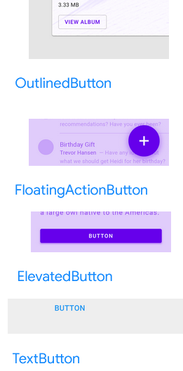
Buttons
There are a couple of variants in buttons in Material Design
ElevatedButton
  A Material Design elevated button. A filled button whose material elevates when pressed.
OutlineButton
  A Material Design outlined button, essentially a TextButton with an outlined border.
TextButton
  A Material Design text button. A simple flat button without a border outline.
FloatingActionButton
  A floating action button is a circular icon button that hovers over content to promote a primary action in the application.
Note, TextButton replaced FlatButton, ElevatedButton replaced Reaisedbutton, and OutlinedButton replaced OutlineButton

Slide 14
Buttons
Elevatedbutton, TextButton, OutlineButton display different, but use basically the same code, except the name.
ElevatedButton(
onPressed: () { //anonymous method, think onclick for android
// do something.
},
child: const Text('Text Shown for the Button'),
)

Slide 15
FloatingAcitionButton
A floating action button is its own spot in the Scaffold after the body statement.
floatingActionButton: FloatingActionButton(
onPressed: _updateText, //call a method or use () {…}
tooltip: 'Update Text',
child: Icon(Icons.update),
),

Slide 16
Back to state.
Let's say when you click a button, it changes the text.
First, we need variable to hold the text for the text field.
Then the update text method will set the state, and it will redraw.
Note, an _ as the first letter of a variable or method, means it's private.
String textToShow = "Flutter is interesting.";
void _updateText() {
setState( () {
// update the text variable.
textToShow = "Flutter has a weird state!";
});
}
… in the build method
Text(textToShow)

Slide 17
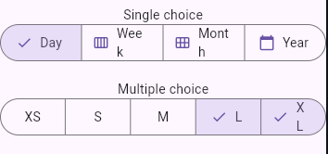
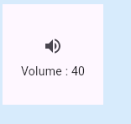
Iconbutton and segmentedButton
This is button that only has a picture.
IconButton(
icon: const Icon(Icons.volume_up),
tooltip: 'Increase volume by 10',
onPressed: () {
setState(() {
_volume += 10;
});
},
),
SegmentedButton and single choice or multiple.
Segmentedbutton, which takes seqments that are ButtonSegment.
These take variable of enum, ie the number of segments, which is also the choices.
https://api.flutter.dev/flutter/material/SegmentedButton-class.html

Slide 18
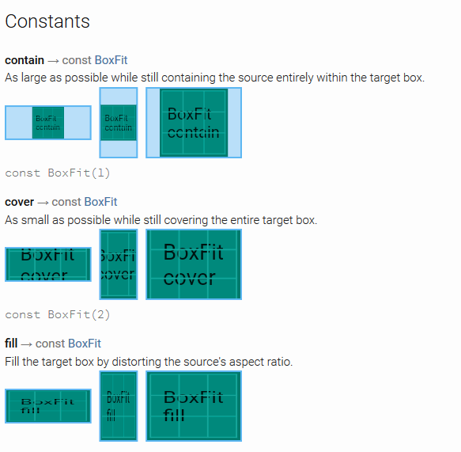
Images
First assets need to be declared in the pubspec.yaml file.
assets:
- images/phone.png
Then the widget is
Image.asset('images/phone.png', fit: BoxFit.cover)
https://docs.flutter.io/flutter/painting/BoxFit-class.html partial list here

Slide 19
Input TextEditingController and TextField
TextField is the widget
TextEditingController holds the data.
You declare a controller and set in the textfield.
So
TextEditingController nameController = TextEditingController();
Then the widget is
new TextField(
controller: nameController,
//captures the text
decoration: const InputDecoration(helperText: "Enter Name"),
)
Note, in the example, its is wrapped in a flexible, since row can't figure out the width correctly and errors out.

Slide 20
Radio buttons
Note, must be in a statefullWidget in order to redraw correctly. We need a state.
int _radioValue = 0; //default zero
Then declare the radio buttons with a value, a groupValue, and onChanged, plus a text for each.
new Radio(
value: 0,
groupValue: _radioValue,
onChanged: _handleRadioValueChange,
),
new Text('Euro'),
new Radio(
value: 1,
groupValue: _radioValue,
onChanged: _handleRadioValueChange,
),
…

Slide 21
Radio buttons (2)
void _handleRadioValueChange(int ? value) {
setState(() {
_radioValue = value!;
} );
}
SetState causes the redraw and now with the new radio value.
Note the variable value can be null, so we have to asset that is won't be later.

Slide 22
A Toast
In the pubspec.yaml we need to include the "package"
dev_dependencies:
flutter_test:
sdk: flutter
fluttertoast: ^8.2.1
won't work in windows, does work for web.
In the dart file import it.
  import 'package:fluttertoast/fluttertoast.dart';
Use it like in android
Fluttertoast.showToast(
msg: 'Hi There',
toastLength: Toast.LENGTH_SHORT);

Slide 23
Android to flutter
There is a pretty good page of "how do I do (android) X in flutter
  Flutter for Android developers https://flutter.dev/docs/get-started/flutter-for/android-devs
  also has IOS, React, Web, and Xamarin to flutter pages.

Slide 24
Layouts

Slide 25
Layouts
Row and Column layouts (think linear layouts)
  IntrinsicWidth and IntrinsicHeight
Stacked
Expended
ContrainedBox
Container
Material
Slivers
SizedBox
SafeArea

Slide 26
Layouts
Widgets are classes used to build UIs.
Widgets are used for both layout and UI elements.
Compose simple widgets to build complex widgets.
simplest layout:
Center, which centers single widget.
  Center( child: Text('Center me') ),

Slide 27
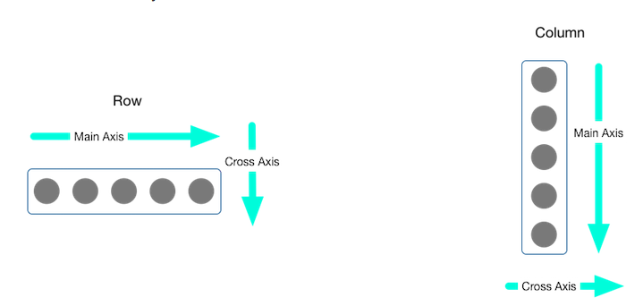
Layouts (2)
center() or container() take a single widget
  child:
Row, Column take a list of child widgets
  children: [ ]
  mainAxisAlignment: and CrossAxisAligenment: (both are optional), and padding:
    Common ones: spaceEvenly, center Also have Start, end, stretch (fill) and baseline

Slide 28
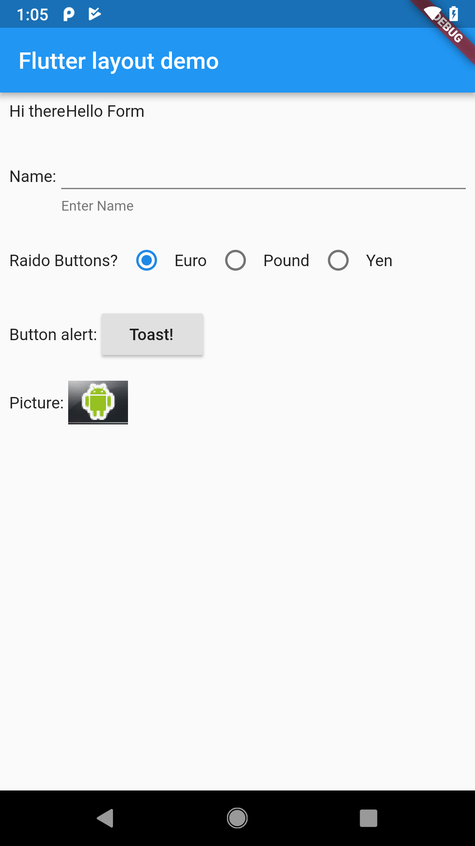
Layout, rows and columns (liner layout)
There is a Column that takes a set of "widgets", so we
body: Column(
children: [
RowOne,
RowTwo,
]
Where RowOne is a Container that is holding a row of widgets.

Slide 29
Layout, rows and columns (liner layout)
Row examples
Widget RowOne = Container(
padding: const EdgeInsets.all(8),
child: Row(children: [
Text('Hi there'),
Text('Hello Form'),
]));
Widget RowFive = Container(
padding: const EdgeInsets.all(8),
child: Row(children: [
Text('Picture: '),
Image.asset( 'images/phone.png', fit: BoxFit.cover)
]));

Slide 30
layout Flexible/Expanded
Expanded layout, use in Row or column and be used to make sure they are all drawn as the same size.
  with Flex: 2 it will make this expanded item twice the size of the other expanded items in row/column.
Flexible widget used in a Row or Column allows it to fill the available space in main axis.
  https://api.flutter.dev/flutter/widgets/Flexible-class.html
https://docs.flutter.dev/ui/layout/tutorial
We come back to layouts and more pieces next lecture.

Slide 31
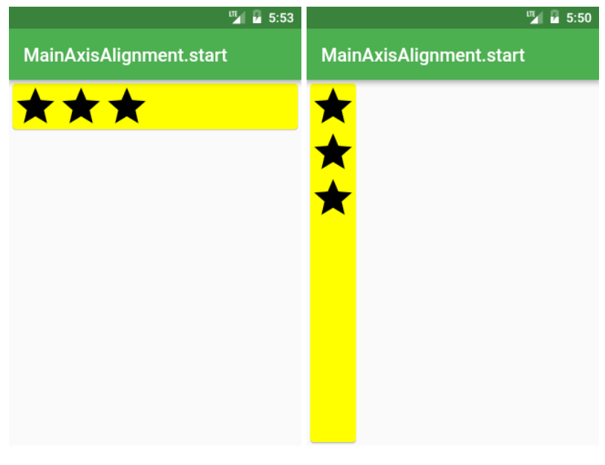
Row ( and Column) layouts
This is also the default
Row /*or Column*/(
mainAxisAlignment: MainAxisAlignment.start,
children: <Widget>[
Icon(Icons.star, size: 50),
Icon(Icons.star, size: 50),
Icon(Icons.star, size: 50),
],
),

Slide 32
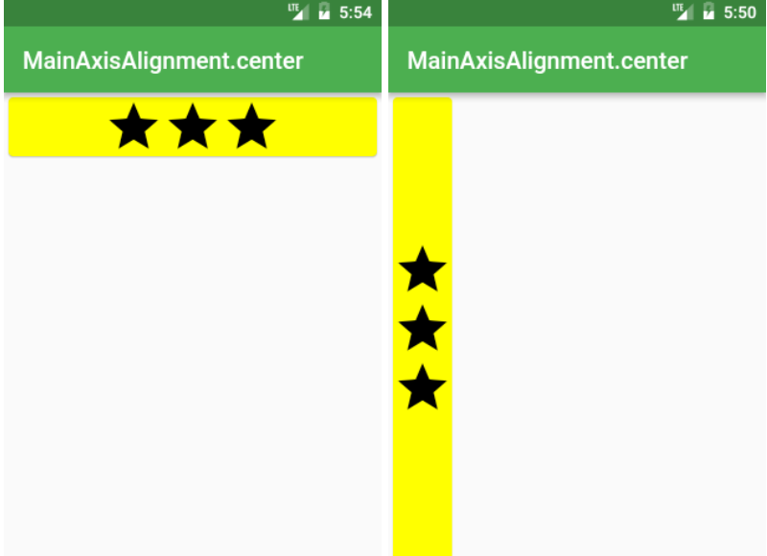
Row Center
Row /*or Column*/(
mainAxisAlignment: MainAxisAlignment.center,
children: <Widget>[
Icon(Icons.star, size: 50),
Icon(Icons.star, size: 50),
Icon(Icons.star, size: 50),
],
),

Slide 33
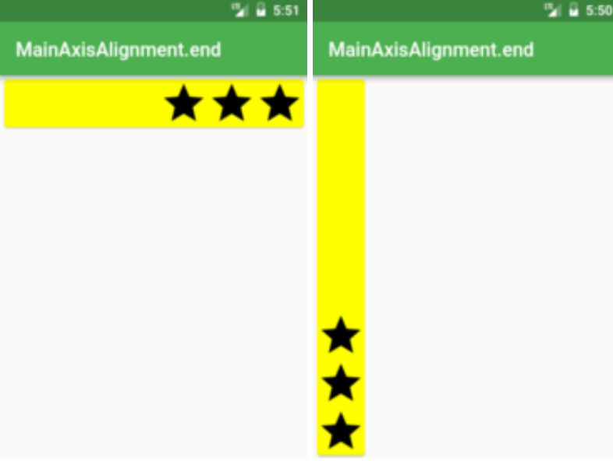
Row end
Row /*or Column*/(
mainAxisAlignment: MainAxisAlignment.end,
children: <Widget>[
Icon(Icons.star, size: 50),
Icon(Icons.star, size: 50),
Icon(Icons.star, size: 50),
],
),

Slide 34
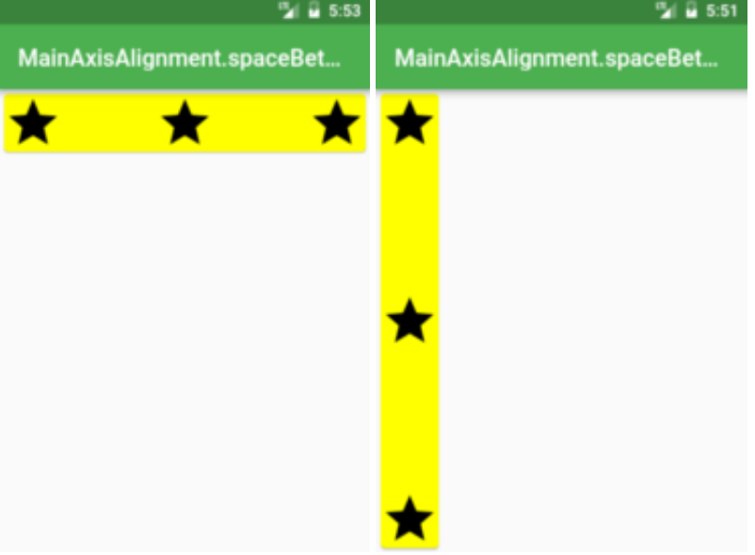
Row Space
Row /*or Column*/(
mainAxisAlignment: MainAxisAlignment.spaceBetween,
children: <Widget>[
Icon(Icons.star, size: 50),
Icon(Icons.star, size: 50),
Icon(Icons.star, size: 50),
],
),
Also, spaceEvenly, and spaceAround

Slide 35
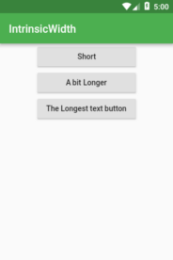
IntrinsicWidth and IntrinsicHeight
Want all the widgets inside Row or Column to be as tall/wide as the tallest/widest widget?
body: Center(
child: Column(
children: <Widget>[
ElevatedButton(onPressed: () {}, child: Text('Short'), ),
ElevatedButton(onPressed: () {}, child: Text('A bit Longer'), ),
ElevatedButton(onPressed: () {}, child: Text('The Longest text button'),),
…

Slide 36
IntrinsicWidth and IntrinsicHeight (2)
body: Center(
child: IntrinsicWidth(
child: Column(
crossAxisAlignment: CrossAxisAlignment.stretch,
children: <Widget>[
ElevatedButton( onPressed: () {},child: Text('Short'), ),
ElevatedButton( onPressed: () {},child: Text('A bit Longer'), ),
ElevatedButton( onPressed: () {}, child: Text('The Longest Text button'), ),
…

Slide 37
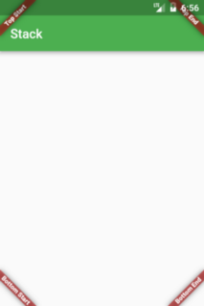
Stack Layout.
the stack layout, is similar to a relative layout. Where we specify the location.
return Stack(
fit: StackFit.expand,
children: <Widget>[ main,
Banner( message: "Top Start", location: BannerLocation.topStart, ),
Banner( message: "Top End", location: BannerLocation.topEnd, ),
Banner( message: "Bottom Start", location: BannerLocation.bottomStart, ),
Banner(message: "Bottom End", location: BannerLocation.bottomEnd, ),
],
);

Slide 38
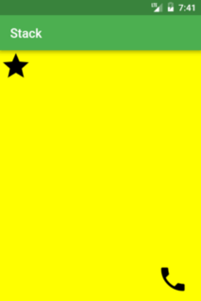
Stack Layout (2)
With your own Widgets, you need to place them in Positioned Widget
body: Stack(
fit: StackFit.expand,
children: <Widget>[
Material(color: Colors.yellowAccent),
Positioned( top: 0, left: 0, child: Icon(Icons.star, size: 50),),
Positioned( top: 340, left: 250, child: Icon(Icons.call, size:50),),
],
),

Slide 39
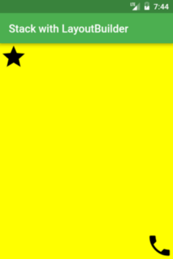
Stack Layout (3)
If you don’t want to guess the top/bottom values you can use LayoutBuilder to retrieve them
body: LayoutBuilder(
builder: (context, constraints) =>
Stack(fit: StackFit.expand,
children: <Widget>[
Material(color: Colors.yellowAccent),
Positioned( top: 0, left: 0, child: Icon(Icons.star, size: iconSize), ),
Positioned( top: constraints.maxHeight - iconSize, left: constraints.maxWidth - iconSize, child: Icon(Icons.call, size: iconSize),
),
], ),

Slide 40
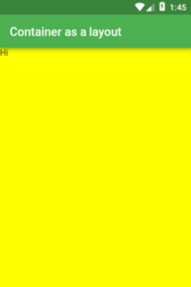
Container
mostly commonly used
  if you don't specify height and width, then it will be just the child size.
  Otherwise you can specify to take some or all the space, using
  Container(
  height: double.infinity,
  width: double.infinity,
  color: Colors.yellowAccent,
  child: Text("Hi"),
  )

Slide 41
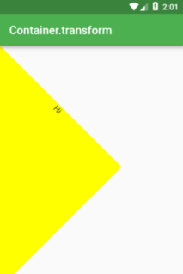
Containers
Used for a lot of decorations as well. including a BoxDecoration
We can also use a Transform in the change it up.
body: Container(
height: 300,
width: 300,
transform: Matrix4.rotationZ(pi / 4),
decoration: BoxDecoration(color: Colors.yellowAccent),
child: Text(
"Hi",
textAlign: TextAlign.center,
),
),

Slide 42
BoxDecoartions
with the boxdecoration,
you can add background images
  or background colors, even gradients
borders
  square
  rounded
using the BoxShape, change from square to another shape
  BoxShape.circle for example.
Add shadows as well.

Slide 43
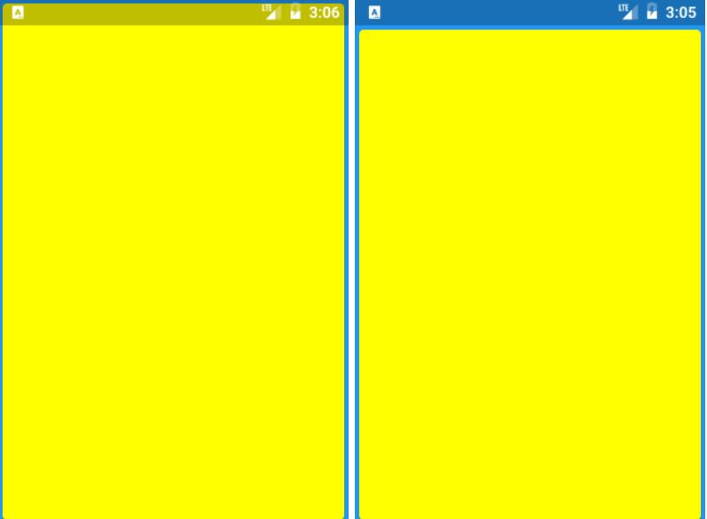
there are many More
Once last one I talk about is SafeArea
  The deals with all the "notches" and special areas on android/iphones that you can't draw on.
  Widget build(BuildContext context) {
  return Material(
  color: Colors.blue,
  child: SafeArea(
  child: SizedBox.expand(
  child: Card(color: Colors.yellowAccent),
  ),
  ),
  );
  }
more layouts https://medium.com/flutter-community/flutter-layout-cheat-sheet-5363348d037e
a tutorial with more pictures: https://www.tutorialspoint.com/flutter/flutter_introduction_to_layouts.htm

Slide 44
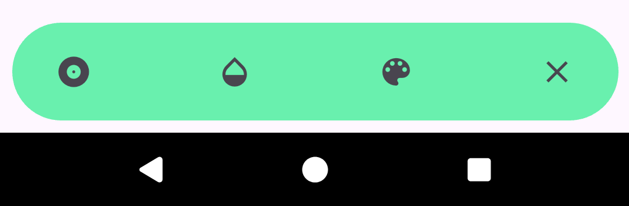
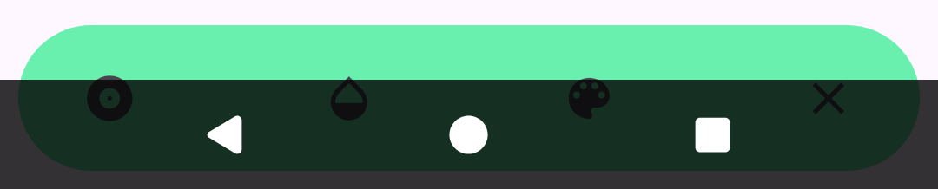
android 15
side note for android 15, which has edge-to-edge turned on by default. This can cause problems with widgets showing up under a 3 buttons and under the notification bar.
  It can be turned off, in android/app/src/main/res/values/styles.xml and values-night/styles.xml files
    add to style
    <item name="android:windowOptOutEdgeToEdgeEnforcement">true</item>

Slide 45

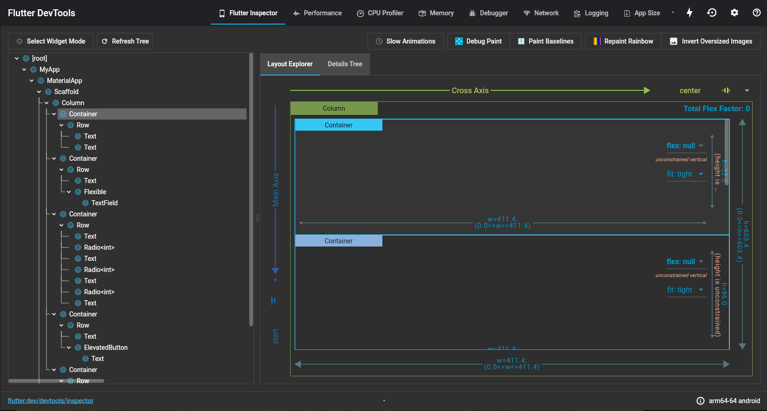
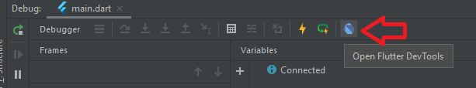
Layout Explorer (flutter devtools)
Must run in debug.
In the debug window below click the open flutter dev tools
opens in a browser.

Slide 46
References
https://flutter.dev/
https://flutter.dev/docs/get-started/install
https://codelabs.developers.google.com/codelabs/first-flutter-app-pt1/
https://hackr.io/blog/how-to-learn-flutter
https://flutter.dev/docs/reference/tutorials
https://flutter.dev/docs/resources/bootstrap-into-dart
https://pub.dartlang.org/flutter
https://developers.googleblog.com/2018/12/flutter-10-googles-portable-ui-toolkit.html

Slide 47
Q
A
&

