Slide 1
Cosc 4735
Flutter
Drawing, plus more.

Slide 2
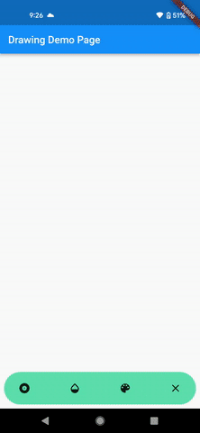
Draw Demo example.
To get this to work we need
  gesture detector for where the use touches
  drawing, of course.
    paint objects, color, width, etc.
  Also used
    Bottom Navigation bar for the pictures
    alert dialogs in the bar
    and a color picker code from a library.

Slide 3
Gesture Detector
before we draw, where need to know how to get touch points.

Slide 4
GuestureDetector
A detector will let you capture all kinds of "gestures" from a tap, long press, down, move, up, etc.
  We are only going to focus on the 3 we need today, where the use touchs the screen, moves their finger, and the lifts their finger.
    onPanStart, onPanUpdate, onPanEnd
    https://api.flutter.dev/flutter/widgets/GestureDetector-class.html
You wrap a GestureDetector around a widget that you want to detect.
  in our case, a customPaint widget (explained next section).
https://www.youtube.com/watch?v=WhVXkCFPmK4 GestureDetector (Widget of the Week)

Slide 5
GuestureDetector (2)
body: GestureDetector(
onPanUpdate: (details) {
//moved
},
onPanStart: (details) {
// touch down
},
onPanEnd: (details) {
//touch up.
},
child: CustomPaint(
size: Size.infinite,
…
)));
For each of the three methods
  we get a "details" object.
    void Function(DragStartDetails details);
    void Function(DragEndDetails details);
    void Function(DragUpdateDetails details);
  it provides information
    globalPosition offset object, which has x and y for the whole screen
    localPosotion offset object, which has x and y for inside the widget we are looking at.
    a timestamp duration if you need
    Update also includes a delta offset how move it moved.

Slide 6
Offset information.
with the Offset information for the localposition
  start those points in a list.
    Flutter doesn't have a simple to draw on an image and then display it, like the android draw demo (that I could find).
    we must draw everything every time the screen is redrawn
We have a list of drawingPoints
  List<DrawingPoints> points = [];
DrawingPoints will hold an offset and a paint object.

Slide 7
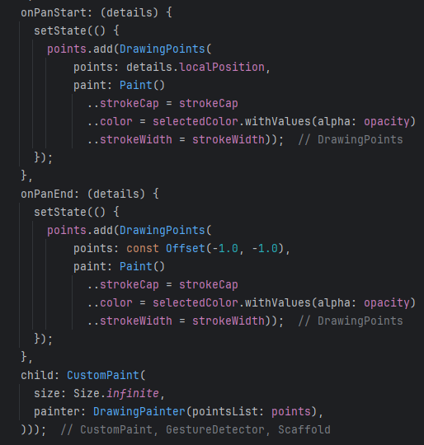
GuestureDetector (3)
For each one, we need to store information
the position (ie offset)
paint object to draw with
It's wrapped in a setState, so it so the CustomPainter will get called and draw the new points.

Slide 8
CustomPaint class
and Paint objects too.

Slide 9
CustomPaint widget
A widget that provides a canvas on which to draw during the paint phase.
It takes a painter: CustomPainter method
  you will likely need a size: (for us, whole screen.
  You could even include a child: where the widgets would be the foreground and the CustomPainter draws a background.
child: CustomPaint(
size: Size.infinite,
painter: DrawingPainter(pointsList: points),
)
https://www.youtube.com/watch?v=kp14Y4uHpHs CustomPaint Widget of the week

Slide 10
CustomPainter class.
We need to extend the CustomPainter for our DrawingPainter
class DrawingPainter extends CustomPainter {
DrawingPainter({required this.pointsList}); //parameter we need.
@override
void paint(Canvas canvas, Size size) {
//called when drawing the widget.
}
@override
bool shouldRepaint(covariant CustomPainter oldDelegate) {
//should repaint
return true; //in my code, I just return true.
}
https://youtu.be/vvI_NUXK00s Advanced UI with CustomPainter (also talked about mlkit face recognition).

Slide 11
Canvas object
The canvas object is very similar to android's canvas object
drawArc, drawCircle, drawColor, DrawDRRect, drawImage, drawLine, drawOval, DrawPaint, drawParagraph, drawPath, drawPicture, drawPoints, drawVertices, etc
each one takes the required parameters and a paint object.
we will use drawLine and drawPoints for our code.

Slide 12


Paint object
Paint object as with android
  color, which is the color to used to draw
  isAntiAlias bool, Whether to apply anti-aliasing to lines and images drawn on the canvas.
  strokeCap, The kind of finish to place on the end of lines drawn
    I chose round, since web didn't support a lot of them.
  stokeWidth, how wide in pixels.
  There are more to paint object
  https://api.flutter.dev/flutter/dart-ui/Paint-class.html

Slide 13
Now we can draw
In the paint method, we go through each set of points and draw them.
OnPanEnd adds an offset position of -1,-1, that way we just draw a point for when the lift their finger.
and start again with the next one.
@override
void paint(Canvas canvas, Size size) {
for (int i = 0; i < (pointsList.length - 1); i++) {
if (pointsList[i].points.dx != -1 && pointsList[i + 1].points.dx != -1) {
canvas.drawLine(pointsList[i].points, pointsList[i + 1].points,
pointsList[i].paint);
} else if (pointsList[i].points.dx != -1 &&
pointsList[i + 1].points.dx == -1) {

Slide 14
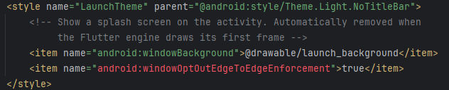
last note
android 15 and full screen.
  starting in android 15, it does edge to edge by default, which will place things under the camera and below navigation button as well.
  the dialogs were all showing up under navigation buttons on the test phone.
To fix this
  go android directory -> app -> src -> main -> res -> values (and values-night)
    in the style file: add <item name="android:windowOptOutEdgeToEdgeEnforcement"> true</item>

Slide 15
The rest
BottomNavagtionBar, plus some dialog boxes

Slide 16
draw demo code
the navigation bar is more complex then shown in the routes lecture, since we need include dialogs inside the bar itself.
It easier to explain the code while looking at the code and running the program at the same time
  since in places is changing how the bottomNavigationbar works.
  If I had written this from scratch, it would be 3 separate dialogs that popped up over the canvas itself. but this code is fancier.

Slide 17
References
https://flutter.dev/docs/codelabs
https://api.flutter.dev/flutter/material/BottomNavigationBar-class.html
https://willowtreeapps.com/ideas/how-to-use-flutter-to-build-an-app-with-bottom-navigation
https://flutter.dev/docs/cookbook/lists/long-lists
https://api.flutter.dev/flutter/material/AlertDialog-class.html
https://www.appsdeveloperblog.com/alert-dialog-with-a-text-field-in-flutter/
https://coflutter.com/flutter-how-to-show-dialog/
https://www.kindacode.com/article/flutter-get-the-position-of-a-tap-x-y-coordinates/
https://api.flutter.dev/flutter/widgets/CustomPaint-class.html
https://medium.com/flutter-community/drawing-in-flutter-using-custompainter-307a9f1c21f8 the code used, but badly out of date, it's for flutter 1.0, and many things simply don't work anymore. but it does give a good idea how to draw
https://youtu.be/kp14Y4uHpHs CustomPaint (flutter widget of the week)

Slide 18
Q
A
&

