Slide 1
Cosc 54735
Playing, Audio, video, and using a webview

Slide 2
Video Player plugin

Slide 3
Video Player.
The player is simple to use
using the VideoPlayerController load the video
from a file (won't work with web), asset, or network.
initialize();
Once it's initialized, you can play the video
.play(), .pause(), .seekTo(position),
.setVolume(volume), setLooping(Boolean)

Slide 4
displaying video
You will need to use the AspectRatio so the video looks correct.
Where _controller is and it's initialized.
using the video_player_demo in flutter repo

Slide 5
Audio player plugin.
just_audio

Slide 6
just_audio plugin
again, very simple to get started.
just_audio, can get very complex and do background audio, plus multiple files, play serially or on top of each other.
get the audioplayer and set the audio source using an await
local or web.
once ready, .play(), pause(), .seek(Duration), .stop()
note stop() also frees the resources, so you would set again.
using the audio_player_demo in flutter repo

Slide 7
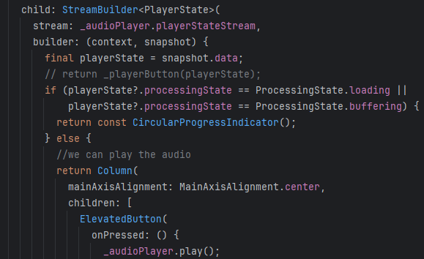
example
set the audio source in initState()
There is no await here, since
I'm using a stream later.

Slide 8
webView

Slide 9
webview
vebview using http to present the data.
ie web pages.
the server side knows the app is requesting data and normally formats it correctly for the mobile device.
note this make little sense for web app, but the rest.
WebViewWidget displays
it takes a controller. This does the bulk of the work.

Slide 10
WebViewController
At very simplest, it does nothing.
no javascript and very simple browser
loadRequest(uri) starts it.
NavigationDelegate lets you update the user when a page is loading
you can also onNvigationRequest:
not allowed to go to youtube for example.

Slide 11
WebViewController
This also can be create buttons you might see in a standard browsers.
example
controller.canGoBack() true if there is a page to back to
controller.goBack() return back one page.
goForward(), canGoForward
setUserAgent, reload() etc.
https://pub.dev/documentation/webview_flutter/latest/webview_flutter/WebViewController-class.html

Slide 12
References
https://docs.flutter.dev/cookbook/plugins/play-video
https://pub.dev/packages/video_player
https://pub.dev/packages/just_audio
https://pub.dev/packages/webview_flutter

Slide 13
Q
A
&

