Slide 1
Cosc 4735
Flutter
Basic UI

Slide 2
getting started.
unlike android
there is no xml or layout.
it's built on the fly in your code.
Widgets are not object or classes.
you will need variables to store all the data and state of the widgets.
widgets all have "state", either they are stateful or stateless
either that are static and don't change stateless
or stateful, where they have data that changes and when it does or there is user interaction. the widget will need to be redrawn (actually more then just the widget) based on the data or interaction.

Slide 3
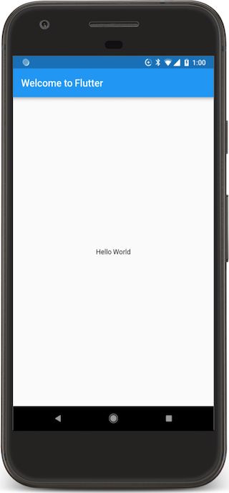
Hello word app.
This is an example of a simple hello world app (complete)
import 'package:flutter/material.dart';
void main() => runApp(MyApp());
class MyApp extends StatelessWidget {
@override
Widget build( BuildContext context) {
return MaterialApp(
title: 'Wecome to Flutter',
home: Scaffold(
appBar: AppBar(
title: Text('Welcome to Flutter' ),
),
body: Center(
child: Text('Hello World'),
),
), ); } }

Slide 4
State?
This is where the concept of Stateful and Stateless widgets comes from.
A StatelessWidget is just what it sounds like—a widget with no state information.
StatelessWidgets are useful when the part of the user interface you are describing does not depend on anything other than the configuration information in the object.
A StateFulWidget changes and has a "state". If you updated the data or dynamically change the UI with new information then you use a statefulWidget
Example A radiobutton group is stateful, since we need to know which on is checked
If you want to update a Textfield with new information, you need a statefulwidget.
Also a textfield doesn't have state. IE, it doesn't know what is stored in it.

Slide 5
Stateless widget
The hello world app before was stateless.
It didn't change, no data was updated and no widgets were interacted with.
So likely you primary/root widget will also be stateless, which calls a stateful widget.
The title of your app, theme, etc doesn't change.
entry point of your app
void main() { runApp(MyApp()); }
class MyApp extends StatelessWidget { // root widget
// This widget is the root of your application.
@override
Widget build(BuildContext context) {
return MaterialApp(
title: 'Flutter Demo',
theme: ThemeData(
primarySwatch: Colors.blue,
),
darkTheme: ThemeData.dark(),
home: MyHomePage(title: 'Flutter Demo Home Page'),
); } }

Slide 6
Widget? android vs flutter.
An android widget even the simple ones like a textview are heavy weight objects, with many methods and hold data.
flutter widgets are all lightweight, have no real methods and hold no data.
That is the important part to keep in mind. the flutter view of a text, doesn't know what text it "displaying".
We, the programmer, have to keep of all this information.
keep this in mind as we start looking at stateful widgets.

Slide 7
Scaffold.
There is no xml layout. It's built by the Widget (stateless or stateful)
via override the Widget build method.
It uses "Scaffold" that is how to display the app.
the home: needs a Scaffold object that is used to draw
Back in the helloworld app, it was all one piece.
In the stateless widget 2 slides back,
home: MyHomePage(title: 'Flutter Demo Home Page') which must return a Scaffold
which is done in the statefulWidget code by overriding the build method.

Slide 8
Basic view of the stateful widget
two parts, first the object
class MyHomePage extends StatefulWidget {
MyHomePage({Key key, required this.title}) : super(key: key);
final String title;
the object overrides createState() which actually does the bulk of the work
@override
State<MyHomePage> createState() => _MyHomePageState();
}

Slide 9
Basic view of the stateful widget (2)
part 2, the "state" method
class _MyHomePageState extends State<MyHomePage> {
//local variables and methods declarations
@override
Widget build(BuildContext context) {
return Scaffold( … ); //this is the layout and how the app will look.
}
}

Slide 10
Scaffold
This is then is how everything is draw.
appBar:
is the application bar/title bar.
body:
this is the bulk of the app and content view, think about this as the first layout in android that it builds from there.
There are more options after the body statement,
floatingActionButton: the floating action button, bottom right or nested with other widgets like BottomSheet
Drawer: the layout drawer, this also several more objects that work with it.
BottomNavigationBar: the bottom navigation Bar that google now recommends
BottomSheet: it's similar to drawer, but opens from the bottom.
SnackBar: lightweight message with optional action and display briefly.

Slide 11
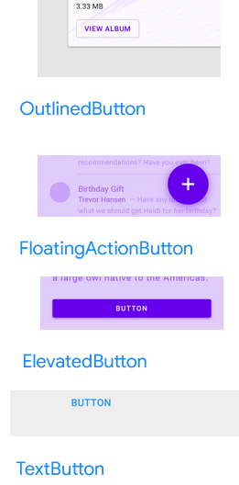
Buttons
There are a couple of variants in buttons in Material Design
ElevatedButton
A Material Design elevated button. A filled button whose material elevates when pressed.
OutlineButton
A Material Design outlined button, essentially a TextButton with an outlined border.
TextButton
A Material Design text button. A simple flat button without a border outline.
FloatingActionButton
A floating action button is a circular icon button that hovers over content to promote a primary action in the application.
Note, TextButton replaced FlatButton, ElevatedButton replaced Reaisedbutton, and OutlinedButton replaced OutlineButton

Slide 12
Buttons
Elevatedbutton, TextButton, OutlineButton display different, but use basically the same code, except the name.
ElevatedButton(
onPressed: () { //anonymous method, think onclick for android
// do something.
},
child: const Text('Text Shown for the Button'),
)

Slide 13
FloatingAcitionButton
A floating action button is it's own spot in the Scaffold after the body statement.
floatingActionButton: FloatingActionButton(
onPressed: _updateText, //call a method or use () {…}
tooltip: 'Update Text',
child: Icon(Icons.update),
),

Slide 14
Back to state.
Let's say when you click a button, it changes the text.
First we need variable to hold the text for the text field.
Then the update text method will set the state and it will redraw.
Note, an _ as the first letter of a variable or method, means it's private.
String textToShow = "Flutter is interesting.";
void _updateText() {
setState( () {
// update the text variable.
textToShow = "Flutter has a weird state!";
});
}
… in the build method
Text(textToShow)

Slide 15
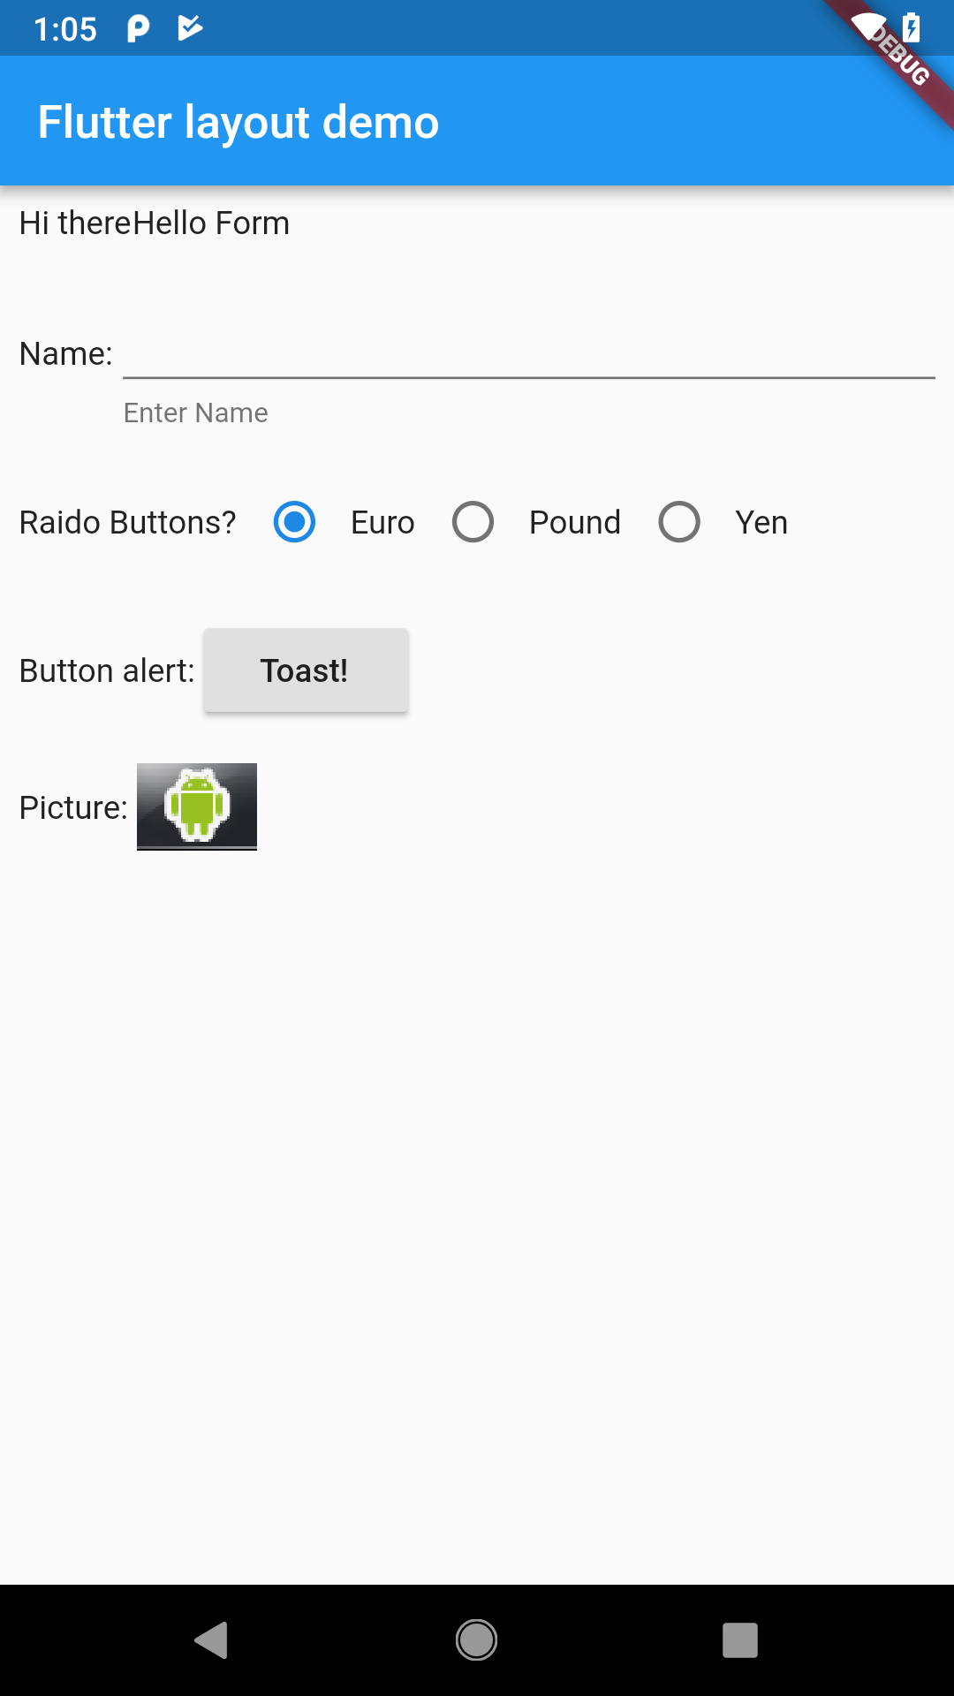
Layout, rows and columns (liner layout)
There is a Column that takes a set of "widgets", so we
body: Column(
children: [
RowOne,
RowTwo,
]
Where RowOne is a Container that is holding a row of widgets.

Slide 16
Layout, rows and columns (liner layout)
Row examples
Widget RowOne = Container(
padding: const EdgeInsets.all(8),
child: Row(children: [
Text('Hi there'),
Text('Hello Form'),
]));
Widget RowFive = Container(
padding: const EdgeInsets.all(8),
child: Row(children: [
Text('Picture: '),
Image.asset( 'images/phone.png', fit: BoxFit.cover)
]));

Slide 17
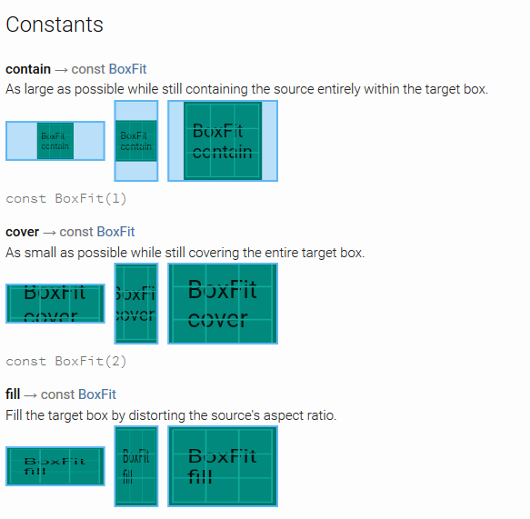
Images
First assets need to be declared in the pubspec.yaml file.
assets:
- images/phone.png
Then the widget is
Image.asset('images/phone.png', fit: BoxFit.cover)
https://docs.flutter.io/flutter/painting/BoxFit-class.html partial list here

Slide 18
Input TextEditingController and TextField
TextField is the widget
TextEditingController holds the data.
You declare a controller and set in the textfield.
So
TextEditingController nameController = TextEditingController();
Then the widget is
new TextField(
controller: nameController,
//captures the text
decoration: const InputDecoration(helperText: "Enter Name"),
)
Note, in the example is wrapped in a flexible, since row can't figure out the width correctly and errors out.

Slide 19
Radio buttons
Note, must be in a statefullWidget in order to redraw correctly. We need a state.
int _radioValue = 0; //default zero
Then declare the radio buttons with a value, a groupValue, and onChanged, plus a text for each.
new Radio(
value: 0,
groupValue: _radioValue,
onChanged: _handleRadioValueChange,
),
new Text('Euro'),
new Radio(
value: 1,
groupValue: _radioValue,
onChanged: _handleRadioValueChange,
),
…

Slide 20
Radio buttons (2)
void _handleRadioValueChange(int ? value) {
setState(() {
_radioValue = value!;
} );
}
SetState causes the redraw and now with the new radio value.
Note the variable value can be null, so we have to asset that is won't be later.

Slide 21
A Toast
In the pubspec.yaml we need to include the "package"
dev_dependencies:
flutter_test:
sdk: flutter
fluttertoast: ^8.2.1
won't work in windows, does work for web.
In the dart file import it.
import 'package:fluttertoast/fluttertoast.dart';
Use it like in android
Fluttertoast.showToast(
msg: 'Hi There',
toastLength: Toast.LENGTH_SHORT);

Slide 22
Android to flutter
There is a pretty good page of "how do I do (android) X in flutter
Flutter for Android developers https://flutter.dev/docs/get-started/flutter-for/android-devs
also has IOS, React, Web, and Xamarin to flutter pages.

Slide 23
References
https://flutter.dev/
https://flutter.dev/docs/get-started/install
https://codelabs.developers.google.com/codelabs/first-flutter-app-pt1/
https://hackr.io/blog/how-to-learn-flutter
https://flutter.dev/docs/reference/tutorials
https://flutter.dev/docs/resources/bootstrap-into-dart
https://pub.dartlang.org/flutter
https://developers.googleblog.com/2018/12/flutter-10-googles-portable-ui-toolkit.html

Slide 24
Q
A
&

