Slide 1
Cosc 4735
Flutterfire and google maps

Slide 2
FlutterFire?
flutter with firebase = FlutterFire
As of March 2023, all the standard firebase works with flutter on all platforms
https://firebase.flutter.dev/
has listing of all the versions and where it works.
firebase with flutter is no where as mature as it is with native android or iOS code.

Slide 3
before you start.
You need node.js installed. you will need to install the firebase cli and you will need to build flutterfire cli. login to firebase via firebase cli
https://firebase.google.com/docs/cli
dart pub global activate flutterfire_cli
firebase login
create your project at this point if you haven't already.
flutterfire configure
which will setup your app and add all the pieces you the google project you choose.
also generates a firebase_options.dart in your lib directory. you will need it.
add at least these dependencies
cloud_firestore: ^4.4.5
firebase_core: ^2.8.0
firebase_auth: ^4.3.0
provider: ^6.0.5
Note covered, but the auth-UI also has plugin.

Slide 4
firebase.
before you do anything else, you need to initialize firebase
this is a async call, so it's recommended are to have a loading screen that is started first while the initialization goes through.
Mine initials in the myApp
but in the end, this is what you need to start up firebase.
final Future<FirebaseApp> _fbapp = Firebase.initializeApp( options: DefaultFirebaseOptions.currentPlatform );

Slide 5
firebase authentication and realtime
Authentication
honesty this is kind of a mess and via examples it appears only the sign with email works (or only people have gotten examples to show)
FirebaseAuth.instance.signInAnonymously().whenComplete( () => { });
it anonymous sign and not the best answer here. but it does work.
realtime database (^firebase_database: ^4.3.0)
DatabaseReference _ref = FirebaseDatabase.instance.reference().child("test");
_ref.set("Hello World"); //to set.
_ref.push().set( { … data object …}) to create random id, like previous shown.

Slide 6
firebase realtime (continued)
Reading back (to be in a future method, since it's asnyc)
_Ref.once(), //don't update if data is changed.
builder: (context, AsyncSnapshot<DataSnapshot> snapshot) {
if (snapshot.hasData) {
Map<dynamic, dynamic> values = snapshot.data.value;
values.forEach((key, values) {
//you will know the keys, since it's the names.
});
}
}
dbRef.onValue, //this fires when every the data is updated.

Slide 7
FireStore

Slide 8
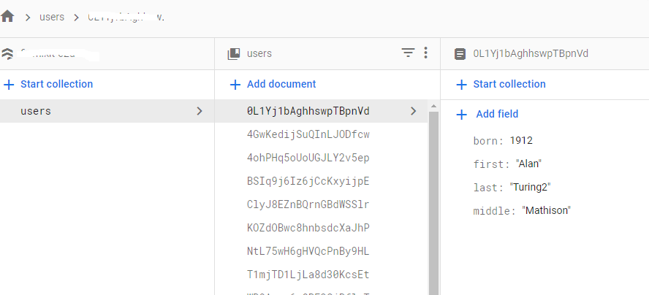
work very similar
insert, delete, update all need to be async
there is a listener for when the database is updated, so the app can update based on the new data.

Slide 9
updates
Future<DocumentReference> addData( String first, String middle, String last, int born) { return FirebaseFirestore.instance.collection('users').add({ 'first': first, 'last': last, 'born': born, 'middle': middle, }); } Future updateData( String id, String first, String middle, String last, int born) { return FirebaseFirestore.instance.collection('users').doc(id).update({ 'first': first, 'last': last, 'born': born, 'middle': middle, }); } Future removeData(String id) { return FirebaseFirestore.instance.collection('users').doc(id).delete(); }
use the instance
add
update
delete

Slide 10
snapshot updates
we need variable for it, if a one shot, skip it.
StreamSubscription<QuerySnapshot>? _dataSubscription;
create the listener for the subscription
_dataSubscription = FirebaseFirestore.instance .collection('users') .snapshots().listen((snapshot) { _dataInfos = []; for (var document in snapshot.docs) { _dataInfos.add( dataInfo( first: document.data()['first'], middle: document.data()['middle'] ?? "none", last: document.data()['last'], born: document.data()['born'], id: document.id, ), ); } notifyListeners(); //or setState, depending on how you set it up. });

Slide 11
ChangeNotifier
You will either need have all reads (that update) in a setState()
or position them in a ChangeNotifier class (class mine extends ChangerNotifier)
when you get an update, you call notifyListeners(); that will setup the redraw of the info.
You main changes to something like this
Future<void> main() async {
runApp(ChangeNotifierProvider(
create: (context) => mine(), //which is called by notifyListeners().
builder: (context, _) => MyApp(),
));
}

Slide 12
Googe Maps
based on a code lab.

Slide 13
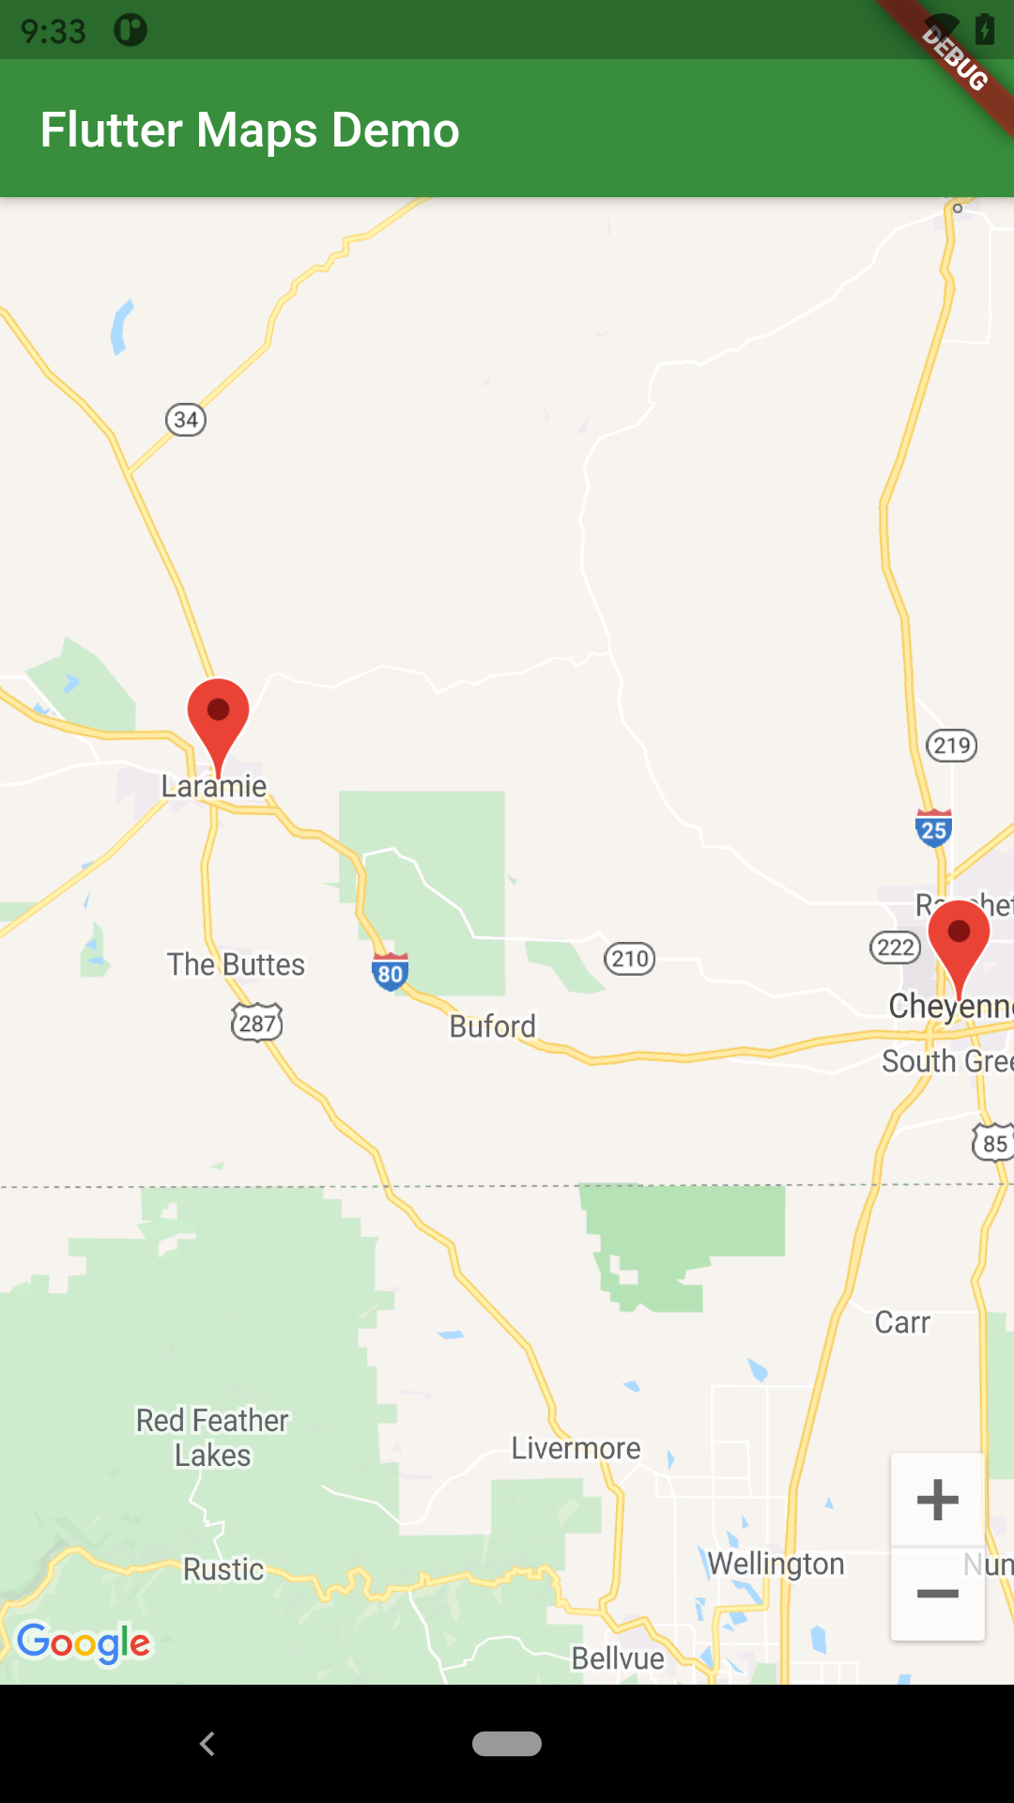
Google Maps.
This is very similar to how it is done in android.
And we actually need to get a map key for android (and iOS as well)
and put in the correct files, just like you would in android app.
see the codelab reference at the end for key information.
in the pubspec.yaml we need to add to the depencies.
# Add the following line (or newer version, use pub outdated to check.)
google_maps_flutter: ^2.2.5

Slide 14
Get the map.
In a stateful widget, but like android part of the map is coming via a thread (async)
you need a couple of pieces.
the controller
googleMap in the body.
a simple version
For markers set this
Future<void> _onMapCreated(GoogleMapController controller) async { mapController = controller; } @override Widget build(BuildContext context) { return MaterialApp( home: Scaffold( appBar: AppBar( title: const Text('Flutter Maps Demo'), backgroundColor: Colors.green[700], ), body: GoogleMap( onMapCreated: _onMapCreated, initialCameraPosition: const CameraPosition( target: LARAMIE, zoom: 11.0, ), //markers: _markers.values.toSet(), ), ), ); }

Slide 15
Get the map (2)
like android, we also have
onTap and onLongPress
And polygons, moves, camera, etc.

Slide 16
markers
To add markers to your map.
in the build GoogleMap
markers: List of markers.
then use the setState to add new markers.
final Map<String, Marker> _markers = {}; Future<void> _onMapCreated(GoogleMapController controller) async { mapController = controller; setState(() { _markers.clear(); Marker laramieMarker = const Marker( markerId: MarkerId("Laramie"), position: LARAMIE, infoWindow: InfoWindow(title: "Laramie", snippet: "home of UW")); _markers["Laramie"] = laramieMarker; }); }

Slide 17
Examples
flutterfirebasedemo gives you some authentication and firestore
flutter_mapdemo give you the maps
remember you need your own key to get it to work.

Slide 18
References
firebase
https://www.youtube.com/watch?v=EXp0gq9kGxI getting started video
https://www.youtube.com/watch?v=DqJ_KjFzL9I using firestore
https://firebase.google.com/docs/auth/web/anonymous-auth
https://medium.com/firebase-tips-tricks/how-to-use-firebase-authentication-in-flutter-50e8b81cb29f
https://medium.com/firebase-tips-tricks/how-to-use-firebase-queries-in-flutter-361f21005467
https://petercoding.com/firebase/2020/02/25/using-firebase-auth-in-flutter/
https://firebase.google.com/codelabs/firebase-get-to-know-flutter#0 code lab for authentication.
https://firebase.google.com/codelabs/firebase-get-to-know-flutter#3 configure firebase page.
https://github.com/flutter/codelabs many of the code for the flutter codelabs
maps
https://codelabs.developers.google.com/codelabs/google-maps-in-flutter#0

Slide 19
Q
A
&

