Slide 1
Cosc 4735
Flutter
More
multiple screen, drawer, and sensors

Slide 2
multiple screen.
Routes

Slide 3
Multiple screens
Flutter uses the term routes to mean screens (activity, fragments, pages)
  unlike android, we also don't have activities, fragments, or pages.
  Remember, everything is Widget.
A route, is simply two different Widgets (Stateless or Stateful) that build a screen.
  Use the Navigator to change been routes.
    Navigator.push( …) to change to a new route
    Navigator.pop() to go back.

Slide 4
Routes
example
void main() {
runApp(
MaterialApp(
title: 'Navigation Basics',
home: FirstRoute(), //this is a widget.
)); }

Slide 5
Multiple screens (2)
class FirstRoute extends StatelessWidget {
@override
Widget build(BuildContext context) {
return Scaffold(
appBar: AppBar(
title: Text('First Route'),
),
body: Center(
child: RaisedButton(
child: Text('Open route'),
onPressed: () {
Navigator.push( context,
MaterialPageRoute(
builder: (context) => SecondRoute()),
);
},
), ), ); } }
class SecondRoute extends StatelessWidget {
@override
Widget build(BuildContext context) {
return Scaffold(
appBar: AppBar(
title: Text("Second Route"),
),
body: Center(
child: RaisedButton(
onPressed: () {
Navigator.pop(context);
},
child: Text('Go back!'),
), ), ); } }
note all this code is main.dart file
or can be in multiple files

Slide 6
Using a Drawer "layout"

Slide 7
Drawer
drawer: Drawer(
child: ListView(
// Important: Remove any padding from the ListView.
padding: EdgeInsets.zero,
children: [
const DrawerHeader(
decoration: BoxDecoration(
color: Colors.blue,
),
child: Text('Drawer Header'),
),
ListTile(
title: const Text('Item 1'),
onTap: () {
// Update the state of the app.
Navigator.pop(context);
},
),
ListTile(
title: const Text('Item 2'),
onTap: () {
// Update the state of the app.
Navigator.pop(context);
},
),
],
),
The drawer is built into the scaffold
easy to use and create.
normally uses a "simple" listview
Scaffold(
drawer: Drawer( … ),
);
use the navigator.pop(context) to close the drawer.

Slide 8
Drawers and multiple routes
If you want to use the drawer more like we would in android, where it changes between fragments, then it a little more complex.
  First put the drawer widget in it's own class and likely own file
  put each router/screen also in itself file.
  define a routes class for each route.
    we have 4 "fragments", so 4 routes.
class routes {
static const String main = MainView.routeName;
static const String first = FirstView.routeName;
static const String second = SecondView.routeName;
static const String third = ThirdView.routeName;
}

Slide 9
main.dart
class MyApp extends StatelessWidget {
const MyApp({super.key});
// This widget is the root of your application.
@override
Widget build(BuildContext context) {
return MaterialApp(
title: 'Navigation Drawer Demo',
debugShowCheckedModeBanner: false,
theme: ThemeData(
primarySwatch: Colors.blue,
),
home: const MainView(),
routes: {
routes.main: (context) => MainView(),
routes.first: (context) => FirstView(),
routes.second: (context) => SecondView(),
routes.third: (context) => ThirdView(),
},
);
}
}
Main lists the routes
home: to display the first page
  just like normal actually.
  except in this case MainView() is in it's own file.

Slide 10
DrawerWidget()
return Drawer(
child: ListView(
children: <Widget>[
DrawerHeader(
decoration: BoxDecoration(
gradient: RadialGradient(
colors: [ Colors.white,Colors.blueAccent],
stops: [0.3, 1],
),
),
child: …,
),
ListTile(
leading: Icon(Icons.add),
title: Text('First Screen',style: TextStyle(fontWeight: FontWeight.bold),),
onTap: (){
Navigator.pop(content) //close the drawer
Navigator.pushReplacementNamed(context, routes.first);
},
),
ListTile(
leading: const Icon(Icons.check),
title: const Text('Second Screen',style: TextStyle(fontWeight: FontWeight.bold),),
onTap: (){
Navigator.pop(context); //closes the drawer, now change screens.
Navigator.pushReplacementNamed(context, routes.second);
},
),
…
it will look like the earlier widget
  declare the listivew and DrawerHeader
and listTile for each route they can select.
  pushReplacementNamed is the important part here.

Slide 11
Example firstscreen.
in each "screen" you then have the drawer: with the widget
class FirstScreen extends StatelessWidget {
const FirstScreen({super.key});
@override
Widget build(BuildContext context) {
return Scaffold(
appBar: AppBar(
title: const Text('First Screen'),
),
body: const SafeArea(
child: Center(
child: Text('Welcome To First Screen'),
),
),
drawer: const DrawerWidget(),
);
}
}

Slide 12
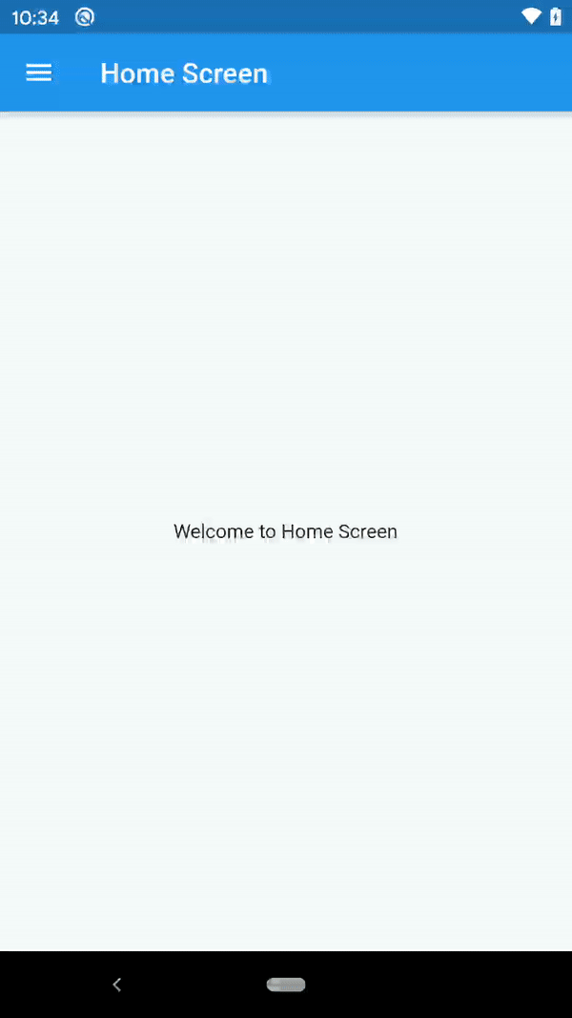
Visually.
This switches between views.
Here you get the same idea as fragments in android.
Note you can use the same technic with bottomNavigationBar too.

Slide 13
Sensors
devices sensors Accelerometer, gyroscope, magnetometer, and battery.
works on all platforms, even if doesn't make sense, like web.

Slide 14
Sensors
We have access to
  Accelerometer (and userAccelerometer doesn't count gravity)
  Gyrosope
  Magnetometer
  and battery information.
Accessing the sensors is pretty straight forward
  We initate listeners for the ones we want and the listener uses the setState to change values in our application.
https://www.youtube.com/watch?v=Fq5zNPJufD0 sensors_plus package of week.

Slide 15
StreamSubscription
A subscription on events from a Stream.
When you listen on a Stream using Stream.listen, a StreamSubscription object is returned.
The subscription provides events to the listener, and holds the callbacks used to handle the events. The subscription can also be used to unsubscribe from the events, or to temporarily pause the events from the stream.

Slide 16
add listeners
in the initState() for the "main" widget, myHomePageState is the default
  add each listener that we want to subscriber to and setState() causes actions.
void initState() {
super.initState();
_streamSubscriptions.add(
accelerometerEvents.listen(
(AccelerometerEvent event) {
setState(() {
_accelerometerValues = <double>[event.x, event.y, event.z];
});
},
),
);
_streamSubscriptions.add(
gyroscopeEvents.listen(
(GyroscopeEvent event) {
setState(() {
_gyroscopeValues = <double>[event.x, event.y, event.z];
});
},
),
);

Slide 17
remove subscriptions
@override
void dispose() {
super.dispose();
for (final subscription in _streamSubscriptions) {
subscription.cancel();
}
}

Slide 18
battery
battery state, charging or not charging from the listener.
We can also get addition information
  first get a instance of the battery.
  var battery = Battery();
  var batteryLevel = await _battery.batteryLevel; //for the battery level
    ie 70% left,

Slide 19
References
https://flutter.dev/docs/codelabs
https://docs.flutter.dev/cookbook/design/drawer
https://betterprogramming.pub/how-to-implement-a-navigation-drawer-in-flutter-8d97d3b599d4
https://github.com/kirshiyin89/flutter_navigation
https://referbruv.com/blog/posts/flutter-for-beginners-customizing-list-tiles-and-on-tap-navigation
https://medium.com/@gadepalliaditya1998/item-selection-in-list-view-on-tap-in-flutter-using-listview-builder-612f6608505a
https://pub.dev/packages/sensors_plus
https://pub.dev/documentation/battery_plus

Slide 20
Q
A
&

