Slide 1
Cosc 4735
Flutter
(cross platform)
Part 2

Slide 2
Using multiple files in dart.
The entire application can be written in the main.dart file.
but that is really bad style and could get really confusing as well.
So style has it, that each screen (like activities or dialogs) should be in their own file.
Flutter does not automatically include all the files either, so you must include them manually
example, from the dialog_Demo
import 'DialogExample.dart';

Slide 3
Flutter widgets
there are a large amount of widgets that can be used from buttons, input, drawers, layout, etc.
Some of default for all of them, but others are material design or Cupertino (ios) specific. (meaning, you need to import them).
widget catalog https://flutter.dev/docs/development/ui/widgets
to use all the https://flutter.dev/docs/development/ui/widgets/material widgets, you need import 'package:flutter/material.dart'; in your dart file.

Slide 4
Layouts
an overview

Slide 5
Layouts
Row and Column layouts (think linear layouts)
IntrinsicWidth and IntrinsicHeight
Stacked
Expended
ContrainedBox
Container
Material
Slivers
SizedBox
SafeArea

Slide 6
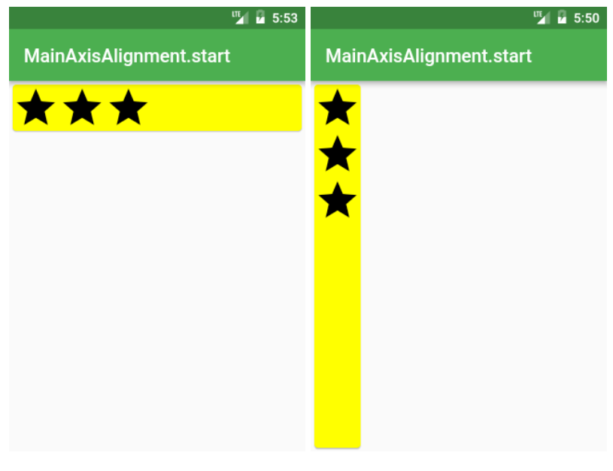
Row ( and Column) layouts
This is also the default
Row /*or Column*/(
mainAxisAlignment: MainAxisAlignment.start,
children: <Widget>[
Icon(Icons.star, size: 50),
Icon(Icons.star, size: 50),
Icon(Icons.star, size: 50),
],
),

Slide 7
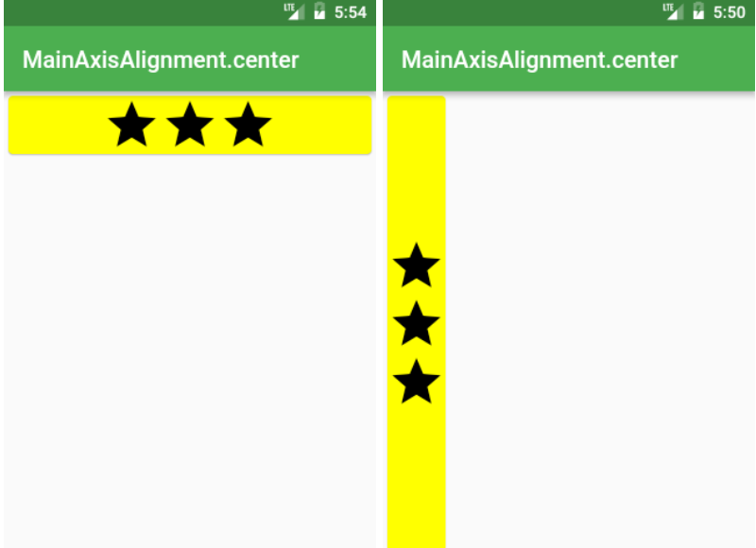
Row Center
Row /*or Column*/(
mainAxisAlignment: MainAxisAlignment.center,
children: <Widget>[
Icon(Icons.star, size: 50),
Icon(Icons.star, size: 50),
Icon(Icons.star, size: 50),
],
),

Slide 8
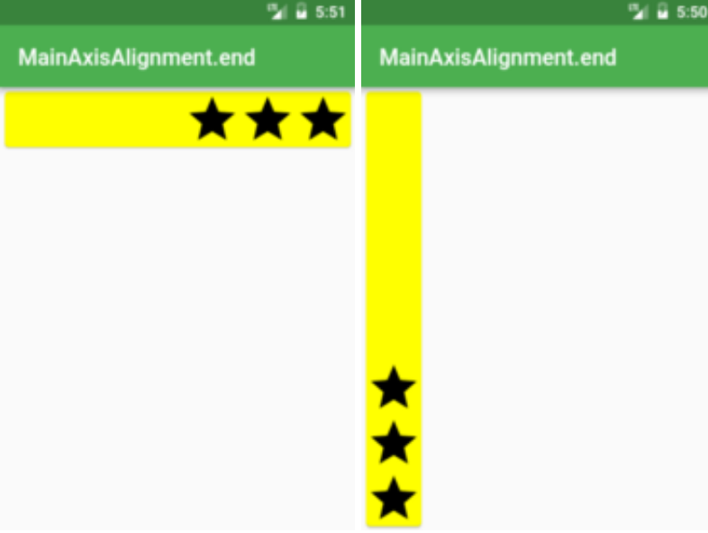
Row end
Row /*or Column*/(
mainAxisAlignment: MainAxisAlignment.end,
children: <Widget>[
Icon(Icons.star, size: 50),
Icon(Icons.star, size: 50),
Icon(Icons.star, size: 50),
],
),

Slide 9
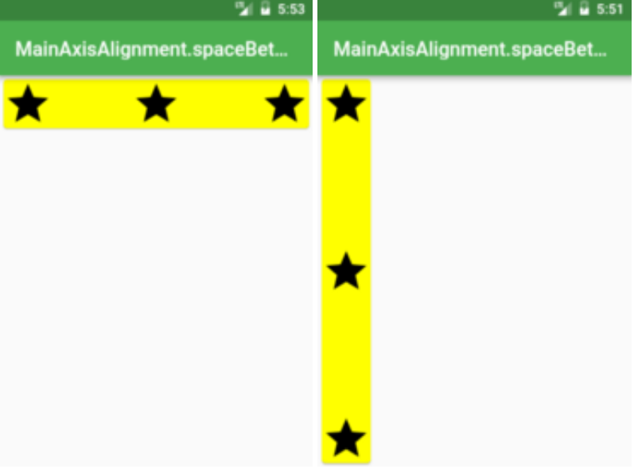
Row Space
Row /*or Column*/(
mainAxisAlignment: MainAxisAlignment.spaceBetween,
children: <Widget>[
Icon(Icons.star, size: 50),
Icon(Icons.star, size: 50),
Icon(Icons.star, size: 50),
],
),
Also, spaceEvenly, and spaceAround

Slide 10
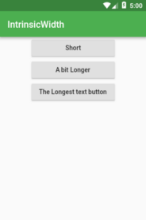
IntrinsicWidth and IntrinsicHeight
Want all the widgets inside Row or Column to be as tall/wide as the tallest/widest widget?
body: Center(
child: Column(
children: <Widget>[
ElevatedButton(onPressed: () {}, child: Text('Short'), ),
ElevatedButton(onPressed: () {}, child: Text('A bit Longer'), ),
ElevatedButton(onPressed: () {}, child: Text('The Longest text button'),),
…

Slide 11
IntrinsicWidth and IntrinsicHeight (2)
body: Center(
child: IntrinsicWidth(
child: Column(
crossAxisAlignment: CrossAxisAlignment.stretch,
children: <Widget>[
ElevatedButton( onPressed: () {},child: Text('Short'), ),
ElevatedButton( onPressed: () {},child: Text('A bit Longer'), ),
ElevatedButton( onPressed: () {}, child: Text('The Longest Text button'), ),
…

Slide 12
Stack Layout.
the stack layout, is similar to a relative layout. Where we specify the location.
return Stack(
fit: StackFit.expand,
children: <Widget>[ main,
Banner( message: "Top Start", location: BannerLocation.topStart, ),
Banner( message: "Top End", location: BannerLocation.topEnd, ),
Banner( message: "Bottom Start", location: BannerLocation.bottomStart, ),
Banner(message: "Bottom End", location: BannerLocation.bottomEnd, ),
],
);

Slide 13
Stack Layout (2)
With your own Widgets, you need to place them in Positioned Widget
body: Stack(
fit: StackFit.expand,
children: <Widget>[
Material(color: Colors.yellowAccent),
Positioned( top: 0, left: 0, child: Icon(Icons.star, size: 50),),
Positioned( top: 340, left: 250, child: Icon(Icons.call, size:50),),
],
),

Slide 14
Stack Layout (3)
If you don’t want to guess the top/bottom values you can use LayoutBuilder to retrieve them
body: LayoutBuilder(
builder: (context, constraints) =>
Stack(fit: StackFit.expand,
children: <Widget>[
Material(color: Colors.yellowAccent),
Positioned( top: 0, left: 0, child: Icon(Icons.star, size: iconSize), ),
Positioned( top: constraints.maxHeight - iconSize, left: constraints.maxWidth - iconSize, child: Icon(Icons.call, size: iconSize),
),
], ),

Slide 15
Container
mostly commonly used
if you don't specify height and width, then it will be just the child size.
Otherwise you can specify to take some or all the space, using
Container(
height: double.infinity,
width: double.infinity,
color: Colors.yellowAccent,
child: Text("Hi"),
)

Slide 16
Containers
Used for a lot of decorations as well. including a BoxDecoration
We can also use a Transform in the change it up.
body: Container(
height: 300,
width: 300,
transform: Matrix4.rotationZ(pi / 4),
decoration: BoxDecoration(color: Colors.yellowAccent),
child: Text(
"Hi",
textAlign: TextAlign.center,
),
),

Slide 17
BoxDecoartions
with the boxdecoration,
you can add background images
or background colors, even gradients
borders
square
rounded
using the BoxShape, change from square to another shape
BoxShape.circle for example.
Add shadows as well.

Slide 18
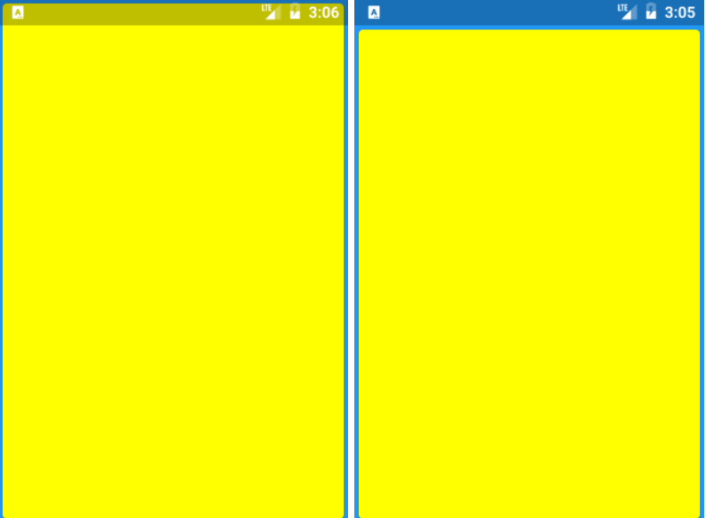
there are many More
Once last one I talk about is SafeArea
The deals with all the "notches" and special areas on android/iphones that you can't draw on.
Widget build(BuildContext context) {
return Material(
color: Colors.blue,
child: SafeArea(
child: SizedBox.expand(
child: Card(color: Colors.yellowAccent),
),
),
);
}
more layouts https://medium.com/flutter-community/flutter-layout-cheat-sheet-5363348d037e
a tutorial with more pictures: https://www.tutorialspoint.com/flutter/flutter_introduction_to_layouts.htm

Slide 19
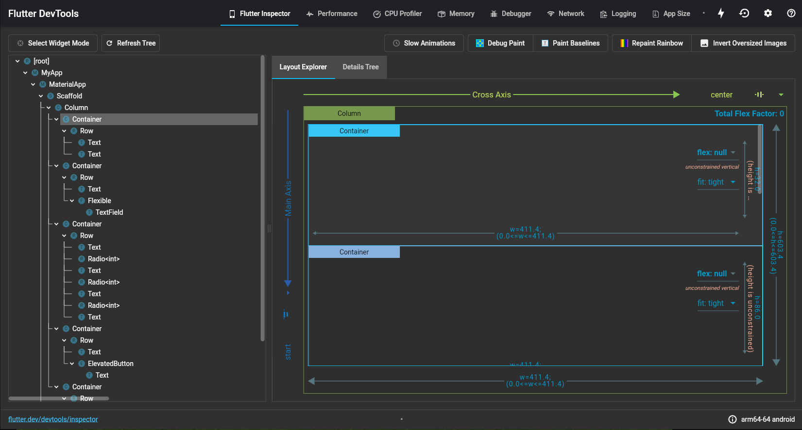
Layout Explorer (flutter devtools)
Must run in debug.
In the debug window below click the open flutter dev tools
opens in a browser.

Slide 20
more input widgets

Slide 21
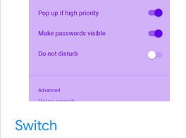
switch
Switch provides on/off toggle.
actually the toggle is very simple
or very complex
you can change the icon from a circle to something else with icon builder, colors different for on and off.
https://api.flutter.dev/flutter/material/Switch-class.html
bool switchvalue = false;
…
Switch( value: switchvalue, //required bool value onChanged: (bool value) { setState(() { switchvalue = value; }); })

Slide 22
slider
allows you to select value from a range
So the value and onChanged are required
leaving off min and max, value must be between 0 and 1
divisions causes to move between the values, in this case 0 to 100, by steps of 10.
label, so the current value as it slides.
double slidervalue = 50.0;
…
Slider( value: slidervalue, onChanged: (newValue) { setState(() { slidervalue = newValue; }); }, min: 0, max: 100, divisions: 10, label: "$slidervalue", )
https://www.youtube.com/watch?v=ufb4gIPDmEs

Slide 23
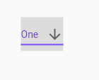
DropdownButton
It takes at min 2 items, but likely 3
DropDownButton(
items: //a list or create here one of a Type
onchanged: (Type ? item){ … }
//or create function, name(Type ? item) { … } and call it
optional
value: //the default value. must match a value in the list.
you can also change the style, colors, etc.
https://www.youtube.com/watch?v=ZzQ_PWrFihg

Slide 24
Listview

Slide 25
listview
Note there is recyclerview in flutter, but there is a AnimatedList that gives more of recyclerview feel, https://youtu.be/ZtfItHwFlZ8
For a short list that doesn't change, use a listview
for a longer lists or an array of data, use the listbuilder
Note, listview doesn't play well with other widgets and likely won't draw correctly if there are any others. So you have to wrap it in Flexible
Flexible( child: ListView( … )
)

Slide 26
"simple" listView
ListView has a set of children that are likely ListTile
ListView ( children: <Widget>[ ListTile( ), ListTile(), etc ] )
Each element is a ListTile
contains at min: title: Text('your text')
likely onTap: () { … your code… }
leading: used for decorations, icons, that show before the text.
optional DrawerHeader, which is intended for a Drawer, similar to NavigationView object in Android.
ListView( padding: const EdgeInsets.all(8), children: <Widget>[ ListTile( title: const Text('Entry A'), onTap: (){…}, ), ListTile( title: const Text('Entry B'), onTap: () {…}, ), ListTile( title: const Text('Entry C'), onTap: () {…}, ], )

Slide 27
ListView using a builder
Using a listView.builder and a array of data
need an array of data
then the builder loops through the array, creating the ListTile for each one
var values = ["Android", … "Linux" ];
…
ListView.builder( itemCount: values.length, itemBuilder: (context, index) { return ListTile( title: Text(values[index]), onTap: () { _ontap(values[index]); }, ); }, ),
…
void _ontap(String item) {…}

Slide 28
SnackBar

Slide 29
Snackbar
It's a really easy way to display information to the user. it will show up at the bottom of the "screen"
ScackBar(Content: const Text('You text here');
to show it
ScaffoldMessenger.of(context).showSnackBar( const SnackBar(content: Text('You clicked A')), );

Slide 30
Snackbar (2)
for a "action", you need to add the action: part with a label and onPressed();
ScaffoldMessenger.of(context).showSnackBar( const SnackBar(
content: Text('You clicked A'),
action: SnackBarAction(
label: 'Action',
onPressed: () {
// Code to execute.
},
),
), );
You can also change it location and duration. https://api.flutter.dev/flutter/material/SnackBar-class.html

Slide 31
Dialogs

Slide 32
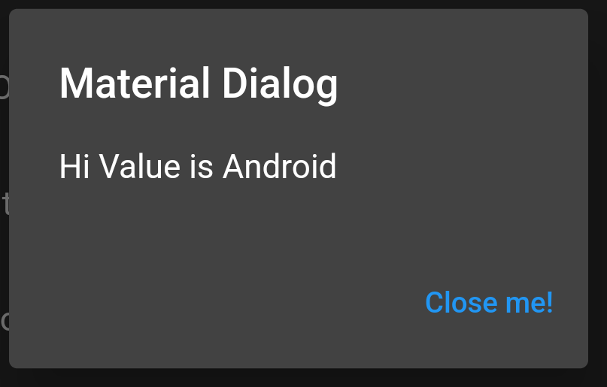
Dialogs
a simple alert dialog
showDialog(
context: context,
builder: (_) => new AlertDialog(
title: new Text("Material Dialog"),
content: new Text("Hi Value is $item"),
actions: <Widget>[
TextButton(
child: Text('Close me!'),
onPressed: () {
Navigator.of(context).pop(); //closes dialog.
},
)
],
));
Note, you can add more buttons, in the widget array, I just needed one here.

Slide 33
dialog with input.
TextEditingController _textFieldController = TextEditingController(); String valueText; Future<void> _displayTextInputDialog(BuildContext context) async { return showDialog( context: context, builder: (context) { return AlertDialog( title: Text('Add an OS to the list'), content: TextField( onChanged: (value) { setState(() { valueText = value; }); }, controller: _textFieldController, decoration: InputDecoration(hintText: "Enter name here"), ), actions: <Widget>[ TextButton( child: Text('CANCEL'), onPressed: () { setState(() { Navigator.pop(context); }); }, ), TextButton( child: Text('OK'), onPressed: () { setState(() { values.add(valueText); Navigator.pop(context); }); }, ), ], ); });
more complex
we need a textfield and all it's pieces, that goes in the content field. for more complex use a container (ie a layout).
it needs to run on a thread
uses Future<void> so it can return and run.
this one has two buttons, add and cancel.
Note, the add button uses setState() to cause the list to update.

Slide 34
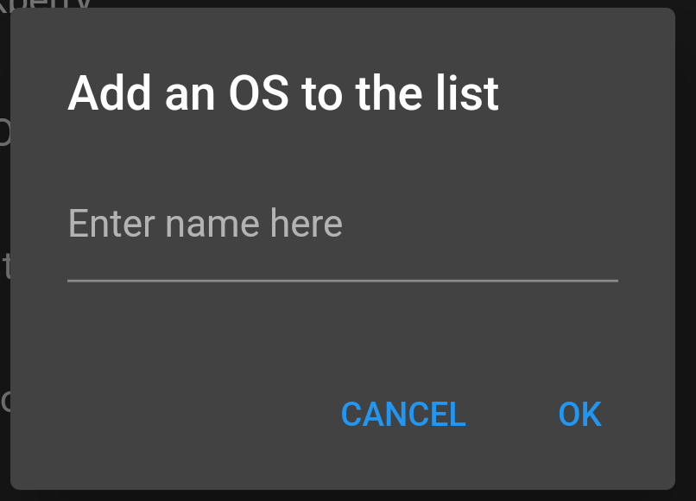
dialog with input.
calling has only one issue.
first we need to clear the text from previous uses
_textFieldController.clear();
now we can call method for it.
_displayTextInputDialog(context);

Slide 35
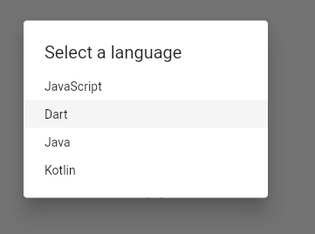
dialog with lists.
SimpleDialog dialog = SimpleDialog( title: const Text('Select a language'), children: <Widget>[ SimpleDialogOption( onPressed: () { Navigator.pop(context, 'JavaScript'); return value }, child: const Text('JavaScript')), SimpleDialogOption( onPressed: () { Navigator.pop(context, 'Dart'); //return value }, child: const Text('Dart')), SimpleDialogOption( onPressed: () { Navigator.pop(context, 'Java'); //return value }, child: const Text('Java')), SimpleDialogOption( onPressed: () { Navigator.pop(context, 'Kotlin'); //return value }, child: const Text('Kotlin')) ], );

Slide 36
dialog and return values and separate files.
There are a couples of ways to get information from a dialog box.
first is the previous version where is in the main code, so has access to all the variables in the code, just deals with them when the user selects a button.
second, you can use the Future
either declare a future function or use the await .then statement.
third set a call back function for the dialog.
handy when you have to return more then one value.

Slide 37
Future
shorten value of the simpleDialog, but with the future.
showSimpleAlertDialog(BuildContext context) {
SimpleDialog dialog = SimpleDialog( title: const Text('Select a language'), children: <Widget>[ SimpleDialogOption( onPressed: () { Navigator.pop(context, 'JavaScript'); }, child: const Text('JavaScript')), ], ); // Call showDialog function to show dialog. Future futureValue = showDialog( context: context, builder: (BuildContext context) { return dialog; }); futureValue.then((language) => { setState(() { selectedLanguage = language; }) }); }
showDialog has a return value that is a future,
future is a version of a thread.
we then use the .then on variable to run when that thread is active.
note, this class is all in the class where selectedLanguage variable is declared.

Slide 38
simpler version of "future"
This version skips the return value for future.
instead the .then is just attached the showDialog.
again, declared in the same class where okcanel is declared.
showDialog( context: context, builder: (BuildContext context) { return AlertDialog( title: const Text('AlertDialog Title'), content: const Text('AlertDialog description'), actions: <Widget>[ TextButton( onPressed: () => Navigator.pop(context, 'Cancel'), child: const Text('Cancel'), ), TextButton( onPressed: () => Navigator.pop(context, 'OK'), child: const Text('OK'), ), ], ); }, ).then((val) { setState(() { okcanel = val; }); }); },

Slide 39
separate files and return values.
when the dialog box is declared in a separate file and has a single return value.
we can use the await
await will wait until the thread is done.
ElevatedButton( onPressed: () async { double? val = await showDialog<double>( context: context, builder: (context) => DialogSlider(val: value), ); //val has the return value, so now set it in a setState so widget updates. setState(() { value = val!; }); }, child: const Text('Slider dialog')),

Slide 40
separate files and return values (2)
class DialogSlider extends StatefulWidget { @override DialogState createState() => DialogState(); final double val; const DialogSlider({ super.key, required this.val, }); } class DialogState extends State<DialogSlider> { double value = 0; @override void initState() { super.initState(); value = widget.val; } @override Widget build(BuildContext context) { return AlertDialog( title: Column( children: [ Slider( value: value, min: 0, max: 100, onChanged: (va) { setState(() { value = va; }); }, ), const SizedBox(height: 15), ElevatedButton( // Pass the value you want to return here ---------------| onPressed: () => Navigator.pop(context, value), //<-----| child: const Text('confirm'), ), ], ), ); }}
in this case, the alert dialog has initState, which takes a value, sent from the previous slide.
the Navigator.pop(content, value) returns the value.
note, you can return more then one value using a map.

Slide 41
dialogs and call function.
class DialogExample extends StatefulWidget { @override DialogState createState() => DialogState(); final Function(String one, String two) onConfirm; const DialogExample({ super.key, required this.onConfirm, }); }
…
actions: <Widget>[ TextButton( onPressed: () { // widget.onConfirm("",""); // cancelled, don't call method. Navigator.pop(context); }, child: const Text('Cancel'), ), TextButton( onPressed: () { widget.onConfirm(_controller1.text,_controller2.text); Navigator.pop(context); }, child: const Text('OK'), ), ],
in this case, a required parameter is a callback function.
so when the button is pressed widget.onConfirmed is used.

Slide 42
dialogs and call function.
When the dialog is called,
it creates an anonymous function to pass
or one needs to be declared ahead of time.
ElevatedButton( onPressed: () { showDialog( context: context, builder: (context) => DialogExample( onConfirm: (String one, String two) { setState(() { input1 = one; input2 = two; }); }, )); // so now set it in a setState so widget updates. }, child: const Text('Slider dialog')),

Slide 43
code examples
all the code for dialogs is complete in the dialog_Demo
also there is a dialog in the listview_demo, but a listview
moreui_demo has another listview (dynamic), plus the snackbar code.

Slide 44
References
https://flutter.dev/docs/codelabs
https://api.flutter.dev/flutter/material/BottomNavigationBar-class.html
https://willowtreeapps.com/ideas/how-to-use-flutter-to-build-an-app-with-bottom-navigation
https://flutter.dev/docs/cookbook/lists/long-lists
https://api.flutter.dev/flutter/material/AlertDialog-class.html
https://www.appsdeveloperblog.com/alert-dialog-with-a-text-field-in-flutter/
https://coflutter.com/flutter-how-to-show-dialog/
https://referbruv.com/blog/posts/flutter-for-beginners-customizing-list-tiles-and-on-tap-navigation
https://medium.com/@gadepalliaditya1998/item-selection-in-list-view-on-tap-in-flutter-using-listview-builder-612f6608505a

Slide 45
Q
A
&

