Slide 1
cosc 5/4735
Microcontrollers

Slide 2
What is a microcontroller?
It is a small computer on a single metal-oxide-semiconductor (MOS) integrated circuit (IC) chip.
A microcontroller contains one or more CPUs (processor cores) along with memory and programmable input/output peripherals. Program memory in the form of ferroelectric RAM, NOR flash or OTP ROM is also often included on chip, as well as a small amount of RAM.
  They are very fast, don't cost much, and consume little power.
  versatile, just change the program and use the same chip.
Microcontrollers are designed for embedded applications, in contrast to the microprocessors used in personal computers or other general purpose applications consisting of various discrete chips. They have no OS and generally only run one program at a time.

Slide 3
what are they used for?
they are found everywhere today and not just in computers and smartphones:
  in automatic testing of products,
  speed control of motors,
  traffic light control,
  communication equipment, television, satellite communication,
  home appliances, such as microwave oven, washing machine, gaming controller,
  industrial controllers and even specialized applications such as military applications.
  If it has an LCD display, there is likely a microcontroller "behind" it.

Slide 4
Raspberry Pi Pico
There are many many many microcontrollers, but I'm going to use the Pico, which is $4 and well documented.
  Designed by Raspberry Pi, RP2040 features a dual-core Arm Cortex-M0+ processor with 264KB internal RAM and support for up to 16MB of off-chip Flash. A wide range of flexible I/O options includes I2C, SPI, and — uniquely — Programmable I/O (PIO).
  Lots of community support!
  we can code in python and c++

Slide 5
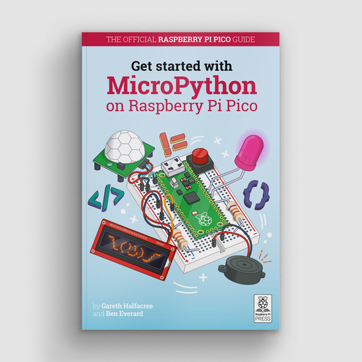
starting guide.
https://hackspace.raspberrypi.org/books/micropython-pico
  you can download it for free from hackspace.
https://www.raspberrypi.org/documentation/pico/getting-started/

Slide 6
Programming.
we can write pretty much a standard program.
using Thonny and python the simple hello world program and the out is bottom window.
We can use c++ and even write parallel programs, since it is a dual core.
  It's easier to program via a raspberry Pi 3 or 4 all the components are already installed
  windows setup
    community support is amazing.

Slide 7
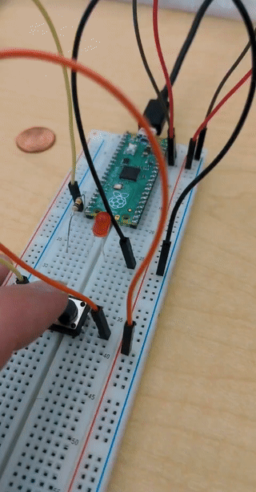
Connecting.
We can connect any number of devices to it.
Write code to respond to user events or sensors and react.
In this case a button that turns on the LED.

Slide 8
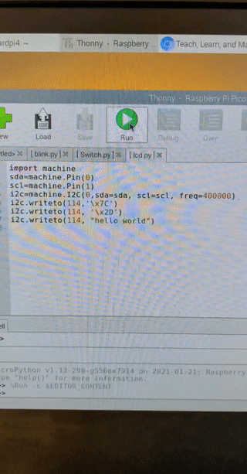
LCD display
In this case, wire in a LCD display and now we can display information.
in this case display hello world on the LCD screen.

Slide 9
Now what?
There are lots of projects and ideas.
  the guide book goes though a motion detector, weather station with display, and a few more all in python.
  How to Build a Raspberry Pi Pico Weather Station in c++
  DC motors, varying sensors, joystick, and music player just to name a few
    https://www.tomshardware.com/news/raspberry-pi-pico-tutorials-pinout-everything-you-need-to-know
Pimoroni has some great looking "packs" and bases:
  https://shop.pimoroni.com/collections/pico
it's up to your imagination and hardware skills.
A note,
  EE 4390 Microprocessors can count as a cosc elective.
    requires EE 2390 Digital Sys Design, which can count as cosc science selection too.
  More hardware: ES 2210 (Elec circ analysis) and EE 2220 (circuits and singals)

Slide 10
References
https://www.raspberrypi.org/blog/raspberry-pi-silicon-pico-now-on-sale/
https://projects.raspberrypi.org/en/projects/getting-started-with-the-pico
https://www.raspberrypi.org/documentation/pico/getting-started/
https://hackspace.raspberrypi.org/books/micropython-pico

Slide 11
Q
A
&

