Slide 1
COSC 5/4735
Firebase and JS.
part 3: app hosting, cloud functions, etc

Slide 2
Note
there is no code or examples here. These require a paid account.
We will talk about them in general, it is something you may consider if you build an app backend.

Slide 3
Firebase app hosting.
"streamlines the development and deployment of dynamic Next.js and Angular applications, offering built-in framework support, GitHub integration, and integration with other Firebase products like Authentication, Cloud Firestore, and Vertex AI in Firebase."
When it's time to deploy, push your changes to GitHub and watch App Hosting roll them out to production using reproducible, cloud-based builds.
supports Next.js 13+, Angular 17.2+
"Note: Express apps with a "start" and "build" script configured generally work in App Hosting, but support is not guaranteed. If there exists a more specific adapter available, we recommend setting your project up with that adapter." --google webpage in other frameworks.

Slide 4
Firebase app hosting (costs)
if you exceed, then you pay. via the Blaze plan.

Slide 5
deploying.
create a project in firebase console
setup any products you need, like normal.
setup a github repository.
use fireconsole via build menu->app hosting -> getStarted
or use cli version, see website.
you should be able to view the app via the web app link
test, push a change to github, then open the app hosting tab in firebase to see the commit and update roll out.

Slide 6
Firebase Hosting.
Not to be confused with firebase app hosting.
this is a static web hosting provider, for html, css, client-side js.
otherwise, it's similar
get project from the console,
use github or speicify where (on your computer) it located for deployment.
and test.

Slide 7
cloud functions
Cloud Functions for Firebase is a serverless framework that lets you automatically run backend code in response to events triggered by background events, HTTPS requests, the Admin SDK, or Cloud Scheduler jobs. Your JavaScript, TypeScript or Python code is stored on Google Cloud infrastructure and runs in a managed environment. There's no need to manage and scale your own servers.
there are version 1 and version 2 functions.
Cloud Functions (2nd gen), which deploys your functions as services on Cloud Run, allowing you to trigger them using Eventarc and Pub/Sub.
Cloud Functions (1st gen), the original version of functions with limited event triggers and configurability.
Page claims they continue to support version 1.

Slide 8
Functions
You can write the "functions" you need (via Node.js) and use them on google cloud systems.
install firebase-functions, firebase-admin, and firebase-tools
Low maintenance and it keeps your logic private and secure (not within the app itself)
Allows for you to use more cpu power then a device has.
These can connect to storage and database.
https://www.youtube.com/watch?v=bpFAdhNkA6c
you write on your system and push to the cloud.

Slide 9
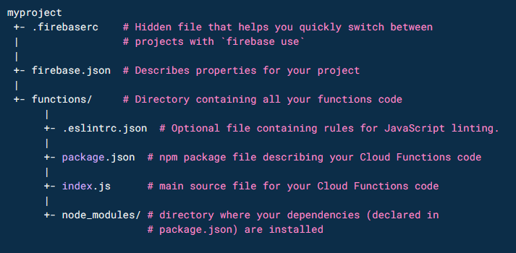
Functions
firebase login, which runs in your browser
in the base of your project,
firebase init firestore
firebase init functions
choose typescript or javascript

Slide 10
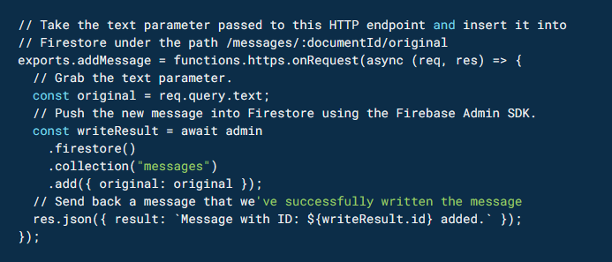
Functions (2)
code

Slide 11
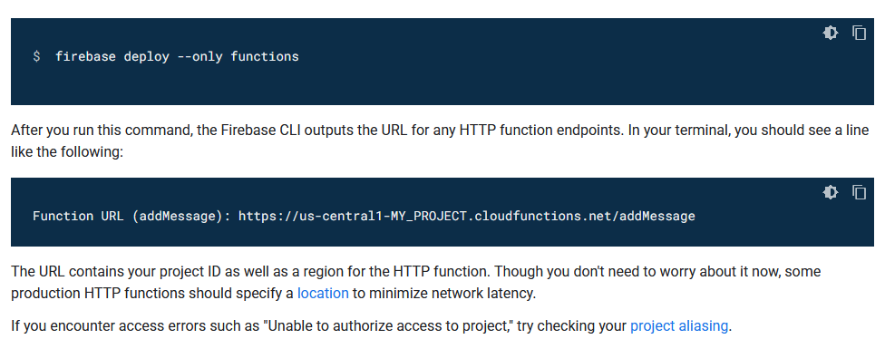
Functions (3)
once tested via an emulator (see web site)
The function be called or triggered by any or all of the firebase operations, like new add to database.

Slide 12
References and resources
https://firebase.google.com/docs/app-hosting
https://www.youtube.com/watch?v=saQ7Ab8ETkY
https://firebase.google.com/docs/functions
https://www.youtube.com/watch?v=vr0Gfvp5v1A
triggering:
https://firebase.google.com/docs/functions/callable?gen=2nd
https://firebase.google.com/docs/functions/alert-events

Slide 13
Q
A
&

