Slide 1
COSC 5/4735
Others
AWS, cloudflare, Azure

Slide 2
Note
there is no code or examples here. These require a paid account.
We will talk about them in general, it is something you may consider if you build an app backend.

Slide 3
Amazon web services
aws

Slide 4
AWS
note, listed the free version first, they paid version for all of them.
Amazon EC2 provides 750 hours per month free, for 12 months
storage up 5 GB free for 12 months.
Relational Database services, 750 hours per month free for 12 months.
NoSQL db free tier (always free) 25GB storage, 25 read/writes per day?, 200M per month.
AWS amplify hosting, free for 12 months.
  web apps hosting, with 5GB storage, transfer of out of 15 GB per month, Request count 500,000 per month,

Slide 5
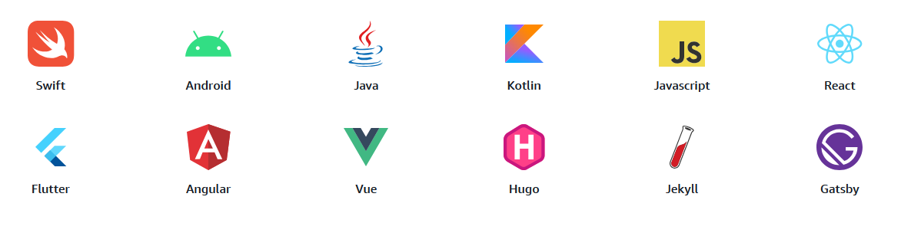
AWS
AWS amplify
  data, authentication, storage, functions,
  supports

Slide 6
references
https://aws.amazon.com/free/
  all the services provided.
https://docs.aws.amazon.com/sdk-for-javascript/
  Introduces you to using JavaScript with AWS services and resources, both in browser scripts and in Node.js applications. Describes how to set up the SDK, connect to AWS services, and access AWS service features. Also provides Node.js and browser code examples for working with popular AWS services.

Slide 7
CloudFlare

Slide 8
CloudFlare
provides what they call, "pages", which is web hosting
you connect via cli or git integration to push you web app to their systems.
supports a wide range of web apps, from Angular to react, including next.js , mono, vue, etc.
  nodejs wasn't listed.
includes, execution eviroments, cloudFlare R2 storage (nosql) and D1 relation db.
how to migrate from both aws and firebase pages too.

Slide 9
CloudFlare
workers
  Build serverless applications and deploy instantly across the globe for exceptional performance, reliability, and scale.

Slide 10
Microsoft Azure

Slide 11
MS Azure
"Since its original launch, Azure continues to offer extensive capabilities that go beyond simplifying infrastructure management. With comprehensive AI, data, and application services that work together, Azure delivers a unified approach to cloud computing that’s unique in the industry. Its open, flexible cloud platform is designed to support each company’s business strategy and stage of AI transformation. "
Azure, the Microsoft Cloud computing platform, offers more than 200 products and services across a global network of datacenters.

Slide 12
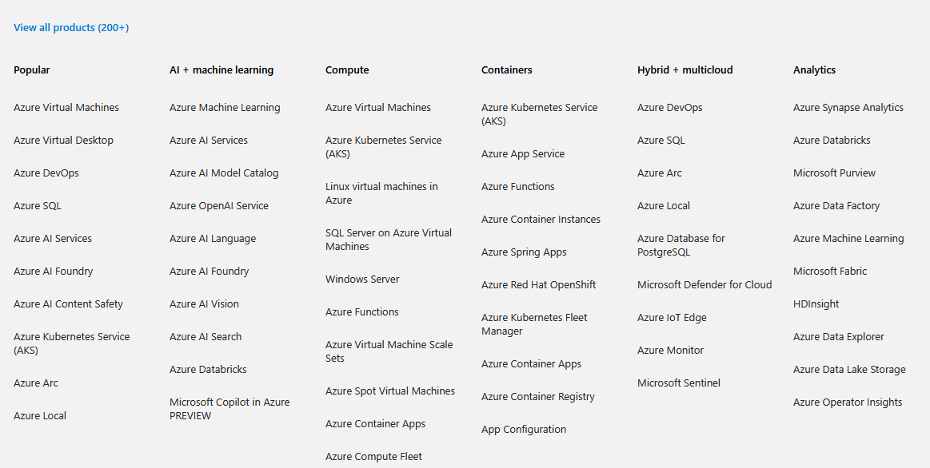
MS Azure (2)

Slide 13
Azure and JS
while MS would prefer you use all actually, products in house (like google) via c#
https://learn.microsoft.com/en-us/azure/developer/javascript/
  full set of SDK for authenticate, database, Cosmos DB (NoSql), storage, functions, containerized apps.
  plus, hosting and webapp hosting with express + mongoDB. (actually, Cosmos DB using a mongoDB interface (?) ).
    I didn't make a deep dive, but looks to be a lot of training and code examples as well.
It should not be a surprise, that if can do it with google or AWS, that you can do on Azure as well.

Slide 14
References and resources
https://aws.amazon.com/free/
https://developers.cloudflare.com/pages/
https://www.cloudflare.com/developer-platform/products/pages/
https://developers.cloudflare.com/workers/
https://azure.microsoft.com/en-us/

Slide 15
Q
A
&

