Slide 1
COSC 5/4735
Onward to Express

Slide 2
Onward to Express
Previously, we replicated the basic behavior of what Apache or IIS already do
We could keep going and get more advanced applications in node.js
Ultimately, we would end up with Express!

Slide 3
Scaffolding
Scaffolding isn’t a new idea
it is a simple concept: most projects require a certain amount of boilerplate code
A simple way is creating a rough skeleton project and then copying it every time you need a new project
Ruby on Rails took the concept one step further by providing a program that would automatically generate scaffolding for you
The advantage being that more sophisticated framework could be generated, rather than a skeleton

Slide 4
Scaffolding (2)
Express took a page from Ruby on Rails, and provides a utility to generate scaffolding to start your express project
While useful it is also important to learn how to start from scratch
In addition to learning more, you have more control over and a better understanding of the structure of your project
The Express scaffolding is generally geared towards server-side HTML generation, and is less relevant for APIs and single-page applications
So, I won't cover it, but it out there and maybe every useful.
express-generator
https://www.tutorialspoint.com/expressjs/expressjs_scaffolding.htm

Slide 5
initial setup for a new express project.
Create a new directory for you project
create a .gitignore file
Add node_modules and .env to .gitignore
other files you don't want in git, like *.bak, .vscode, etc.
command: npm init (could add –y to skip questions)
it will ask you a series of questions and generate a package.json file to get you started (for the "entry point" question, use projectname.js for the name of your project). It's used later if you auto start the project, but we won't likely to do.
https://docs.npmjs.com/cli/v11/configuring-npm/package-json
command: npm install express
it will install packages into the node_modules directory.
Later, when you get a clean copy code from git, use the command: npm install
It will reinstall the modules for you.

Slide 6
Brief side
Project structure
There is a lot of discussions about how the directories of any project should look. Some comes how the generator creates directories
public/ views/ routes/
others argue that is
project/src for any js
project/src/routes for routes
project/src/views for view code
I'm not worried about your project structure. But it should make sense to you, and that I don't always use subdirectories either.

Slide 7
.env file
In previous lecture we had this command:
const port = process.env.PORT || 3000
We can create .env file for the process.env variables.
.env
PORT=3000
We can use dotenv module, which add any environment variables we want as well. npm install dotenv
require('dotenv').config() //read .env and setup variables for use.
as note, no idea why everyone recommend not including .env file in git.
likely they are storing passwords and keys, which you don't want in github for everyone to see.

Slide 8
Basic setup.
create a minimal server
include express, as app
we have no routes, just 404 and 500 pages.
command: node index1.js
also includes the .env pieces as an example.
so it will print which port we are using, assuming you change it .env file.
index1.js

Slide 9
Add some routes
To make the webpage a bit more exciting we need to add some routes, before the 404 handler
Here we are using app.get()
In the Express documentation you may see app.METHOD()
Method refers to which HTTP method you want to use, in this case HTTP get
In code the HTTP verbs will be all lowercase
It take 2 parameters, path and a function
index2.js
Notes:
This method takes two parameters: a path and a function.

Slide 10
Add some routes (2)
The path is what defines the route
Note, app.METHOD does the heavy lifting for you
It doesn’t care about casing or a trailing slash
It also doesn’t consider the query string when performing the match
note in this one, about* which take everything, include about.html
previously /about.html would give 404
The function provided will be invoked when the route is matched
Notes:
This method takes two parameters: a path and a function.

Slide 11
Add some routes (3)
The parameters passed to that function are the request and response objects
For now we are returning plain text with Express implicitly sending code 200 for us
Rather than using Node’s low-level res.end() we are instead using Expresses res.send() and we use res.status()
Notes:
Show thunder client
While it’s still possible to use res.writeHead and
res.end, it isn’t necessary or recommended.

Slide 12
Add some routes (4)
Express also conveniently provides res.type() which sets the Content-Type header
The custom 404 and 500 don’t use app.get()
they use app.use(), which is the method by which Express allows middleware
Essentially it is a catchall handler for anything that didn’t get matched
Recall we put the routes before, the order in which you add routes matters
If the 404 were first it would always show
Notes:
We’ll talk about middleware later
Middleware is a concept commonly used in software development, particularly in web development and server-side applications. It refers to a software layer that sits between different components of an application to facilitate communication, processing, and interactions. Middleware acts as a bridge that connects different parts of an application's architecture.
Express can distinguish between the 404 and 500 handlers by the number of argu‐
ments their callback functions take.

Slide 13
Add some routes (5)
Again, we haven’t really done anything dramatic
We have the same functionality as we did using the built in Node http
But Express is helping out
remember how much more work we needed to handle the URLs earlier in the lecture?
Express now handles the details for us automatically

Slide 14
Views and Layouts
Express supports many different view engines that provide different levels of abstraction
Express does give preference to the view engine called Pug, express's author also wrote it.
It very minimalistic approach and what you write doesn't resemble HTML, so less typing. But for many HTML is the tool, you need to know for web programming.
Also Not useful for API like rest.
The book prefers Handlebars framework, since it doesn't abstract away HTML and so I'll use it as well.
npm install express-handlebars (note on the pi, some "engines" don't work)

Slide 15
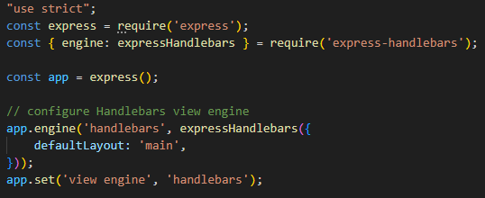
config handlebars.
This creates a view engine and configures Express to default to it
Within your app directory create a views directory that in turn has a layouts subdirectory
project/views/layouts/
You may have also heard layouts referred to as Master Pages
these are basic template for all the website pages.
index3.js

Slide 16
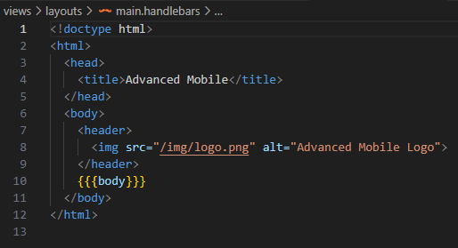
template layout page
create the main template in /views/layouts/
filename main.handlebars
It's mostly standard HTML
But {{{body}}} is what express will now replace it
Previous slide, we defined the default view with defaultLayout: 'main' this is that main

Slide 17
views
Once the layout is created the view pages can be added
home.handlebars
about.handlebars
404.handlebars
500.handlebars
This is the unique content you want displayed on every page, not the shared
examples
home.handlebars
<h1>Welcome to Advanced Mobile</h1>
404.handlebars
<h1>404 - Not Found</h1>

Slide 18
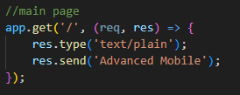
update the code.
replace our code, with the engine code, so now it will render everything
uses names on previous slide
previous code:

Slide 19
Static Files and Views
Again, express relies on middleware to handles stactic files and views
At its core, middleware provides modularization making it easier to handle requests
The static middleware allows you to designate one or more directories as containing static resources that are simply to be delivered to the client without any special handling
This is where you would put things like images, CSS and client side JS
To utilize the static middleware you must first make a public/ directory within your project directory
Before declaring any routes the static middleware needs to be added

Slide 20
Static Files and Views (2)
The static middleware has the same effect as creating route for each static file you want to deliver that renders a file and returns it to the client
This allows to create things like images and other static files without specifying routes and rendering.
project/public/image
logo.png and favicon.ico
Notes:
Remember that middleware is processed in order, and static mid‐
dleware—which is usually declared first or at least very early—will
override other routes. For example, if you put an index.html file in
the public directory (try it!), you’ll find that the contents of that file
get served instead of the route you configured! So if you’re getting
confusing results, check your static files and make sure there’s
nothing unexpected matching the route.

Slide 21
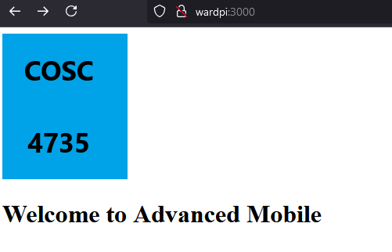
Final product
main page
<!doctype html>
<html>
<head>
<title>Advanced Mobile</title>
</head>
<body>
<header>
<img src="/img/logo.png" alt="Advanced Mobile Logo">
</header>
<h1>Welcome to Advanced Mobile</h1>
</body>
</html>

Slide 22
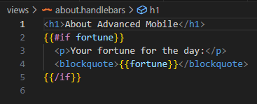
Dynamic Content in Views
Views aren’t simply a complicated way to deliver static HTML
They can contain dynamic information
Suppose you want to add some dynamic information to the about page
A random fortune on the about page.
if there is fortune code, then it add this extra information.

Slide 23
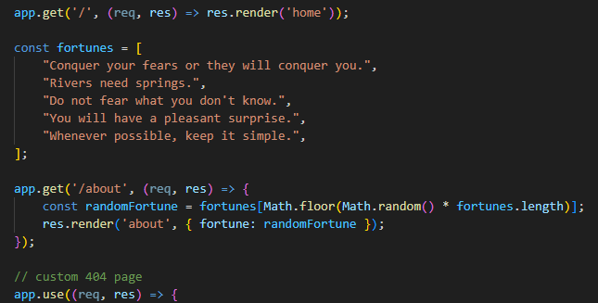
Dynamic Content in Views (2)
Now add code for it.
first an array of fortunes
most important tell the render the fortune uses randomFortune function.

Slide 24
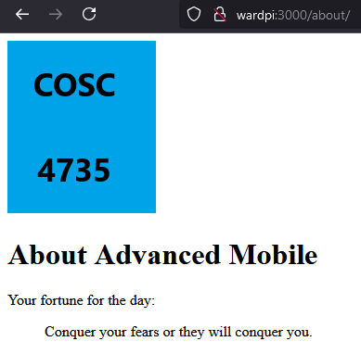
Final product (2)
html code
<!doctype html>
<html>
<head>
<title>Advanced Mobile</title>
</head>
<body>
<header>
<img src="/img/logo.png" alt="Advanced Mobile Logo">
</header>
<h1>About Advanced Mobile</h1>
<p>Your fortune for the day:</p>
<blockquote>Conquer your fears or they will conquer you.</blockquote>
</body>
</html>

Slide 25
References and resources
this lecture heavily references the Web Development with Node and Express, Chapter 3
Example code is based on the books, so you use the books website or
all example code can be found in the class github repo
https://github.com/JimSeker/nodejs/lectuer2
https://www.tutorialspoint.com/expressjs/expressjs_scaffolding.htm
https://docs.npmjs.com/cli/v11/configuring-npm/package-json
https://medium.com/craft-academy/how-to-scaffold-expressjs-server-and-test-it-d2a2ab1d30e0

Slide 26
Q
A
&

