Slide 1
COSC 5/4735
Request and Response Objects

Slide 2
The Request and Response Objects
These are the beginning and the end of everything in Express
When building a web server with express, most of what you’ll be doing comes down to these two things
These objects originate in node and are extended by Express

Slide 3
The Parts of a URL
protocol, hostname
and port are about the
host itself. how to connect the server and not about the app.
path is part where your app makes decisions, mostly we have using static or routing.
querystring is optional collection of name/value pairs. It starts with a ? and each pair is separated by ampersands (&)
URL encoded, means spaces are replaced with plus signs (+) and other replaced with numeric character references
fragment are not passed to the server, the are used browser to determine which section to display.
Notes:
Protocol
The protocol determines how the request will be transmitted. We will be dealing
exclusively with http and https. Other common protocols include file and p.
Host
The host identifies the server. Servers on your computer (localhost) or a local
network may be identified simply be one word or by a numeric IP address. On
the internet, the host will end in a top-level domain (TLD) like .com or .net.
Additionally, there may be subdomains, which prefix the hostname. www is a
common subdomain, though it can be anything. Subdomains are optional.
Port
Each server has a collection of numbered ports. Some port numbers are special,
like 80 and 443. If you omit the port, port 80 is assumed for HTTP and 443 for
HTTPS. In general, if you aren’t using port 80 or 443, you should use a port num‐
ber greater than 1023.
It’s common to use easy-to-remember port numbers like
3000, 8080, and 8088. Only one server can be associated with a given port, and
even though there are plenty of numbers to choose from, you may have to change
the port number if you’re using a commonly used port number.
Path
The path is generally the first part of the URL that your app cares about (it is pos‐
sible to make decisions based on protocol, host, and port, but it’s not good prac‐
tice). The path should be used to uniquely identify pages or other resources in
your app.
Querystring
The querystring is an optional collection of name/value pairs. The querystring
starts with a question mark (?), and name/value pairs are separated by amper‐
sands (&). Both names and values should be URL encoded. JavaScript provides a
built-in function to do that: encodeURIComponent. For example, spaces will be
replaced with plus signs (+). Other special characters will be replaced with
numeric character references. Sometimes the querystring will be referred to as
the search string or simply the search.
Fragment
The fragment (or hash) is not passed to the server at all; it is strictly for use by the
browser. Some single-page applications use the fragment to control application
navigation. Originally, the fragment’s sole purpose was to cause the browser to
display a specific part of the document, marked by an anchor tag (for example: <a
id="chapter06">).

Slide 4
HTTP Request Methods
For a website most pages will respond to GET requests
POST requests are usually reserved for sending information back to the server
It is common for POST requests to respond with the same HTML as the corresponding GET request
Browsers primarily use the GET and POST method when communicating with a server
The AJAX requests an application makes can use any of the HTTP verbs
With Node and Express you are fully in charge of what verbs can be used
Their verbs are:
GET, HEAD, POST, PUT, DELETE, CORRECT, OPTIONS, TRACE, PATCH
https://developer.mozilla.org/en-US/docs/Web/HTTP/Methods
Notes:
Post - (form processing, for exam‐
ple).
Also known as HTTP verbs

Slide 5
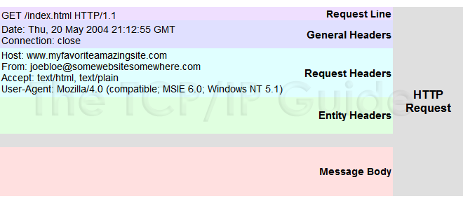
Request Message Example
The browser sends information to the web site
things, like your current browser, OS, and hardware
what your browser can handle and process.
With a Post, the message body has data as well

Slide 6
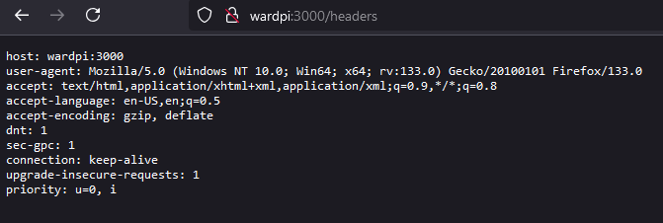
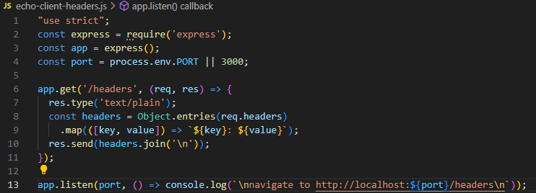
Request headers.
information the browser sends to the server
echo-client-headers.js

Slide 7
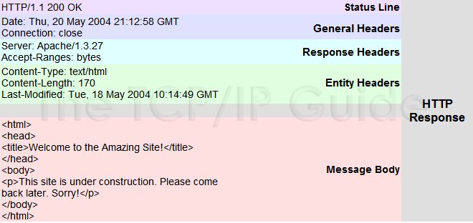
Response Message Example

Slide 8
Response Headers
Severs also sends back information that may not be displayed in the form of headers and metadata
We’ve seen a content type header, which tells the browser what kind of media is being sent
All browsers expect a Content-Type header
Headers may also include if the response is compressed or encoding
Headers may also include something regarding how long the browser should cache the files
Response headers also typically contain some information about the server, like what kind it is
This can also be a security risk to your server.
It can be disabled by adding app.disable('x-powered-by') to your code

Slide 9
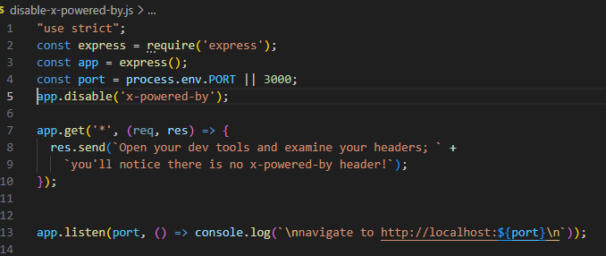
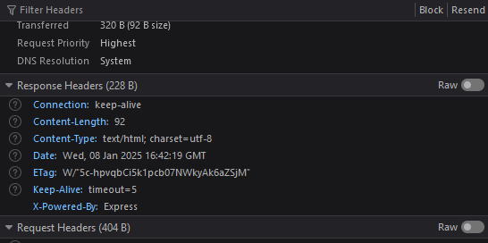
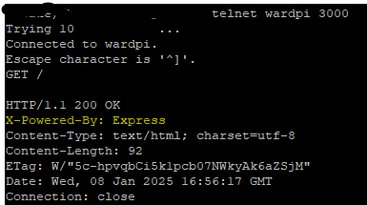
adding app.disable('x-powered-by')
https://help.zscaler.com/zia/capturing-http-headers-mozilla-firefox

Slide 10
Request Body
In addition to the request headers, a request can have a body
Normal GET requests don’t have bodies, but POST requests do
The most common media type for POST bodies is application/x-www-form-urlencoded
This is simply encoded name/value pairs separated by ampersands
Essentially, these are of the same format as a query string
If the POST needs to support file uploads, the media type is multipart/form-data
AJAX requests can use application/json
but not they don't have to, it's just common, the X in AJAX stands are XML.
Notes:
We’ll talk more about bodies in a coming lecture

Slide 11
The Request Object
The request object starts its life as an instance of http.IncomingMessage
That is a core node object
Express adds further functionality
There are several useful properties and methods for the request object
req.params
req.body
req.route
req.cookies/req.signedcookies
req.headers
req.accepts(types)
req.ip
req.path
req.hostname
req.xhr
req.protocol
req.secure
req.url/req.originalurl
Notes:
The request object (which is passed as the first parameter of a request handler, mean‐
ing you can name it whatever you want; it is common to name it req or request)
req.params
An array containing the named route parameters. We’ll learn more about this in
Chapter 14.
req.query
An object containing querystring parameters (sometimes called GET parameters)
as name/value pairs.
req.body
An object containing POST parameters. It is so named because POST parameters
are passed in the body of the request, not in the URL as querystring parameters
are. To make req.body available, you’ll need middleware that can parse the body
content type, which we will learn about in Chapter 10.
req.route
Information about the currently matched route. This is primarily useful for route
Debugging.
req.cookies/req.signedCookies
Objects containing cookie values passed from the client. See Chapter 9.
req.headers
The request headers received from the client. This is an object whose keys are the
header names and whose values are the header values. Note that this comes from
the underlying http.IncomingMessage object, so you won’t find it listed in the
Express documentation.
req.accepts(types)
A convenience method to determine whether the client accepts a given type or
types (optional types can be a single MIME type, such as application/json, a
comma-delimited list, or an array). This method is of primary interest to those
writing public APIs; it is assumed that browsers will always accept HTML by
default.
req.ip
The IP address of the client.
req.path
The request path (without protocol, host, port, or querystring).
req.hostname
A convenience method that returns the hostname reported by the client. This
information can be spoofed and should not be used for security purposes.
req.xhr
A convenience property that returns true if the request originated from an Ajax
call.
req.protocol
The protocol used in making this request (for our purposes, it will be either http
or https).
req.secure
A convenience property that returns true if the connection is secure. This is
equivalent to req.protocol === 'https'.
req.url/req.originalUrl
A bit of a misnomer, these properties return the path and querystring (they do
not include protocol, host, or port). req.url can be rewritten for internal routing
purposes, but req.originalUrl is designed to remain the original request and
querystring.

Slide 12
The Response Object
The response object starts life as an instance of http.ServerResponse another core node object
Express again adds additional functionality
And again there is a collection of useful; properties and methods
res.status(code)
res.set(name, value)
res.cookie(name, value, [options]),res.clearCookie(name, [options])
res.redirect([status],url)
res.send(body)
res.json(json)
res.jsonp(json)
res.end()
res.type(type)
res.format(object)
res.attachment(...)
res.sendFile(path, [options],[callback])
res.links(links)
res.locals, res.render(view, [locals], callback)
Notes:
The response object (which is passed as the second parameter of a request handler,
meaning you can name it whatever you want; it is common to name it res, resp, or
response)
res.status(code)
Sets the HTTP status code. Express defaults to 200 (OK), so you will have to use
this method to return a status of 404 (Not Found) or 500 (Server Error), or any
other status code you want to use. For redirects (status codes 301, 302, 303, and
307), there is a method redirect, which is preferable. Note that res.status
returns the response object, meaning you can chain calls: res.sta
tus(404).send('Not found').
res.set(name, value)
Sets a response header. This is not something you will normally be doing man‐
ually. You can also set multiple headers at once by passing a single object argu‐
ment whose keys are the header names and whose values are the header values.
res.cookie(name, value, [options]), res.clearCookie(name, [options])
Sets or clears cookies that will be stored on the client. This requires some middle‐
ware support; see Chapter 9.
res.redirect([status], url)
Redirects the browser. The default redirect code is 302 (Found). In general, you
should minimize redirection unless you are permanently moving a page, in
which case you should use the code 301 (Moved Permanently).
res.send(body)
Sends a response to the client. Express defaults to a content type of text/html, so
if you want to change it to text/plain (for example), you’ll have to call
res.type('text/plain’) before calling res.send. If body is an object or an
array, the response is sent as JSON (with the content type being set appropri‐
ately), though if you want to send JSON, I recommend doing so explicitly by call‐
ing res.json instead.
res.json(json)
Sends JSON to the client.
res.jsonp(json)
Sends JSONP to the client.
res.end()
Ends the connection without sending a response. To learn more about the differ‐
ences between res.send, res.json, and res.end, see this article by Tamas Piros.
res.type(type)
A convenience method to set the Content-Type header. This is essentially equiva‐
lent to res.set(\'Content-Type ', type), except that it will also attempt to
map file extensions to an internet media type if you provide a string without a
slash in it. For example, res.type(\'txt ') will result in a Content-Type of
text/plain. There are areas where this functionality could be useful (for exam‐
ple, automatically serving disparate multimedia files), but in general, you should
avoid it in favor of explicitly setting the correct internet media type.
res.format(object)
This method allows you to send different content depending on the Accept
request header. This is of primary use in APIs, and we will discuss this more in
Chapter 15. Here’s a simple example: res.format({'text/plain': 'hi there',
'text/html': '<b>hi there</b>'}).
res.attachment([filename]), res.download(path, [filename], [callback])
Both of these methods set a response header called Content-Disposition to
attachment; this will prompt the browser to download the content instead of dis‐
playing it in a browser. You may specify filename as a hint to the browser. With
res.download, you can specify the file to download, whereas res.attachment
just sets the header; you still have to send content to the client.
res.sendFile(path, [options], [callback])
This method will read a file specified by path and send its contents to the client.
There should be little need for this method; it’s easier to use the static middle‐
ware and put files you want available to the client in the public directory. How‐
ever, if you want to have a different resource served from the same URL
depending on some condition, this method could come in handy.
res.links(links)
Sets the Links response header. This is a specialized header that has little use in
most applications.
res.locals, res.render(view, [locals], callback)
res.locals is an object containing default context for rendering views. res.ren
der will render a view using the configured templating engine (the locals
parameter to res.render shouldn’t be confused with res.locals: it will override
the context in res.locals, but context not overridden will still be available).
Note that res.render will default to a response code of 200; use res.status to
specify a different response code.

Slide 13
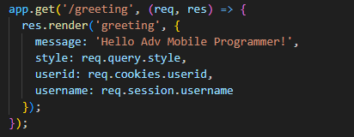
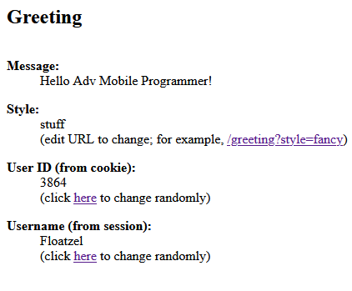
Rendering Content
When rendering res.render is most often used as we have already seen
greetings.js code snippet to right
This renders with handlebars, plus add extra content we get to later, like cookies and sessions
it can also process a querystring variable called style.
We can do things like passing context to a view
best to look at this in code, then in powerpoint. to many different files.
greeting.js, views/greeting.handlebars, and views/layout/main.handlebars

Slide 14
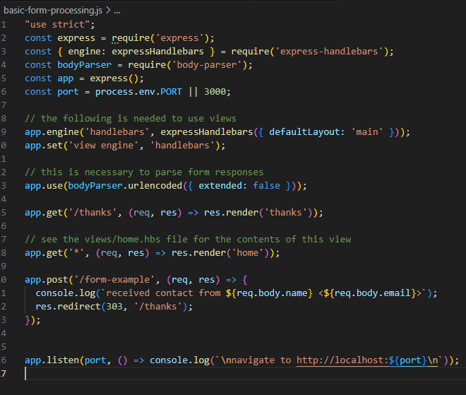
Processing Forms
When processing a form, the information is typically in req.body
To best parse the body we need some middleware called bodyparser
req.xhr can be used to determine if it was an AJAX request or a browser request
a lot more in the next lecture.
basic-form-processing.js, plus views/home.handlebars and thanks.handlebars
Notes:
Show basic-form.js

Slide 15
Providing an API
When providing an API the parameters will often be in req.query but req.body can be used too
APIs are different, in that they will often be returning JSON, XML, or plain text rather than HTML
In addition they may use less common HTTP methods
We delve in APIs and developing them more in a later lecture

Slide 16
References and resources
this lecture heavily references the Web Development with Node and Express, Chapter 6
Example code is based on the books, so you use the books website or
all example code can be found in the class github repo
https://github.com/JimSeker/nodejs/lectuer3

Slide 17
Q
A
&

