Slide 1
COSC 5/4735
Forms

Slide 2
Form Handling
Forms are the usual way to collect information from users in HTML
Forms can be submitted normally through the browser, done via AJAX, or other "fancy front end control"
Regardless of the choice the underlying technology is still an html form
We’ll talk about:
Creating forms
Handling forms
Form validation

Slide 3
Sending Data From Client to Server
Speaking in general terms there are two options for sending client data to a server
Querystring Using a GET request
Request Body Using a POST request.
There is a misconception that POST is secure whereas GET isn’t
In general, if HTTPS is used then both are secure
If not, an intruder can look at the body data from POST just as easily as their querystring
If using GET users will see all their input in the querystring and on many systems, the entire querystring will be logged on the server as well.
Which does make for security questions.

Slide 4
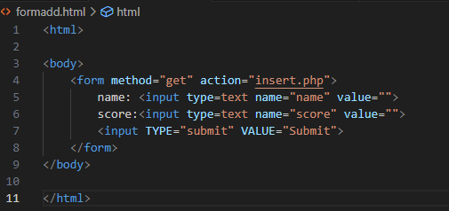
HTML Forms
Forms have been around for a very long time and are nothing new. Most just look prettier then used too. CSS and div tags have helped a lot. But the basic function is unchanged.

Slide 5
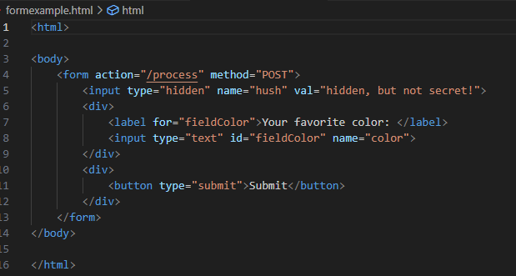
HTML Forms (2)
the important attributes in the <input> fields are the name how the server identifies the field
The name attribute is distinct from the id attribute
The id attribute is for styling and frontend
the hidden field, this won’t be displayed but it shouldn’t be used for sensitive information
It's easy seen with page source.

Slide 6
HTML Forms (3)
All forms should be kept logically consistent
A form should contain all the fields you want submitted at once (including optional)
Don’t include any fields you don’t want submitted
When a form is submitted it must be encoded in some fashion
If you don’t specify an encoding it defaults to application/x-www-form-urlencoded
This is a basic coding, that Express can handle by default
If you have two different actions on a page, use two different forms

Slide 7
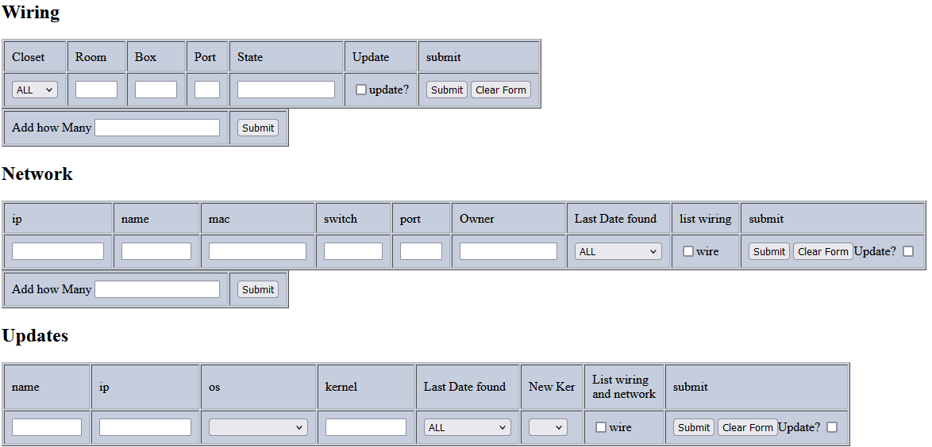
HTML Forms (4)

Slide 8
Different Approaches to Form Handling
Once the "user" hits submit, now how your program handles it
There are couple of ways the data maybe submitted as well.
Traditional web browser, you selected GET or POST in the form
AJAX submission, which can use more VERBS.
Other, such applications using your server as REST API service.
most of the time with either GET or POST.
There are two things to consider when processing forms:
What path handles the form
What response is sent to the browser
HTML response
302 or 303 redirect. 303 is recommended
success/failure pages (may or may not) be HTML response
original location with a message
new location with a message.

Slide 9
Form Handling with Express
If using GET for form handling, fields will be available on the req.query object
If you have an HTML input field with a name attribute email, its value will be passed to a handler in req.query.email
If using POST you will need to install a middleware to parse the URL-encoded body
The recommended one is body-parser , once installed it can be used in your project , then req.query will be available from POST

Slide 10
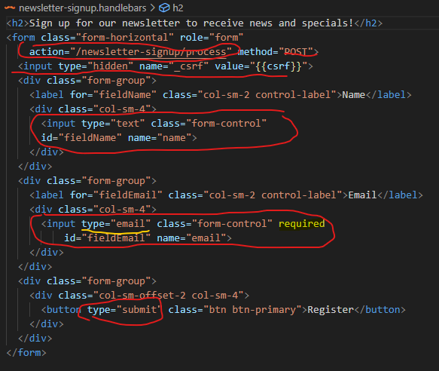
Form processing
From the book, we have this signup form via POST.
name field
_csrf which is hiddle field.
email field, that is required. The browser will help us here.
Note, don't count it on, as a browser may ignore or user could submit another way.
submit button.
req.query.email and req.query.name should be available in the processing.

Slide 11
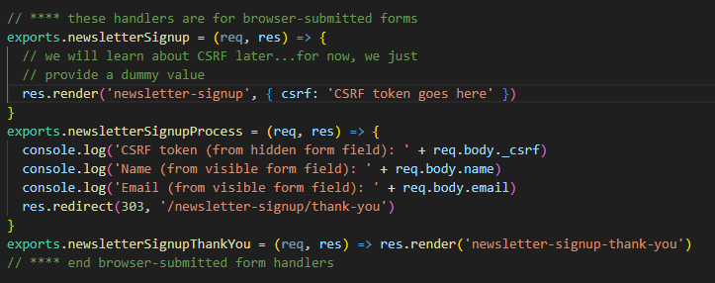
Form processing (2)
The code here is very simple
it's print to the console the 3 fields.
And redirects to a new page
Note, a redirect is not required, you could just put html here, but that breaks the idea of handlebars and page reuse.

Slide 12
Using Fetch to Send Form Data
A more "modern" version, is to use fetch and json. This also minimizes the number of page calls and network traffic.
There is no need for roundtrip requests to the server
So, there is no longer a worry regarding redirects and multiple user URLss
As a result, the entire experience can be condensed down to a singular newsletter route
This is far easier to see in the code in lectuer5, then in here.

Slide 13
Now what?
We have the form data, Now what?
only in this example would you print it to the console and do nothing else with it.
options
enter/update the data into persistence storage, ie databases or files
The pages become very dynamic as the user is using your site to search for information, based on what they entered.
We customize the user experience immediately, with session or cookies.
Some pages offer light or dark modes for example.
Use the clients name or login information
it's up to you.
A note, I skipped over the section in the book about uploading files.

Slide 14
References and resources
this lecture heavily references the Web Development with Node and Express, Chapter 8
Example code is based on the books, so you use the books website or
all example code can be found in the class github repo
https://github.com/JimSeker/nodejs/lectuer5

Slide 15
Q
A
&

