Slide 1
Cosc 4735
Course Overview

Slide 2
Material and coverage.
I'm planning to cover a lot of material
Some of it is very exponential (even by google saying that)
We may not cover everything in detail, but I'll try and give an overview of all of it.
We will change gears pretty quickly.
I can't give homework to cover all of it.
Homework will be more taking pieces from here and there and combining it into a more complex application.
By the time this course is done, we will have cover all the android material, plus
cross-platform (using dart and flutter also Xamarin)
We also branch out of android and cover more embedded and mobile topics
  Voice: Alexa and google assistant, AR and AR, PIs, and robots.

Slide 3
Overview of the course.
Covering
  Audio and Video, including recording and play back.
    Plus a little youtube and QR
  Bluetooth applications and controllers
  Google play services
  NearBy, location
  Firefbase and Mlkit
  graphics via OpenGL ES
    VR and AR
  Unity
    with VR and hopefully AR

Slide 4
Overview of the course (2)
  Pis and raspbian devices (hats, even motors.) likely with python.
    firebase as well. and microcontrollers.
  Android Wear/Wear OS
    part of google api
  Flutter (cross platform "phone" programming)
  Xamarin (Cross platform "phone" programming)
  Google Assistant and Alexia skills
  ROS on Fetch Robots

Slide 5
Google Play Services (Google API)
Google Login service
  needed for many of these services
Fused Location services
  not to be confused with gps sensors.
Activity Recognition
  is your phone walking?, those kind of activities
Mobile Vision
  face and barcode recognition, plus OCR
  Also added into firebase.
Android Fit API
Admob
  which also shows up in Firebase too
Nearby API
  wifi and Bluetooth
Google maps and places
Wear OS
Not covered
  Google Panorama Viewer
  Google drive
  Google cast
  Google+ (defunct)
  Google play game services
A note, firebase and google play services are overlapping in many places now.
  The two seem to be heading for a merger.

Slide 6
Firebase material
Some of this has already been covered
  Analytics
  Notifications
  Authentication
    (not to confused with Google API authentication)
  Realtime Database and Cloud FireStone Database
  Storage
Cloud Messaging
Functions (a little bit)
Remote config
AdMob
ML Kit
Firebase material not covered
  Hosting, App Indexing, Dynamic Links, invites (depreciated), and Adwords

Slide 7
Architecture Components
Some have been covered, but review and cover
  Live Data and View Model, plus lifecycle
  Navigation (new)
  Paging
  Room persistence (as opposed to sqlite3)
  workManager (replacement for some services)
  Network components

Slide 8
Graphics, with VR and AR
Google's VR SDK and Google's ARCore kit
  While we will look at android, this works for IOS and even the web too.
We'll cover the
  "native" graphics with Open GL ES (v 1.1 to v3.1)
  And Unity
We will not covering Unreal engine components.

Slide 9
More
Android Wear applications (both watch and phone connected)
Internet of Things, mostly controllers, and pis
Voice and "home automation"
  Google Assistant and integration pieces.
  Alexa.
Flutter
  Cross platform programming and delivery for android, IOS, and FuchsiaOS (maybe the android/chrome replacement)
  Flutter apps are written in Dart
  there are plugins for Visual Studio Code, Android Studio, and IntelliJ.
  Apps come with their own set of Flutter UI widgets for Android and iOS, with the iOS widgets closely following Apple's guidelines and the Android widgets following Google's Material Design.
    https://arstechnica.com/gadgets/2018/12/google-bridges-android-and-ios-development-with-flutter-1-0/

Slide 10
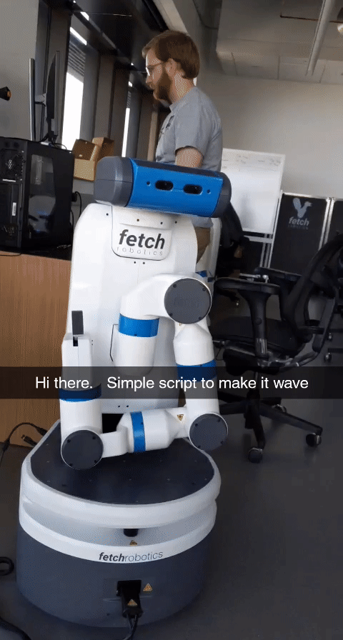
ROS
ROS (Robot Operating System) provides libraries and tools to help software developers create robot applications. It provides hardware abstraction, device drivers, libraries, visualizers, message-passing, package management, and more. ROS is licensed under an open source, BSD license.
http://wiki.ros.org/Documentation

Slide 11
If time allows or for projects.
NDK (native c++ language for android)
  this is used mostly to write libraries at this point.
Android Auto
Android TV (I don't have one to test with).
Casting/sharing (like Chromecast, we have several to play with)
???

Slide 12
Q
A
&

