Slide 1
cosc 5/4735
Introduction to ROS

Slide 2
What is ROS
The robotics community has made impressive progress in recent years. Reliable and inexpensive robot hardware—from land-based mobile robots, to quadrotor helicopters, to humanoids—is more widely available than ever before.
But there are a lot of challenges for software developers. Robot Operating System (ROS), is a software platform
  official description:
    ROS is an open-source, meta-operating system for your robot. It provides the services you would expect from an operating system, including hardware abstraction, low-level device control, implementation of commonly-used functionality, message-passing between processes, and package management. It also provides tools and libraries for obtaining, building, writing, and running code across multiple computers.

Slide 3
What is ROS (2)
ROS has a pretty steep learning curve, but since there are so many public ROS packages and modules, you can spend more time working on interesting code and a lot least time reinventing wheels.
You can alos reuse code across platforms and it has a build in message protocol to allow to have multiple robots work together.
ROS is not a programming language. instead many programs are written in c++, may client applications are also written in python, java, and even lisp.

Slide 4
what is ROS (3)
ROS is not (only) a library, while ROS does include client libraries, it also includes (among other things), a central server, a set of command-line tools, a set of graphical tools, and a build system.
it is also not an IDE, instead you use whatever IDE you are comfortable with or just a text editor.

Slide 5
ROS Distribution
similar to the idea with Linux distributions. It's a relatively stable codebase and support.
While the current version is (as of March 2023) is ROS Noetic, you will also need to look at the ROS1 version installed and documentation.
  ROS Melodic, Kinetic, Jade, indigo, hydro, groovy, are names of older versions.
    Box turtle was the first version in 2010.
there is also newer ROS2 version along side of ROS1 as well.

Slide 6
ROS and Ubuntu
ROS is primarily supported on Ubuntu.
  There are directions for windows (for noetic)
    http://wiki.ros.org/Installation/Windows
  There are directions for raspberry as well.
    but recommends, using a Ubuntu version.
    To compile using the Raspberry Pi directions.
      http://wiki.ros.org/ROSberryPi/Setting%20up%20ROS%20on%20RaspberryPi
On Windows it's recommend, to use install Ubuntu in a vm with bridged networking.

Slide 7
Robot Programming
a robot is a machine with sensors, actuators (motors), and a computing unit that behaves based on user controls, or it can make its own decisions based on sensors inputs.
  The main components of any robot are the actuators and the sensors. Actuators move a robot’s joints, providing rotary or linear motion. Servo, Stepper, and DC gearmotors are actuator brands. Sensors provide the robot’s state and environment. Examples of robot sensors include wheel encoders, ultrasonic sensors, and cameras.
program can be firmware running on a microcontroller, or C/C++ or Python code running on a PC or a single board computer, like the Raspberry Pi
  we can say robot programming is programming the PC/SBCand microcontroller/PCL inside robot for performing a specific application using actuators and feedback from various sensors. The robot applications includes pick and place of object, moving robot from A to B. A variety of programming languages can program robots. C/C++, Python, Java, C #, and so forth are used with PCs. Microcontrollers use Embedded C, the Wiring language (based on C++), which is used in Arduino, and Mbed programming (https://os.mbed.com).

Slide 8
ROS
is a free and open source robotics software framework and provides the following:
  Message passing interface between processes
    there maybe an image processing a process for the camera, that send coordinates to the tracker process
  OS like features (not an OS though), so includes multithreading, low-level device control, package management, hardware abstractions.
    ie you have control different types of devices with the same code.
  support for high level programming languages (c++ and python are common), while others are experimental
  third-party libraries, like OpenCV (robotic vision) and PCL (3D robot perception)
  Off-the-shelf algorithms.
    This is a useful feature. ROS has implemented popular robotics algorithms such as PID (http://wiki.ros.org/pid); SLAM (Simultaneous Localization and Mapping) (http://wiki.ros.org/ gmapping); and path planners such as A*, Dijkstra (http://wiki.ros.org/global_planner), and AMCL (Adaptive Monte Carlo Localization) (http://wiki.ros.org/amcl). The list of algorithm implementations in ROS continuous. The off-the shelf algorithms reduce development time for prototyping a robot.

Slide 9
ROS (2)
Ease in prototyping
  reuse of code from one robot to another, as well customizing existing packages.
Ecosystem/community support.
  https://answers.ros.org/questions/ and https://discourse.ros.org
Extensive tools and simulators. ROS is built with many command-line and GUI tools to debug, visualize, and simulate robotics applications.
  Rviz tool for visualization with cameras, laser scanners, inertial measurement unit
  Gazebo for robot simulations.

Slide 10
Architecture and Concepts
ROS is a framework to communicate between two programs or process.
  while you can write a robot program in a single large program, it goes complex very fast.
Instead we want to write independent programs to handle sensor data and controlling actuators (motors) and then communicate.

Slide 11
Architecture and Concepts (2)
We have two programs. Node1 and Node2.
A node always sends to a ROS Master
  nodes register with a the master.
nodes that send data are publisher nodes and receiving nodes are subscriber nodes.
ROS messages can be primitive like integer, strings, etc
  They can send the message or multiple data with different data types.
they are sent though a message path, called ROS topics.
  each has it's own name like chatter might send strings.

Slide 12
ROS Computation Concepts
ROS nodes:
  Process that use ROS APIs to perform computations.
ROS master:
  An intermediate program that connects ROS nodes.
ROS parameter server:
  A program that normally runs along with the ROS master. The user can store various parameters or values on this server and all the nodes can access it. The user can set privacy of the parameter too. If it is a public parameter, all the nodes have access; if it is private, only a specific node can access the parameter.
ROS topics:
  Named buses in which ROS nodes can send a message. A node can publish or subscribe any number of topics.
ROS message:
  The messages are basically going through the topic. There are existing messages based on primitive data types, and users can write their own messages.
ROS service:
  We have already seen ROS Topics, which is having publishing and subscribing mechanism. The ROS Service has Request/Reply mechanism. A service call is a function, which can call whenever a client node sends a request. The node who create a service call is called Server node and who call the service is called client node.
ROS bags:
  A useful method to save and play back ROS topics. Also useful for logging the data from a robot to process it later.

Slide 13
ROS tools
roscore
  this command starts the ROS master, the parameter server and the logging node. This is run in it's own terminal window or command window.
rosnode list
  shows a list of nodes running on the system
rostopic list
  shows all the topics (ie message paths).
    if you wanted to show the message of a path, rostpic echo /chatter would print the messages from topic /chatter.
rosservice list
  lists all the services.
rosparam list
  shows the list of parameters

Slide 14
ROS tools
roslaunch
  you can bundle up a number of nodes into a a xml launch file and the use roslaunch to start them all at the same time.
  roslaunch ros_pkg_name launch_file_name
    note each project has a package name.
rosrun
  this will start up a single node.
  rosrun ros_pkg_name node_name

Slide 15
Example
ROS comes with a demo to learn with call turtlesim
so start the basic example.
you need an roscore running
rosrun turtlesim turtlesim_node

Slide 16
ROS programming

Slide 17
creating a ROS workspace
source /opt/ros/medolic/setup.bash
  change to your version of ROS.
  this should just be in your bashrc file.
the standard directory to work in is catkin_ws/src
  you can change catkin_ws to whatever, but don't change src
  mkdir -p ~/catkin_ws/src
  cd ~/catkin_ws
initialize the workspace
catkin_make
  catkin_make -DPYTHON_EXECUTABLE=/usr/bin/python3 for python 3.
    only need the parameter the first time, after that it is set to python3.
and run the setup
source devel/setup.bash
You may need to run this command after you create new packages. also a good idea to put this in your bashrc file as well.

Slide 18
creating a ROS workspace (2)
You will have a build, devel, and src directory after the catkin_make, plus a CMakeList.txt file in the src directory.
src/ is where you create or clone new packages.
  catkin_make will look in the src directory
build/ is where catkin_make caches and builds packages
devel/ is after a successful make, your compiled packages part put here.
Once you have a package working, catkin_make install
  it will now be installed into the ROS directories.

Slide 19
Creating a ROS package.
catkin_create_pkg package_name package_dependencies
so creating a demo package
  catkin_create_pkg hello_world roscpp rospy std_msgs
    package name is hello_world and it needs roscpp, rospy, and std_msgs
  it will create a hello_world directory in ~catkin_ws/src/
  in the hello_world/ package.xml and src/ and include/
    src/ is where you put your c++ files. include/ is auto generated headers
    package.xml is information about your package, including dependencies that we will add.
dependencies
  roscpp is the c++ ROS libraries, you need to c++ programs
  rospy is the python ROS libraries
  std_msgs is "standard" messages, the strings data type.

Slide 20
talker and listener node.
I'll show you a simple talker and listener node that uses chatter/ topic to communicate. in c++ (later in python)
  The talker will generate strings hello world # and put them the chatter and the listener will receive them. both will print out the messages.
To do this
  register the node with the ros server, publish a topic and send/receive on the topic.

Slide 21
talker.cpp
#include "ros/ros.h"
#include "std_msgs/String.h"
#include <sstream>
int main(int argc, char **argv) {
initialize and set the node to talker
ros::init(argc, argv, "talker");
our node access point for communications
ros::NodeHandle n;
advertise, say we want to publish chatter with a queue size of 1000.
ros::Publisher chatter_pub = n.advertise<std_msgs::String>("chatter", 1000);
used to control the loop rate
ros::Rate loop_rate(10);
int count = 0;
while (ros::ok()) { //has control-c been pushed.
std_msgs::String msg;
std::stringstream ss;
ss << "hello world " << count;
msg.data = ss.str();
ROS_INFO("%s", msg.data.c_str());
chatter_pub.publish(msg);
ros::spinOnce(); //publish the topic and message.
loop_rate.sleep(); //loop rate.
++count;
}
return 0;
}

Slide 22
listener.cpp
#include "ros/ros.h"
#include "std_msgs/String.h"
this is the call back that receives the messages
void chatterCallback(const std_msgs::String::ConstPtr& msg)
{
in this case, just print out what we heard.
ROS_INFO("I heard: [%s]", msg->data.c_str());
}
int main(int argc, char **argv) {
register this as node listener
ros::init(argc, argv, "listener");
ros::NodeHandle n;
setup as a subscriber
ros::Subscriber sub = n.subscribe("chatter", 1000, chatterCallback);
spin() will cause us to enter a wait state for messages, until control-c is pressed.
ros::spin();
return 0;
}

Slide 23
CMakeLists.txt
we need to add our two files in the and any depencies so the system can compile the code.
add the talker
add_executable(talker src/talker.cpp)
target_link_libraries(talker ${catkin_LIBRARIES})
add the listener
add_executable(listener src/listener.cpp)
target_link_libraries(listener ${catkin_LIBRARIES})

Slide 24
finally build the project.
You must go back to the base directory in order to build
cd ~/catkin_ws
catkin_make
the output is lengthy, but it should end with something like
built target listener
built target talker
in your devel/lib/ there should be hello_world folder with listener and talker

Slide 25
run it.
make sure roscore is running in one window
in another window
rosrun hello_world talker
if you run rostopic list in a third window you should see /chatter topic
in a third window
rosrun hello_world listener

Slide 26
python
either cd to your hello_world directory or roscd hello_world will work too.
you need a scripts directory
mkdir scripts
cd scripts
python scripts all go into the scripts directory. these are no compiled and actually to tell, you can just run them from the directory.
  once they are working, though, you should add them to the Cmakefile and complie.

Slide 27
talker.py
1 #!/usr/bin/env python
2 # license removed for brevity
3 import rospy
4 from std_msgs.msg import String
5
6 def talker():
7 pub = rospy.Publisher('chatter', String, queue_size=10)
8 rospy.init_node('talker', anonymous=True)
9 rate = rospy.Rate(10) # 10hz
10 while not rospy.is_shutdown():
11 hello_str = "hello world %s" % rospy.get_time()
12 rospy.loginfo(hello_str)
13 pub.publish(hello_str)
14 rate.sleep()
15
16 if __name__ == '__main__':
17 try:
18 talker()
19 except rospy.ROSInterruptException:
20 pass
The code is very similar to the c++ version, but there is no spinonce method in python.

Slide 28
listener.py
1 #!/usr/bin/env python
2 import rospy
3 from std_msgs.msg import String
5 def callback(data):
6 rospy.loginfo(rospy.get_caller_id() + "I heard %s", data.data)
8 def listener():
10 # In ROS, nodes are uniquely named. If two nodes with the same
11 # name are launched, the previous one is kicked off. The
12 # anonymous=True flag means that rospy will choose a unique
13 # name for our 'listener' node so that multiple listeners can
14 # run simultaneously.
15 rospy.init_node('listener', anonymous=True)
17 rospy.Subscriber("chatter", String, callback)
19 # spin() simply keeps python from exiting until this node is stopped
20 rospy.spin()
22 if __name__ == '__main__':
23 listener()

Slide 29
CMakeLists.txt
add to the file
catkin_install_python(PROGRAMS scripts/talker.py scripts/listener.py
DESTINATION ${CATKIN_PACKAGE_BIN_DESTINATION}
)
now you can make everything and the scripts will be copied in the devel/ version.
cd ~/catkin_ws
catkin_make

Slide 30
Some more complex.

Slide 31
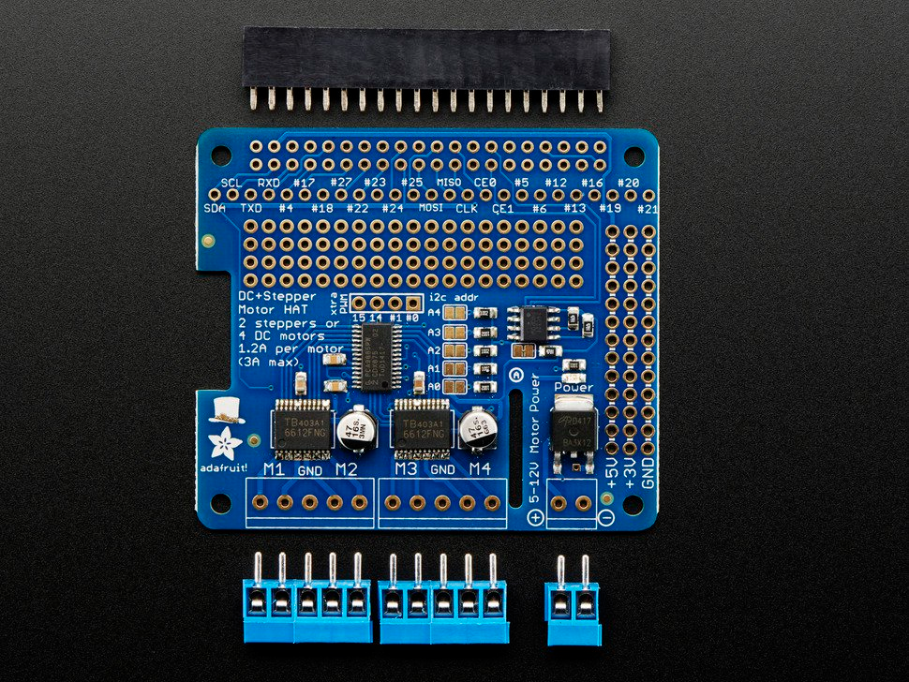
DC & Stepper Motor Hat
Allows for motors. (note requires soldering)
  Up to 4 bi-directional DC motors and UP to 2 stepper motors
    Requires a battery pack and motors are sold separately.
  This is based on the following project:
    https://www.hackster.io/46886/android-robocar-553991

Slide 32
Motor hat
So the listener python code was modified to take commands.
  left, right, forward, backward, stop
It then uses the motor hat python code to move the wheels.
  note the car doesn't have turning wheels, so turning is skid turns.
from adafruit_motorkit import MotorKit
kit = MotorKit(i2c=board.I2C())
kit.motor1.throttle = 1.0
motor1 (which is the front left wheel) turns on and go forward
kit.motor1.throttle = 0.0 #turn it off.

Slide 33
tele_op.py
The talker.py was mostly replaced with a script that takes command line input (backward, forward, left, right, stop, q)
it loops on the input
if q, quits
else publishes the command to the /chatter topic

Slide 34
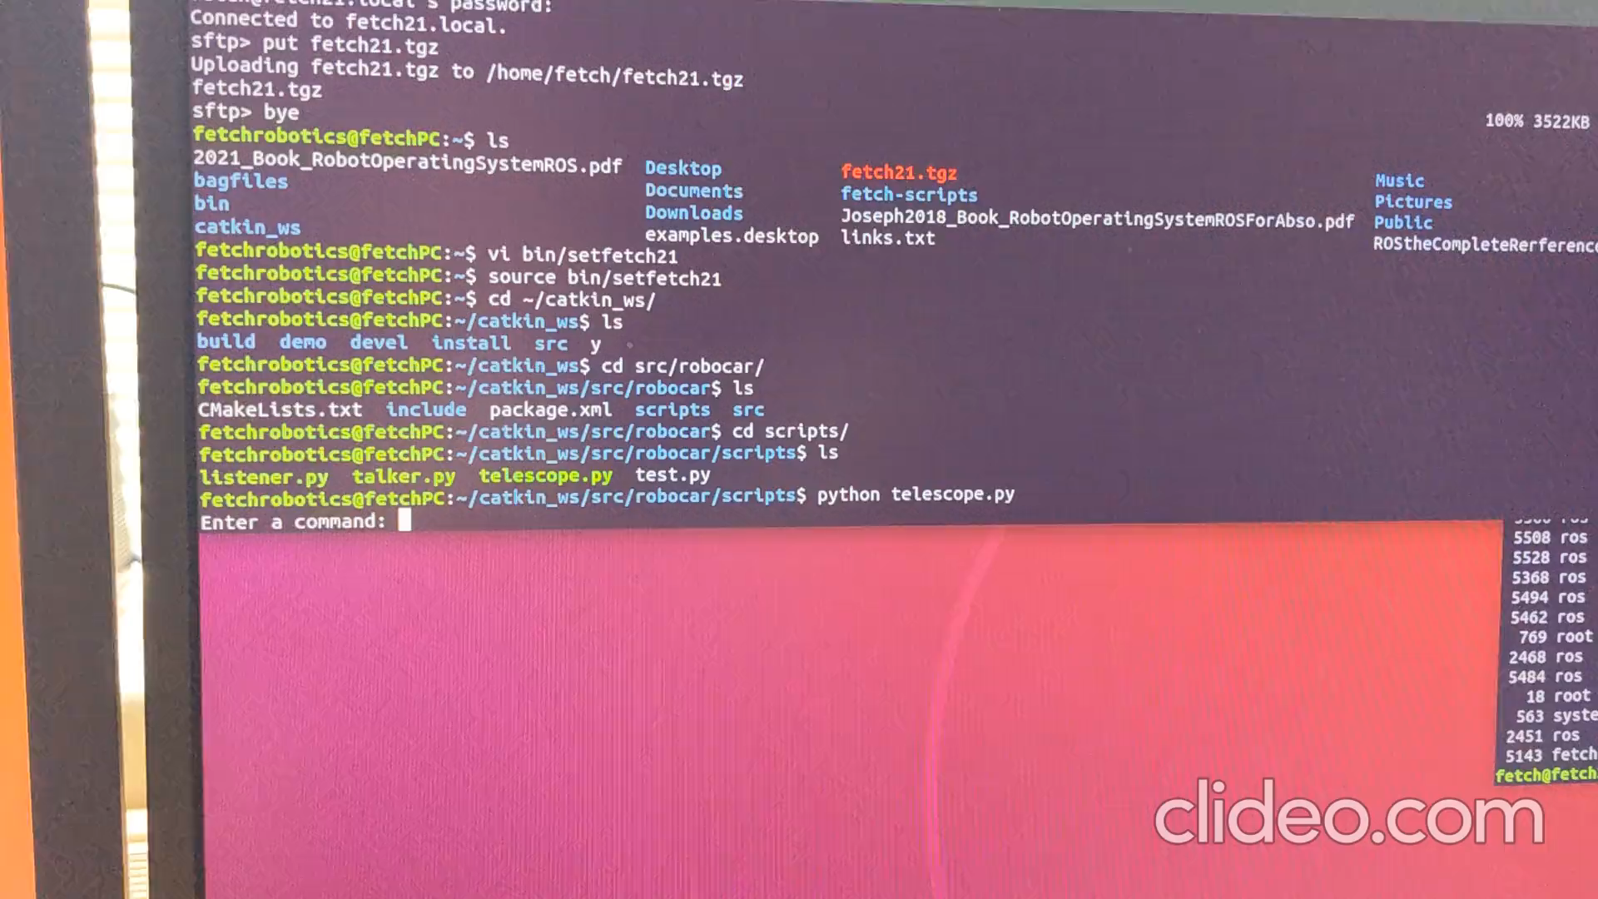
video demo

Slide 35
A final note.
In the beginning of this lecture, I say each motor should be it's own node.
  which I then didn't follow.
  but that would have been the better way to write this code, with a my listener code talking to each motor node instead of handling them as a group.
    for one, I had to remember which wheels are reversed, and if I had just handled each while as node, then the primary code would have just go forward, instead of having remember which is which.
  We would use a roslaunch file to start up all 5 nodes.
    6 once the camera node was working as well, which is not even covered here.
  Later I could add a Bluetooth controller and create node for it and send the same commands (ie reuse).

Slide 36
Reference
http://wiki.ros.org/
https://docs.ros.org/en/foxy/Releases.html
http://wiki.ros.org/ROS/Tutorials
http://wiki.ros.org/ROS/Tutorials/WritingPublisherSubscriber%28c%2B%2B%29
http://wiki.ros.org/ROS/Tutorials/WritingPublisherSubscriber%28python%29
http://wiki.ros.org/ROSberryPi
http://wiki.ros.org/melodic/Installation/Ubuntu
https://www.apress.com/us/book/9781484234044 ROS for absolute beginners
https://www.cse.sc.edu/~jokane/agitr/ A gentle intro to ROS.
https://learn.adafruit.com/adafruit-dc-and-stepper-motor-hat-for-raspberry-pi/installing-software

Slide 37
Q
A
&

