Slide 1
O/S 4740
Chapter 19
Networks and Distributed Systems

Slide 2
Overview
A distributed system is a collection of loosely coupled nodes interconnected by a communications network
Nodes variously called processors, computers, machines, hosts
  Site is location of the machine, node refers to specific system
  Generally a server has a resource a client node at a different site wants to use

Slide 3
Overview (2)
Nodes may exist in a client-server, peer-to-peer, or hybrid configuration.
  In client-server configuration, server has a resource that a client would like to use
  In peer-to-peer configuration, each node shares equal responsibilities and can act as both clients and servers
Communication over a network occurs through message passing
  All higher-level functions of a standalone system can be expanded to encompass a distributed system

Slide 4
Reasons for Distributed Systems
Resource sharing
  Sharing files or printing at remote sites
  Processing information in a distributed database
  Using remote specialized hardware devices such as graphics processing units (GPUs)
Computation speedup
  Distribute subcomputations among various sites to run concurrently
  Load balancing – moving jobs to more lightly-loaded sites
Reliability
  Detect and recover from site failure, function transfer, reintegrate failed site

Slide 5
Network Structure
Local-Area Network (LAN) – designed to cover small geographical area
  Consists of multiple computers (workstations, laptops, mobile devices), peripherals (printers, storage arrays), and routers providing access to other networks
  Ethernet and/or Wireless (WiFi) most common way to construct LANs
    Ethernet defined by standard IEEE 802.3 with speeds typically varying from 10Mbps to over 10Gbps
    WiFi defined by standard IEEE 802.11 with speeds typically varying from 11Mbps to over 400Mbps.
    Both standards constantly evolving

Slide 6
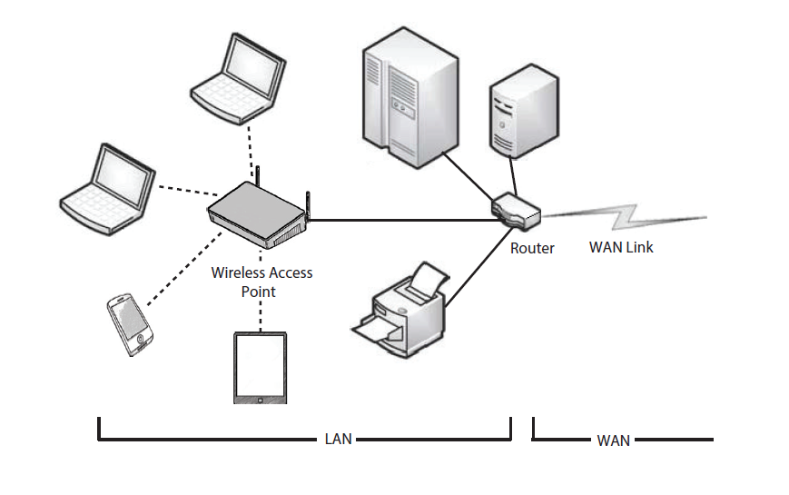
Local-Area Network (LAN)

Slide 7
Network Structure (Cont.)
Wide-Area Network (WAN) – links geographically separated sites
  Point-to-point connections via links
    Telephone lines, leased (dedicated data) lines, optical cable, microwave links, radio waves, and satellite channels
  Implemented via routers to direct traffic from one network to another
  Internet WAN enables hosts world wide to communicate
  Speeds vary
    Many backbone providers have speeds at 40-100Gbps
    Local Internet Service Providers (ISPs) may be slower
    WAN links constantly being upgraded
  WANs and LANs interconnect, similar to cell phone network:
    Cell phones use radio waves to cell towers
    Towers connect to other towers and hubs

Slide 8
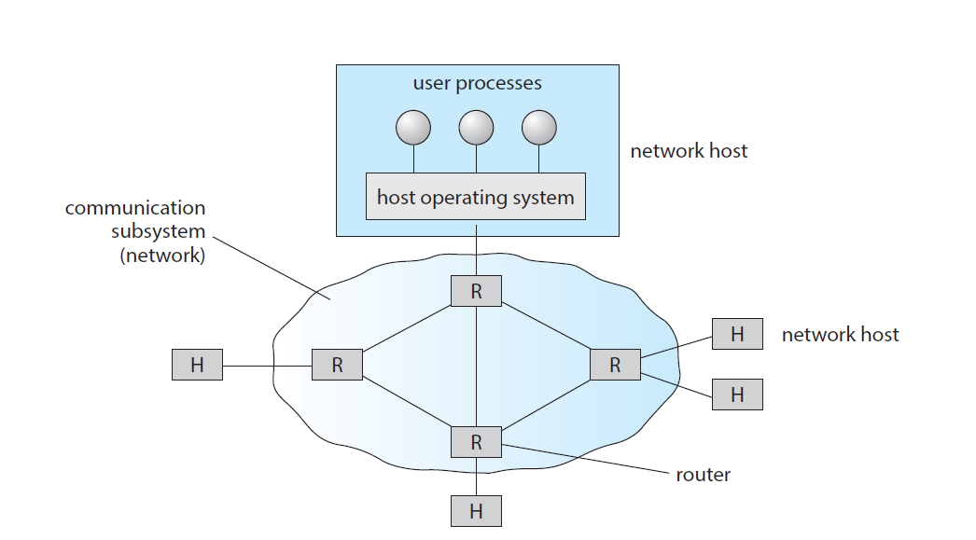
Wide-Area Network (WAN)

Slide 9
Naming and Name Resolution
Each computer system in the network has a unique name
Each process in a given system has a unique name (process-id)
Identify processes on remote systems by
      <host-name, identifier> pair
Domain name system (DNS) – specifies the naming structure of the hosts, as well as name to address resolution (Internet)

Slide 10
Communication Protocol
The communication network is partitioned into the following multiple layers:
  Layer 1: Physical layer – handles the mechanical and electrical details of the physical transmission of a bit stream
  Layer 2: Data-link layer – handles the frames, or fixed-length parts of packets, including any error detection and recovery that occurred in the physical layer
  Layer 3: Network layer – provides connections and routes packets in the communication network, including handling the address of outgoing packets, decoding the address of incoming packets, and maintaining routing information for proper response to changing load levels

Slide 11
Communication Protocol (2)
Layer 4: Transport layer – responsible for low-level network access and for message transfer between clients, including partitioning messages into packets, maintaining packet order, controlling flow, and generating physical addresses
Layer 5: Session layer – implements sessions, or process-to-process communications protocols
Layer 6: Presentation layer – resolves the differences in formats among the various sites in the network, including character conversions, and half duplex/full duplex (echoing)
Layer 7: Application layer – interacts directly with the users, deals with file transfer, remote-login protocols and electronic mail, as well as schemas for distributed databases

Slide 12
OSI Network Model
Logical communication between two computers, with the three lowest-level layers implemented in hardware.

Slide 13
OSI Protocol Stack

Slide 14
OSI Network Message

Slide 15
The OSI model
The OSI model formalizes some of the earlier work done in network protocols but was developed in the late 1970s and is currently not in widespread use.
The most widely adopted protocol stack is the TCP/IP model, which has been adopted by virtually all Internet sites.
The TCP/IP protocol stack has fewer layers than the OSI model. Theoretically, because it combines several functions in each layer, it is more difficult to implement but more efficient than OSI networking.
The relationship between the OSI and TCP/IP models is shown in the next slide.

Slide 16
The OSI and TCP/IP Protocol Stacks

Slide 17
Network-oriented Operating Systems
Two main types
Network Operating Systems
  Users are aware of multiplicity of machines
Distributed Operating Systems
  Users not aware of multiplicity of machines

Slide 18
Network Operating Systems
Users are aware of multiplicity of machines
Access to resources of various machines is done explicitly by:
  Remote logging into the appropriate remote machine (ssh)
  Transferring data from remote machines to local machines, via the File Transfer Protocol (FTP) mechanism
  Upload, download, access, or share files through cloud storage
Users must change paradigms – establish a session, give network-based commands, use a web browser
  More difficult for users

Slide 19
Distributed Operating Systems
Users not aware of multiplicity of machines
  Access to remote resources similar to access to local resources
Data Migration – transfer data by transferring entire file, or transferring only those portions of the file necessary for the immediate task
Computation Migration – transfer the computation, rather than the data, across the system
  Via remote procedure calls (RPCs)
  Via messaging system

Slide 20
Distributed-Operating Systems (2)
Process Migration – execute an entire process, or parts of it, at different sites
  Load balancing – distribute processes across network to even the workload
  Computation speedup – subprocesses can run concurrently on different sites
  Hardware preference – process execution may require specialized processor
  Software preference – required software may be available at only a particular site
  Data access – run process remotely, rather than transfer all data locally
Consider the World Wide Web

Slide 21
Design Issues of Distributed Systems
We investigate three design questions:
  Robustness – Can the distributed system withstand failures?
  Transparency – Can the distributed system be transparent to the user both in terms of where files are stored and user mobility?
  Scalability – Can the distributed system be scalable to allow addition of more computation power, storage, or users?

Slide 22
Robustness
Hardware failures can include failure of a link, failure of a site, and loss of a message.
A fault-tolerant system can tolerate a certain level of failure
  Degree of fault tolerance depends on design of system and the specific fault
  The more fault tolerance, the better!
Involves failure detection, reconfiguration, and recovery

Slide 23
Failure Detection
Detecting hardware failure is difficult
To detect a link failure, a heartbeat protocol can be used
Assume Site A and Site B have established a link
  At fixed intervals, each site will exchange an I-am-up message indicating that they are up and running
If Site A does not receive a message within the fixed interval, it assumes either (a) the other site is not up or (b) the message was lost
Site A can now send an Are-you-up? message to Site B
If Site A does not receive a reply, it can repeat the message or try an alternate route to Site B

Slide 24
Failure Detection (Cont.)
If Site A does not ultimately receive a reply from Site B, it concludes some type of failure has occurred
Types of failures:
- Site B is down
- The direct link between A and B is down
- The alternate link from A to B is down
- The message has been lost
However, Site A cannot determine exactly why the failure has occurred

Slide 25
Reconfiguration and Recovery
When Site A determines a failure has occurred, it must reconfigure the system:
  If the link from A to B has failed, this must be broadcast to every site in the system
  If a site has failed, every other site must also be notified indicating that the services offered by the failed site are no longer available
    What happens to all the running processes/resources on B that were needed by A?
When the link or the site becomes available again, this information must again be broadcast to all other sites
  With B is back, it needs to be integrated back into the system again.
    Includes if “things” were changed and B didn’t get those updates.

Slide 26
Design Issues
Fault tolerance
  the distributed system should continue to function in the face of failure
Clusters
  a collection of semi-autonomous machines that acts as a single system
Scalability
Transparency

Slide 27
Scalability
As demands increase, the system should easily accept the addition of new resources to accommodate the increased demand
  Reacts gracefully to increased load
  Adding more resources may generate additional indirect load on other resources if not careful
  Data compression or deduplication can cut down on storage and network resources used

Slide 28
Transparency
The distributed system should appear as a conventional, centralized system to the user
  User interface should not distinguish between local and remote resources
    Example: NFS
  User mobility allows users to log into any machine in the environment and see his/her environment
    Example: LDAP plus desktop virtualization

Slide 29
Distributed File System
Distributed file system (DFS) – a file system whose clients, servers, and storage devices are dispersed among the machines of a distributed system
  Should appear to its clients as a conventional, centralized file system
Key distinguishing feature is management of dispersed storage devices

Slide 30
Distributed File System (2)
Service – software entity running on one or more machines and providing a particular type of function to a priori unknown clients
Server – service software running on a single machine
Client – process that can invoke a service using a set of operations that forms its client interface
A client interface for a file service is formed by a set of primitive file operations (create, delete, read, write)
Client interface of a DFS should be transparent; i.e., not distinguish between local and remote files
Sometimes lower level inter-machine interface need for cross-machine interaction

Slide 31
Distributed File System (3)
Two widely-used architectural models include client-server model and cluster-based model
Challenges include:
  Naming and transparency
  Remote file access
  Caching and cache consistency

Slide 32
Q
A
&

