Slide 1
Cosc 5/4730
Firebase Databases:
Realtime and Cloud Firestore

Slide 2
What is firebase
It's basically middle ware that allows you do a number of things cross platform
Analytics
is a free and unlimited analytics tool to help you get insight on app usage and user engagement. No extra code needed, only console.
Cloud Messaging
Firebase Cloud Messaging lets you deliver and receive messages across platforms reliably.
Notifications (part of cloud messaging)
helps you re-engage with users at the right moment. No extra code needed, only console
Authentication
a key feature for protecting the data in your database and storage.
Realtime Database
lets you sync data across all clients in realtime and remains available when your app goes offline.
Cloud Firestore (new database)
Combines cloud database and functions together. Uses a scalable NoSQL cloud database to store and sync data.
Storage
lets you store and serve user-generated content, such as photos or videos. Firebase Storage is backed by Google Cloud Storage

Slide 3
What is firebase (2)
Functions
Run your mobile backend code without managing servers
Hosting
provides fast and secure static hosting. No backend, but delivers .html,.css, etc files.
Remote Config
change the behavior and appearance of your app without publishing an app update.
Dynamic Links
lets you pull users right to the content they were interested in, keeping them engaged and increasing the likelihood that they will continue to use the app.
Invites
Firebase Invites helps your users share your app with others. referral codes or share content from the app. Uses the Dynamic Links so links survive the install of the app. And do most of the work automatically.
AdMob
provides easy and powerful ad monetization with full support in Firebase.

Slide 4
What is firebase (3)
Machine Learning (ML Kit )
"use machine learning to solve problems." Currently, it is just the Vision APIs for text recognition, face detection, barcode scanning, image labeling, and landmark recognition. But this would use the cloud based systems instead of just the device cpu.
A/B Testing
Let you optimize your app experience based on analytics. Change it for different demographics, make it different experience for say a teenage group verses a retired group. Without having to deploy two version of the app. Needs remote config.
Deploy a new feature to a group and evaluate the effect of the changes on app use.
Predictions
Uses remote config, providing a custom experience based on each of your users' predicted behavior.
You can use Predictions with the Notifications composer to deliver the right message to the right user groups.

Slide 5
Firebase console
Google has a number of "consoles".
These are webpages to control varying things.
Other Examples:
https://partner.android.com/things/console#/ android things
https://console.developers.google.com/apis/ for apis like maps
https://developers.google.com/beacons/dashboard/ for beacons
Firebase has it's own as well.
https://console.firebase.google.com/

Slide 6
Firebase console (2)
You will need to log into the console
And setup a project. As primer guide, I'm skipping all this.
It can be done pretty easy with android studio.
Last part to remember, this is platform independent.
Can be used on IOS, Android, Unity, C++, and on the Web as well.
Firebase versions will be listed in the following slides, but see https://firebase.google.com/docs/android/setup#available_libraries for the current versions.

Slide 7
Adding Firebase to your project

Slide 8
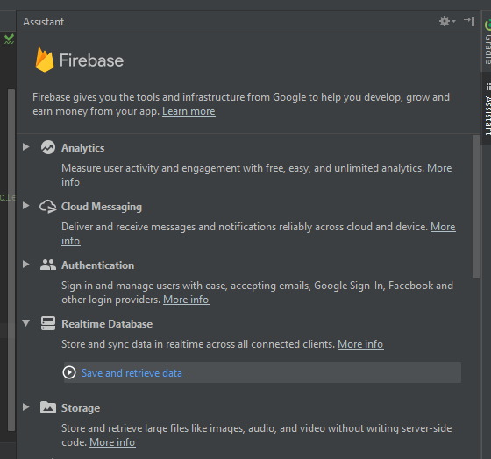
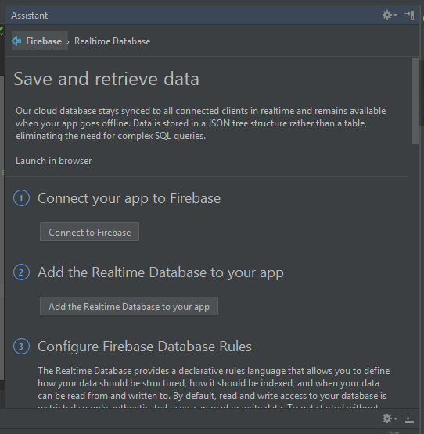
Basic setup
In Studio (this is setup the Realtime Database)

Slide 9
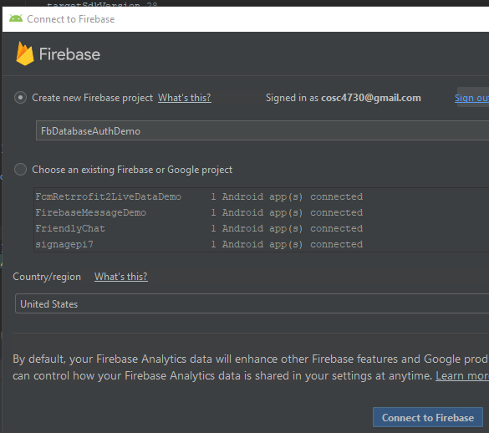
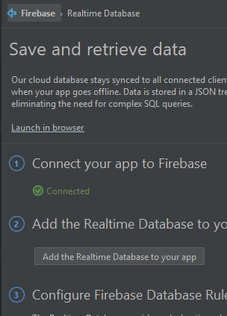
Basic Setup (2)
In the browser Back in Studio

Slide 10
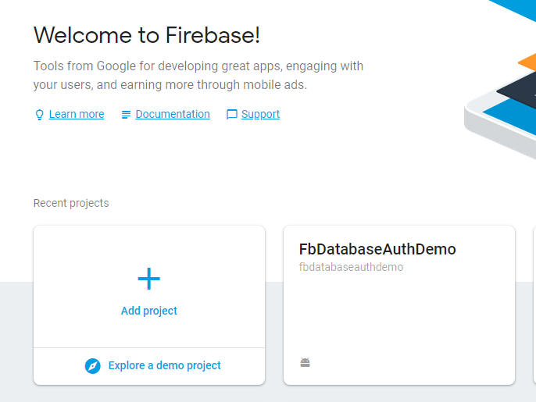
Basic Setup (3)
You should now have the project in the firebase console as well

Slide 11
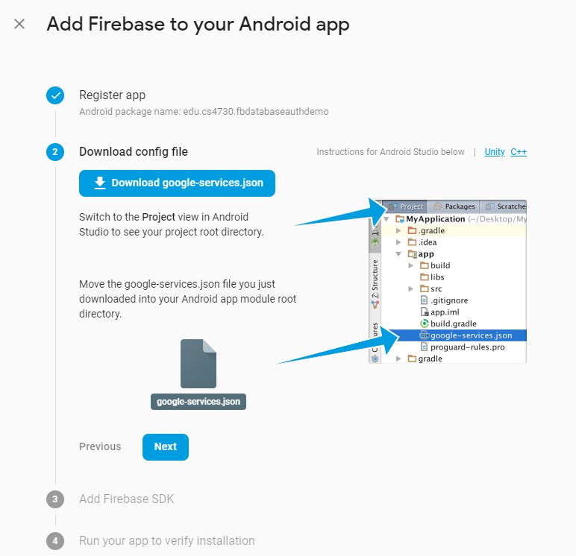
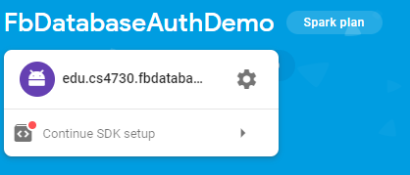
Through the console only
Create a project and
add the app project

Slide 12
Including.
In the build.gradle you can add each individual
or add the BOM (Bill of Materials) and then which packages you need with the version numbers.
Example:
// Import the BoM for the Firebase platform
implementation platform('com.google.firebase:firebase-bom:32.3.1')
// Declare the dependencies for the desired Firebase products without specifying versions
implementation 'com.google.firebase:firebase-auth'
implementation 'com.google.firebase:firebase-firestore'
https://firebase.google.com/support/release-notes/android

Slide 13
RealTime database

Slide 14
Realtime Database
Is a cloud based database with live connections to the app.
The data is stored a json objects and is only intended for text, to allow for fast responses.
Authentication is needed.
Works even offline, with cached data then sync when online.
dependencies
implementation 'com.google.firebase:firebase-database:20.2.2’
OR with the BOM included, just leave off the version number.

Slide 15
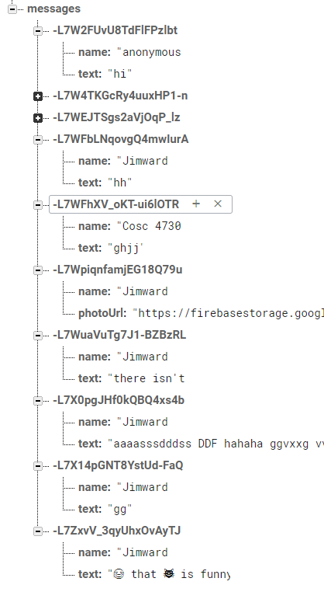
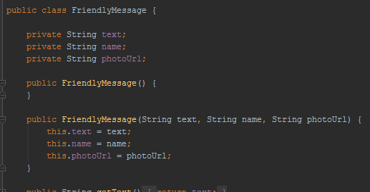
Data
The data is stored as a json object.
The L7W.. Is a unique key, that I didn't have to create.
You will need a POJO class that matches your data names

Slide 16
Database setup and use.
Setup a connection and reference.
FirebaseDatabase database = FirebaseDatabase.getInstance();
DatabaseReference dbReference = database.getReference().child("messages");
To add a new value use the push and setValue
dbReference.push().setValue( friendlyMessage);
Where friendlyMessage is a object holding the data.

Slide 17
Database setup and use. (2)
Listener for new data
ChildEventListener mChildEventListener = new ChildEventListener() { @Override public void onChildAdded(DataSnapshot dataSnapshot, String s) { FriendlyMessage friendlyMessage = dataSnapshot.getValue(FriendlyMessage.class);
//now do something with the data } public void onChildChanged(DataSnapshot dataSnapshot, String s) { } public void onChildRemoved(DataSnapshot dataSnapshot) { } public void onChildMoved(DataSnapshot dataSnapshot, String s) { } public void onCancelled(DatabaseError databaseError) { } }; mMessagesDatabaseReference.addChildEventListener(mChildEventListener);
Don’t forget to remove listeners in onPause, add them in onResume

Slide 18
Database notes
Firebase Realtime Database allows nesting data up to 32 levels deep, but where possible avoid nesting deep.
Also don't use json arrays.

Slide 19
Database and security
By default, only authenticated users can read and write the database.
Console:

Slide 20
Database and security (2)
It can be changed, but not recommend.
You can setup very complex rules, where only some users can access data, etc. With cascading rules for the depth of nodes.
See the documentation:
https://firebase.google.com/docs/database/security/quickstart

Slide 21
Authentication

Slide 22
Authentication
Allows the user to "login" to your app.
With any number of services using FirebaseUI
Currently: phone number, email and password, google, facebook, twitter, and github.
Note facebook and twitter require their api key in order for it to work.
You don't write the code, just call the method for sign in or sign out.
It keeps track, even the password for email.
dependencies
implementation 'com.google.firebase:firebase-auth:21.0.6' //using bom, no version.
implementation 'com.firebaseui:firebase-ui-auth:8.0.1’ //NOT in the BOM.
See https://github.com/firebase/FirebaseUI-Android
Also requires implementation 'com.google.android.material:material:1.6.1'

Slide 23
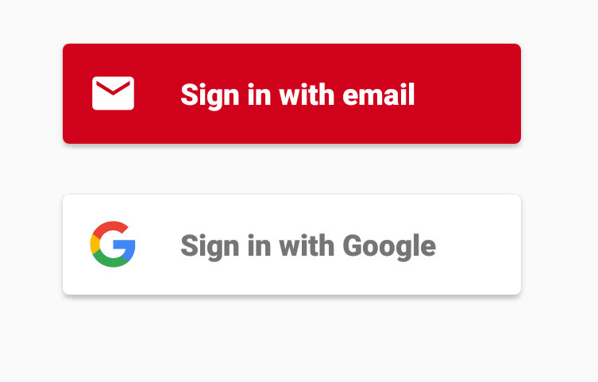
Setup and use
private FirebaseAuth mFirebaseAuth;
private FirebaseAuth.AuthStateListener mAuthStateListener;
mFirebaseAuth = FirebaseAuth.getInstance();

Slide 24
Setup and use (2)
In onResume,
mFirebaseAuth.addAuthStateListener(mAuthStateListener);
Where
mAuthStateListener = new FirebaseAuth.AuthStateListener() { @Override public void onAuthStateChanged(@NonNull FirebaseAuth firebaseAuth) { FirebaseUser user = firebaseAuth.getCurrentUser(); if (user != null) { // User is signed in use user.getDisplayName() to get the name. } else { // User is signed out
} } };
Again, don't forget to remove the listener in onPause()
mFirebaseAuth.removeAuthStateListener(mAuthStateListener);
myActivityResultLauncher.launch(AuthUI.getInstance()
.createSignInIntentBuilder()
.setIsSmartLockEnabled(false)
.setAvailableProviders(Arrays.asList(
new AuthUI.IdpConfig.EmailBuilder().build(),
new AuthUI.IdpConfig.GoogleBuilder().build(),
new AuthUI.IdpConfig.PhoneBuilder().build()
)
)
.build());

Slide 25
Setup and use (3)
myActivityResultLauncher = registerForActivityResult(
new ActivityResultContracts.StartActivityForResult(),
new ActivityResultCallback<ActivityResult>() {
@Override
public void onActivityResult(ActivityResult result) {
if (result.getResultCode() == Activity.RESULT_OK) {
mFirebaseUser = mFirebaseAuth.getCurrentUser();
mUsername = mFirebaseUser.getDisplayName();
} else {
//failed login.

Slide 26
Cloud Firestore

Slide 27
FireStore Database.
For flexibility, query the database, and scalable.
Like realtime db, realtime updates and offline support.
Uses a NoSQL data model.
You have a collections, which contain documents, which can contain subcollections to build hierarchical data structures.
Allows for efficient questions, by creating shallow queries or nested questions.
https://firebase.google.com/docs/firestore/

Slide 28
Getting started.
In the console turn on firestone.
First add firestone to gradle (it's in the bom)
implementation 'com.google.firebase:firebase-firestore'
Access your database
FirebaseFirestore db = FirebaseFirestore.getInstance();
Adding data, create a HashMap
Map<String, Object> data = new HashMap<>();
data.put("back in 5 minutes", et_msg.getText().toString());
data.put("Arrow", "none");

Slide 29
Adding data.
Now Add the data to the level you want it. In this case, /sign/jim/
db.collection("sign").document("Jim")
.set(data) //hashmap previously created.
.addOnSuccessListener(new OnSuccessListener<Void>() {
@Override
public void onSuccess(Void aVoid) {
Log.d(TAG, "DocumentSnapshot successfully written!");
}
})
.addOnFailureListener(new OnFailureListener() {
@Override
public void onFailure(@NonNull Exception e) {
Log.w(TAG, "Error writing document", e);
}
});

Slide 30
In the console it looks like this

Slide 31
Receive the data
db.collection("users").document("Jim").get()
.addOnCompleteListener(new OnCompleteListener<DocumentSnapshot>() {
@Override
public void onComplete(@NonNull Task<DocumentSnapshot> task) {
if (task.isSuccessful()) {
DocumentSnapshot snapshot = task.getResult();
Map<String, Object> data = snapshot.getData();
TestText = String.valueOf(data.get("text"));
Arr = String.valueOf(data.get("Arrow"));
}
}
});

Slide 32
To get multiple documents from a collection
db.collection("users")
.get()
.addOnCompleteListener(new OnCompleteListener<QuerySnapshot>() {
@Override
public void onComplete(@NonNull Task<QuerySnapshot> task) {
if (task.isSuccessful()) { //iterate over the documents.
for (QueryDocumentSnapshot document : task.getResult()) {
//using document.getData() to get each one.
}
} else {
Log.w(TAG, "Error getting documents.", task.getException());
}
}
});

Slide 33
Retrieve via a listener
DocumentReference docRef = db.collection("sign").document("Jim");
docRef.addSnapshotListener(new EventListener<DocumentSnapshot>() {
@Override
public void onEvent(@Nullable DocumentSnapshot snapshot, @Nullable FirebaseFirestoreException e) {
if (e != null) { Log.w(TAG, "Listen failed.", e); return; }
//retrieve the data if it exists.
if (snapshot != null && snapshot.exists()) {
Map<String, Object> data = snapshot.getData();
TestText = String.valueOf(data.get("text"));
Arr = String.valueOf(data.get("Arrow"));
}
} });

Slide 34
Learn more.
There are series of very good youtube set of videos on how to use firestore (12 as of 10/2022).
Video 1
https://www.youtube.com/watch?reload=9&reload=9&v=v_hR4K4auoQ&list=PLl-K7zZEsYLluG5MCVEzXAQ7ACZBCuZgZ

Slide 35
Authentication and Firestore
Firestore uses the same authentication as realtime db

Slide 36
Using Google Authentication with firebase
If your app already uses google authentication, (ie requires a google sign in)
Then you can use that to login to firebase as well.
First sign in with Google Authentication
Pass the credentials off to firebase.
https://developers.google.com/identity/sign-in/android/sign-in

Slide 37
Example code
The FbDatabaseAuthDemo
Has code to firebase sign in example
DBlistFragment and DBSimpleFragment use RealTime database example.
the FirebaseFireStoredemo
firestore.

Slide 38
project limits! (firebase and google platform)
You can have between 5 and 10 firebase projects, but google won't tell you the number until you hit it. And your google platform projects effect this number in some way.
It appears my firebase project number is 7, other have reported as low as 5. Google's page actually says 30.
Note, it takes 30 days! to delete a project.
https://cloud.google.com/resource-manager/docs/creating-managing-projects?hl=en&visit_id=637018228706845638-1983767179&rd=1
This is in case you change your mind.
You can request additional. It normally takes 2 business days for a response.

Slide 39
References
https://console.firebase.google.com/
https://firebase.google.com/docs/
Many of the sub doc's where listed on slides.
Code lab: FriendlyChat app (about 2ish hours)
https://codelabs.developers.google.com/codelabs/firebase-android/#0
Covers database, auth, invites, remote config, admob, analytics, and firebase notifications.
A short course (about 8 hours) Firebase in a weekend
https://classroom.udacity.com/courses/ud0352 (free course)
It's dated, but still pretty good.

Slide 40
Q
A
&

