Slide 1
cosc 5/4730
GUI: layouts, more views, and viewpagers.

Slide 2
Layout "managers"
Most of the time you need more then one view. So you use a layout to control how the widgets are shown on the screen.
LinearLayout is very simple
<LinearLayout android:id="@+id/LinearLayout01" android:layout_width="fill_parent" android:layout_height="fill_parent"
android:orientation="vertical">
Orientation controls placement of the next widget:
vertical: next line
horizontal: to the right of the previous widget
Normally you use several layouts to control how everything is displayed.

Slide 3
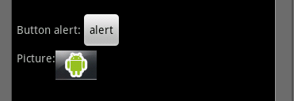
multiple Layout example
For presentation reasons lots of info was left off.
<?xml version="1.0" encoding="utf-8"?>
<LinearLayout android:id="@+id/LinearLayout01"
android:layout_width="fill_parent"
android:layout_height="fill_parent"
android:orientation="vertical">
<LinearLayout android:id="@+id/LinearLayout02"android:orientation="horizontal">
<TextView ></TextView>
<Button ></Button>
</LinearLayout>
<LinearLayout android:id="@+id/LinearLayout02" android:orientation="horizontal">
<TextView ></TextView>
<ImageView></ImageView>
</LinearLayout>
</LinearLayout>

Slide 4
Layout Settings
Weight
Inside a layout, then each Widget can use Layout_Weight
This determines, which gets more space
Setting them all to 1, means they share the space equally.
Setting widget1 to 1 and widget2 to 2, means widget2 gets twice as much space as widget1

Slide 5
Layout Settings Weight
Visual example:

Slide 6
Layout Settings (2)
Gravity
A nice way of saying alignment, which is flush on the left side of the screen
Layout_gravity: (Vertical)
left (default) flush on the left side of the screen
center_horizontal center
right is flush on the right side of the screen.
Horizontal layout
Center_vertical Center vertical, instead of on the "baseline" (bottom).

Slide 7
Layout Settings (3)
Padding
how much in pixels space between the widget and the side of the screen/next widget
android:padding="15dp" is about 15 “pixels” all around
Also paddingLeft, paddingRight, paddingTop, and paddingBottom

Slide 8
Relative Layout
More complex and widgets placed based on the previously placed widgets
Except the first one (no other widget yet)
layout_above, layout_below, layout_toLeftOf, layout_toRightOf
With the above, these can be used layout_alignTop, layout_alignBottom, layout_alignLeft, layout_alignRight, layout_alignBaseline
Or placed relative to the container itself
layout_alignParentTop, layout_ParentBottom, layout_alignParentLeft, layout_parentRight, layout_centerHorizontal, layout_centerVertical, layout_CenterInParent
Settings are placed in the Widgets

Slide 9
Relative Example
<RelativeLayout android:id="@+id/RelativeLayout01" android:layout_width="fill_parent" android:layout_height="fill_parent" android:padding="5px">
<TextView android:text="Some Text " android:id="@+id/TextView01"
android:layout_alignParentBottom="true" >
</TextView>
<Button android:text="alert" android:id="@+id/Button01"
android:layout_above="@id/TextView01" >
</Button>
</RelativeLayout>
NOTE : Button uses @id/TextView01, no + sign. + sign only needed for the id, when referencing it somewhere, just @id/name

Slide 10
Relative Example (2)
<TextView
android:id="@+id/headingValue"
android:layout_width="wrap_content"
android:layout_height="wrap_content"
android:layout_alignBaseline="@+id/headingLabel"
android:layout_alignBottom="@+id/headingLabel"
android:layout_alignLeft="@+id/zAxisValue"
android:text="Nothing..." />

Slide 11
Relative Example (3)
Views over the top of each other. This can easy be done with the relative layout. Like the previous example:
<ImageView
android:id="@+id/ImgV" android:layout_width="fill_parent"
android:layout_height="fill_parent" android:src="@drawable/ic_launcher"/>
<TextView
android:id="@+id/xAxisLabel"
android:layout_width="wrap_content"
android:layout_height="wrap_content"
android:layout_alignParentLeft="true“ this aligns to the top of the “screen”,
android:layout_alignParentTop="true“ since no id was chosen.
android:layout_marginLeft="18dp"
android:layout_marginTop="15dp"
android:text="xAxis" />

Slide 12
Relative and Linear Layouts.
The problem with a relative layout maybe the screen size. The previous example can be redone with a Relative layout and then linear layouts to create the “table” of values. It can then resize as needed.
But it’s also possible you don’t want that behavior.

Slide 13
ConstraintLayout
The constraint layout should fix the problems with the linear and relative layouts.
You can use studio's UI to position the widgets and how you want everything to look.
This can be very time consuming, and missed click with somethings mess everything up (remember the back button when then happens).
https://developer.android.com/training/constraint-layout/index.html
https://developer.android.com/studio/write/layout-editor.html

Slide 14
Constraints Rundown
Constraints are what is used to define a view’s position relative to it’s siblings and parent.
They represent a connection or alignment to other another view or to the parent layout or some other invisible guideline.
Each view must have at least one horizontal and one vertical constraint, but adding more is possible and often necessary.
Notes:
Give example of poor constraints

Slide 16
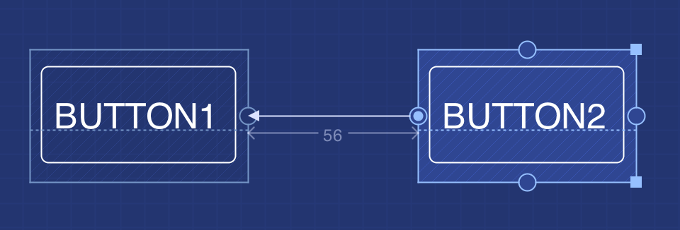
Adding a Constraint
In the design editor simply drag and drop a view from the palette into the blueprint of your layout.
Then use the constraint handles on the view to drag and drop a constraint to an anchor point on another view or to the parent layout.
Conversely, remove a constraint by clicking it’s handle or by selecting the Remove all constraints button below the view.
Constraint
Anchor point
Constraint handle
Notes:
Demonstrate:
How to add constraints
How to remove one constraint
How to remove all constraints
Remember the following rules:
Every view must have at least two constraints: one horizontal and one vertical.
You can create constraints only between a constraint handle and an anchor point that share the same plane. So a vertical plane (the left and right sides) of a view can be constrained only to another vertical plane; and baselines can constrain only to other baselines.
Each constraint handle can be used for just one constraint, but you can create multiple constraints (from different views) to the same anchor point.

Slide 17
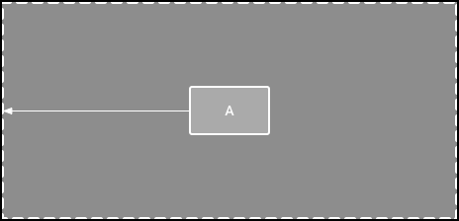
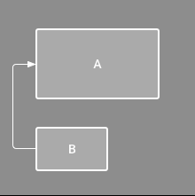
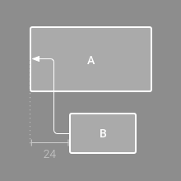
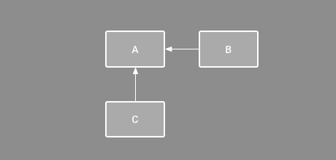
Layout behaviors
1. Parent position
3. Alignment
2. Order position

Slide 18
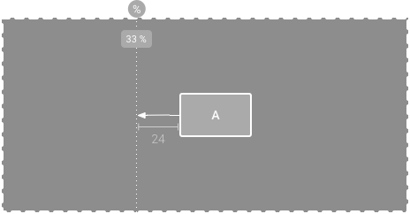
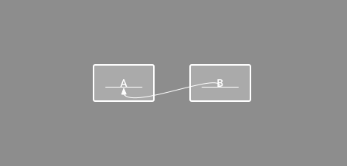
More behaviors
4. Baseline Alignment
(Can be set by selecting the baseline button below a view)
5. Constraint to guideline
(Can be set by selecting Guidelines in the toolbar)

Slide 19
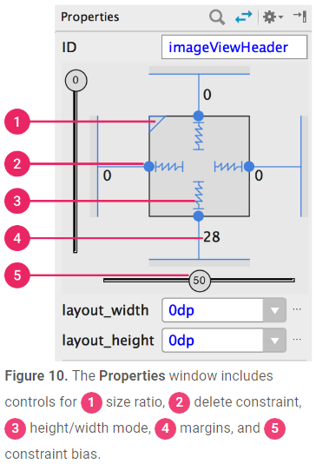
Properties
A view’s spatial occupancy can be entirely edited in the Properties window.
If at least one view dimension is set to match constraint then a size ratio can be set.
Constraint bias give a view weight within a constraint set.

Slide 20
Other Layouts
TableLayout works like html tables (with all the complications like spanning rows)
TableRow is used with it for row layouts
Scrollview work is just like linearLayout, except you get a vertical scrollbars as needed or HorizontalScrollView.
It takes one widget, which is likely a LinearLayout.
There is also a GridView, which items are inserted to the layout via a ListAdapter
We come back to the listAdapter later on (with ListViews)

Slide 21
Progress Bar
A ProgressBar is like a gauge.
The bar can look in one of 4 ways, set in the style tag
android:progressBarStyle This is a medium circular progress bar
android:progressBarStyleHorizontal This is a horizontal progress bar.
android:progressBarStyleLarge This is a large circular progress bar.
android:progressBarStyleSmall This is a small circular progress bar.
The format looks like this:
style="?android:attr/progressBarStyleHorizontal">

Slide 22
Progress Bar (2)
SetMax(int m) uses to set the bar from 0 .. m
Need to call this when it is setup in java
No setmin, zero is always the min.
setProgress(int p) sets to a specific progress p
int getProgress() returns the current level
incrementProgressBy(int d) increments the progress by d.

Slide 23
SeekBar
SeekBar is inherits ProgressBar and is touchable/ interactive. Otherwise it is the same as ProgressBar
Add a listener SeekBar.OnSeekBarChangeListener
seekBar.onClickListener to add the listener
Must override 3 methods
public void onStartTrackingTouch (SeekBar seekBar)
Use of a touch gesture
public void onStopTrackingTouch (SeekBar seekBar)
touch gesture ended
public void onProgressChanged(SeekBar seekBar, int progress, boolean fromUser)
The seekBar has changed and it's progress
fromUser is true if a user changed it

Slide 24
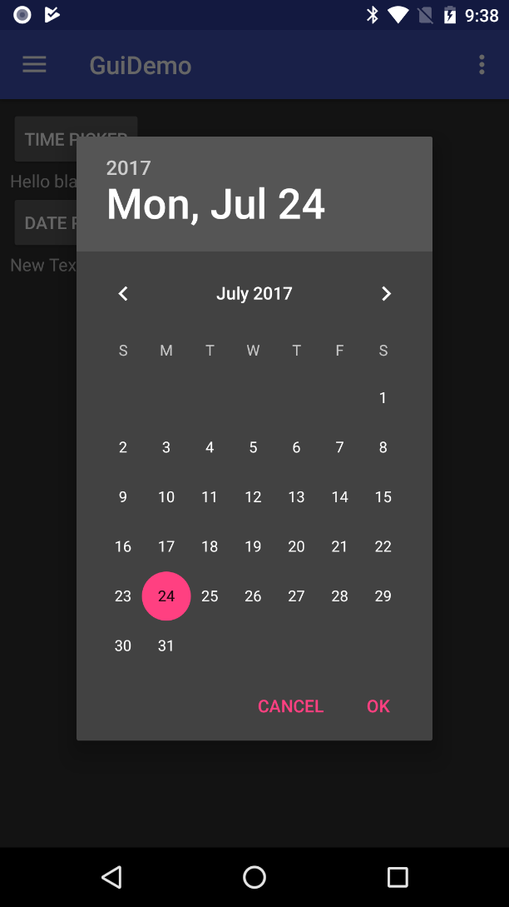
DatePickerDialog
DatePicker is a built-in dialog to pick a date
TimePickerDialog picks the time
There is a custom ColorPickerDialog
In the api demos, get the ColorPickerDialog.java file and add it to your project.

Slide 25
DatePickerDialog (2)
Calling the Dialog
constructor
DatePickerDialog(Context context, DatePickerDialog.OnDateSetListener callBack, int year, int monthOfYear, int dayOfMonth)
Example:
Calendar dateAndTime = Calendar.getInstance();
new DatePickerDialog(FormExample.this, d, //d is the listener
dateAndTime.get(Calendar.YEAR),
dateAndTime.get(Calendar.MONTH),
dateAndTime.get(Calendar.DAY_OF_MONTH)
).show();

Slide 26
DatePickerDialog (2)
listener:
in previous example assumed a declared listener,
if implemented, change d to this.
declared listener
d = new DatePickerDialog.OnDateSetListener() {
public void onDateSet(DatePicker view, int year, int monthOfYear, int dayOfMonth) {
dateAndTime.set(Calendar.YEAR, year);
dateAndTime.set(Calendar.MONTH, monthOfYear);
dateAndTime.set(Calendar.DAY_OF_MONTH, dayOfMonth);
}
};

Slide 27
Threads and widgets
Only the original thread that created a view hierarchy can touch its view.
So you can't change widgets on threads you create!
To get around the problem, you need a handler
specially a message handler.
import android.os.Handler;
import android.os.Message;
private Handler handler = new Handler() {
@Override
public void handleMessage(Message msg) {
if (msg.what == 0) {
tvok.setText("Process done"); //Change the dialog textview.
}
}
};
// in the thread, (assuming handler is accessible to it) you can then send a message with
handler.sendEmptyMessage(0); //where 0 is a message
You could also use a post on a specific widget
to update that widget
tvok.post(new Runnable() {
public void run() {
tvok.setText("Process done");
}
});
We could just as easily use a viewmodel in the thread and observer on the UI thread.

Slide 28
ViewSwitcher and ViewFlipper
The ViewSwitcher and ViewFlipper
ViewFlipper allows you set an animation, so it continues to change to the view.
Allows you to change the “layout” very easily.
They take a setup of “views” and then allow you to change between them.
Any view, but a layout is handy, so you can have more then one widget in each “view”.

Slide 29
ViewSwitcher and ViewFlipper (2)
<ViewSwitcher
android:id="@+id/viewSwitcher1"
android:layout_width="match_parent"
android:layout_height="wrap_content" >
<LinearLayout
android:layout_width="fill_parent"
android:layout_height="match_parent" >
<EditText …/>
<button/>
…
</LinearLayout>
<LinearLayout >
<ImageButton ../>
…
</LinearLayout>
</ViewSwitcher>
So now it will switch between the two layouts. For simplicity, a RED layout and a BLUE layout
myViewSwitch = (ViewSwitcher) myView.findViewById( R.id.viewSwitcher1);
To switch between use
myViewSwitch.showNext()
It will cycle between the red and blue layouts.
OR using viewbinding, skip the variable.
Binding.viewSwitcher1.showNext()

Slide 30
ViewSwitcher and ViewFlipper (3)
With the ViewFlipper
myViewFlipper.isFlipping() true if automatically flipping between
Use myViewFlipper.StartFlipping(); to start
Use myViewFlipper.startFlipping(); to stop.
The guidemo code has how to setup some animation, so it fade in/out or slides in/out
Viewswitch_fragment .java and .xml

Slide 31
View pagers.
The easiest way to implement a left/right swipe is to use a ViewPager.
You add fragments to the ViewPager (via an adapter) and then the user can swipe left or right to change pages.
You can also add custom animations
Not shown here.
use the androidx, in build.gradle
implementation 'androidx.viewpager:viewpager:1.0.0'

Slide 32
ViewPager
The viewpager is setup in the layout and can be the only view or included with other widgets.
<androidx.viewpager.widget.ViewPager xmlns:android="http://schemas.android.com/apk/res/android"
android:id="@+id/pager"
android:layout_width="match_parent" android:layout_height="match_parent">
</androidx.viewpager.widget.ViewPager>

Slide 33
ViewPager (2)
You can also include a tab strip to give the user reference and click those instead of swiping.
<androidx.viewpager.widget.ViewPager xmlns:android="http://schemas.android.com/apk/res/android"
android:id="@+id/pager"
android:layout_width="match_parent" android:layout_height="match_parent">
<androidx.viewpager.widget.ViewPager
android:id="@+id/pager_header“
android:layout_width="match_parent" android:layout_height="wrap_content" android:layout_gravity="top"
android:background="#000" android:paddingBottom="4dp"
android:paddingTop="4dp" android:textColor="#fff" />
</androidx.viewpager.widget.ViewPager>

Slide 34
FragmentPageAdapter
Basically, you add/put fragments in an adapter and then add the adapter to the viewpager.
The FragmentPagerAdatper requires an override of
GetItem which says which fragment to display
getCount which says how many fragments/pages are there.
You need a constructor as well.
For the PagerTabStrip to work, you also need to override getPageTile as well.

Slide 35
FragmentPageAdapter example
public class ThreeFragmentPagerAdapter extends FragmentPagerAdapter {
public ThreeFragmentPagerAdapter(FragmentManager fm) { super(fm); }
@Override
public int getCount() { return 3; }
@Override
public Fragment getItem(int position) {
switch (position) {
case 0: return leftfrag; //these are fragments.
case 1: return midfrag;
case 2: return rightfrag;
default: return null;
}
}
}
import androidx.fragment.app.Fragment;
import androidx.fragment.app.FragmentManager;
import androidx.fragment.app.FragmentPagerAdapter;
import androidx.viewpager.widget.ViewPager;

Slide 36
ViewPager in the Activity
In the OnCreate
Get the ViewPager from the layout
ViewPager viewPager = findViewById(R.id.pager);
Set the adapter.
viewPager.setAdapter(new ThreeFragmentPagerAdapter(fragmentManager));
That’s it, now the veiwpager handles everything else.
Viewbinding:
Binding.pager. setAdapter(new ThreeFragmentPagerAdapter(fragmentManager));

Slide 37
ViewPager2
ViewPager is no longer being updated (since 2018) is recommended to use ViewPager2 instead.
It very similar, but also allows for vertical or horizontal paging via the android: orientation in xml. Also supports right-to-left (RTL) locale pages as well.
As a note, ViewPager2 is built on a recyclerview and some pieces of the recyclerview (such notifyDatasetChanged()) can be called.
implementation 'androidx.viewpager:viewpager2:1.0.0'

Slide 38
ViewPager2 xml
The viewpager is setup in the layout and can be the only view or included with other widgets.
<androidx.viewpager2.widget.ViewPager2 xmlns:android="http://schemas.android.com/apk/res/android"
android:id="@+id/pager"
android:layout_width="match_parent" android:layout_height="match_parent"/>
there is no tabstrip, use the TabLayout widget instead (shown in the example code).

Slide 39
viewpager 2FragmentStateAdapter example
public class ThreeFragmentPagerAdapter extends FragmentStateAdapter {
public ThreeFragmentPagerAdapter(FragmentActivity fa) { super(fa); }
@Override
public int getItemCount() { return 3; }
@Override
public Fragment createFragment(int position) {
switch (position) {
case 0: return leftfrag; //these are fragments.
case 1: return midfrag;
case 2: return rightfrag;
default: return null;
}
}
}

Slide 40
ViewPager2 in the Activity
In the OnCreate
Get the ViewPager from the layout
ViewPager2 viewPager = findViewById(R.id.pager);
Set the adapter.
viewPager.setAdapter(new ThreeFragmentPagerAdapter(this));
That’s it, now the veiwpager handles everything else.
Viewbinding:
Binding.pager.setAdapter(new ThreeFragmentPagerAdapter(this));

Slide 41
References
See the GuiExample and FormExample on the handout pages for source code.
https://github.com/JimSeker/ui advanced directory
For a full list of xml and methods, see the developer guide, because I skipped a lot of information

Slide 42
Q
A
&

