Slide 1
Cosc 5/4730
Android Communications
Intents, callbacks, and setters.

Slide 2
Intents
Android

Slide 3
Intents
An intent is an abstract description of an operation to be performed. It can be used with startActivity to launch an Activity, broadcastIntent to send it to any interested BroadcastReceiver components, and startService(Intent) or bindService(Intent, ServiceConnection, int) to communicate with a background Service.
An activity can also receive a “new” intent, via the OnIntent(Intent) method
An Intent provides a facility for performing late runtime binding between the code in different applications. Its most significant use is in the launching of activities, where it can be thought of as the glue between activities. It is basically a passive data structure holding an abstract description of an action to be performed.

Slide 4
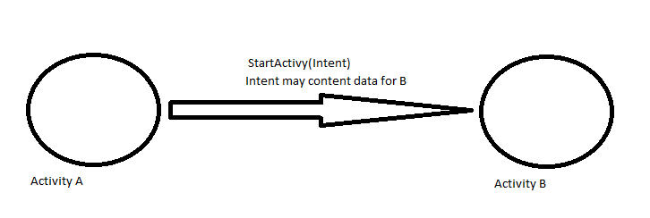
Intents
The intent
Contains the class to be “called” by the activity
And may contain other information needed by that class (Activity, service, Broadcast receiver, etc)

Slide 5
Start an Activity with an intent
To start a specific Activity, use an explicit Intent
Create an Intent
Intent intent = new Intent(this, ActivityName.class);
Use the Intent to start the Activity
startActivity(intent);

Slide 6
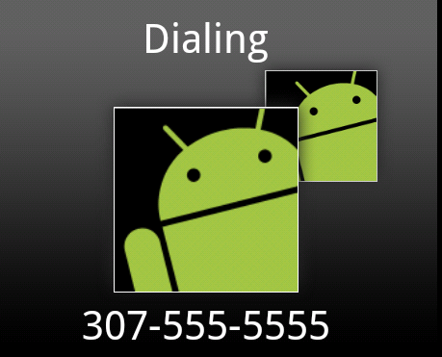
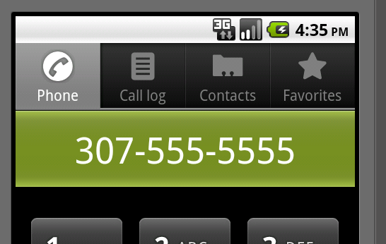
Making a call example
The intent is pretty simple
Intent dialIntent = new Intent( "android.intent.action.CALL", Uri.parse("tel:3075555555"));
Use “android.intent.action.DIAL”
To just bring up the dialer, but not call.
startActivity(dialIntent);
Needs <uses-permission android:name= "android.permission.CALL_PHONE"> </uses-permission>
In the manifest.xml file.
http://developer.android.com/reference/android/Manifest.permission.html

Slide 7
Web browser intent
To start up the browser with a page location you specify
Intent webIntent = new Intent( "android.intent.action.VIEW", Uri.parse("http://www.cs.uwyo.edu"));
startActivity(webIntent);
<uses-permission android:name="android.permission.INTERNET"></uses-permission>

Slide 8
Other “standard” intents
You can start up the maps with an intent
intent = new Intent(Intent.ACTION_VIEW,Uri.parse("geo:41.312927,105.587251?z=19"));
Should show Laramie on the map. Will force closes on the simulator.
Launch the camera
intent = new Intent("android.media.action.IMAGE_CAPTURE");
<uses-permission android:name="android.permission.CAMERA"></uses-permission>
Show contacts
intent = new Intent(Intent.ACTION_VIEW, Uri.parse("content://contacts/people/"));
<uses-permission android:name="android.permission.READ_CONTACTS"></uses-permission>
Selection a contacts returns the information to the activity
Edit a contact
Intent = new Intent(Intent.ACTION_EDIT, Uri.parse("content://contacts/people/1"));
Brings up Editor the first entry in the contacts list.

Slide 9
Returning data.
Instead of startActivity, use
startActivityForResult(intent, resultCode);
resultCode is a number you pick, that you can identify the callback with.
Override onActivityResult(int requestCode, int resultCode, Intent data) method.

Slide 10
Passing data to a new activity.
Create an intent
Intent i = new Intent(this, ActivityTwo.class);
i.putExtra(“key1”, “Some data”);
i.putExtra(“key2”, “more data”);
Where key1, key2 are names both activities know.
startActivityForResult(i, REQUEST_CODE);
Assumes we want return data, otherwise use startActivity.

Slide 11
Passing data to a new activity. (2)
ActivityTwo
In the onCreate method
Bundle extras = getIntent().getExtras();
//Make sure the activity was called correctly.
if (extras == null) {return;}
String value1 = extras.getString(“key1");
String value2 = extras.getString(“key2");
Like others, many getX methods, like getInt(String key)

Slide 12
Return data.
When activityTwo finishes, it can return an Intent with data.
In the finish() method
@Override
public void finish() {
Intent data = new Intent();
data.putExtra("returnKey1", “some data ");
data.putExtra("returnKey2", “more data");
setResult(RESULT_OK, data);
super.finish();
}
Result: constants are RESULT_OK, RESULT_CANCELED, but you can also use any custom result with an int.
When an activity fails, crashes, the result will be RESULT_CANCELED.

Slide 13
Return data (2)
In the Calling activity
@Override
protected void onActivityResult(int requestCode, int resultCode, Intent data) {
if (resultCode == RESULT_OK && requestCode == REQUEST_CODE) {
//remember if RESULT_CANCELED, likely no data in the intent!
if (data.hasExtra("returnKey1")) {
Toast.makeText(this, data.getExtras().getString("returnKey1"),
Toast.LENGTH_SHORT).show();
}
} else if (resultCode == RESULT_CANCELED && requestCode == REQUEST_CODE}
Toast.makeText(this, “ActivityTwo canceled!”,
Toast.LENGTH_SHORT).show();
}

Slide 14
Finally.
You can see these intents working in the code provided with the lecture.
For more of google applications intents see
http://developer.android.com/guide/appendix/g-app-intents.html
http://developer.android.com/reference/android/content/Intent.html
http://www.openintents.org/en/intentstable which also list some 3rd party intents as well.

Slide 15
More Intents
We will use intents all over the place
We also put Intents in PendingIntents, which allows our intents to be launch by others
From the notification for example.
Services, Broadcast Receivers also all use intents as we’ll see later on.
We can also setup to receive intents in the activities as well with an intent-filter.

Slide 16
Callbacks and setters/ CONSTRUCTORS
Android

Slide 17
Communication between fragments
Basically we can use callbacks and setters/constructors to communicate between fragments via the activity.
The activity passes the data between them or preforms actions the fragments can’t (such as changing fragments).
Note much of these can be replaced with a modelview and livedata, which android/google is encouraging.

Slide 18
Setters
The constructor takes values when the fragment is instantiated.
This is done with setArguments/getArguments in the factory methods.
A setter takes the new values and updates the variables.
The widgets/views are now updates as needed.

Slide 19
callbacks
The fragment creates a interface, which is a fragment listener.
The activity implements it.
This is likely a button click or other action.
Now the activity receives it and the data. It then preforms the necessary action.
Note, When you create a new fragment, studio has a check mark to create skeleton code for the callback in your fragment.

Slide 20
Callbacks fragment
Create the interface.
public interface OnFragmentInteractionListener {
// change parameters to your needs.
public void onFragmentInteraction(String Data);
}
Declare a variable of the interface to use in the fragment.
private OnFragmentInteractionListener mListener;
Use the onAttach() and OnDeteach() to set the variable correctly.
@Override
public void onAttach(Activity activity) {
super.onAttach(activity);
try {
mListener = (OnFragmentInteractionListener) activity;
} catch (ClassCastException e) { }
}
@Override
public void onDetach() {
super.onDetach();
mListener = null;
}

Slide 21
Callbacks fragment (2)
Lastly use the variable (carefully).
if (mListener != null) {
mListener.onFragmentInteraction(variable);
}
Likely called from some widget/view listener when the user preforms some action.

Slide 22
Callbacks activity
The activity then implements the interface.
public class MainActivity extends ActionBarActivity implements myFrag.OnFragmentInteractionListener {
And somewhere in the code
@Override
public void onFragmentInteraction(String Data) {
//implement whatever code is necessary
//to carry out the action.
}
The activity can implement multiple interfaces for different fragments (different names) or the same one for all of them (same name).

Slide 23
Callbacks, not an Android invention.
Android calls them callbacks, but this is just the standard java interface mech.
You can add (and may need) to any class.
The method is then just an object that is run when called.
Callback/interface vs listener
A callback or interface must have an “implements X” otherwise it won’t compile or dies a runtime.
There is no default action
A listener can work without any extra code and the default action is taken.
Normally a default action is to do nothing.

Slide 24
Listviews, fragments, and callbacks.

Slide 25
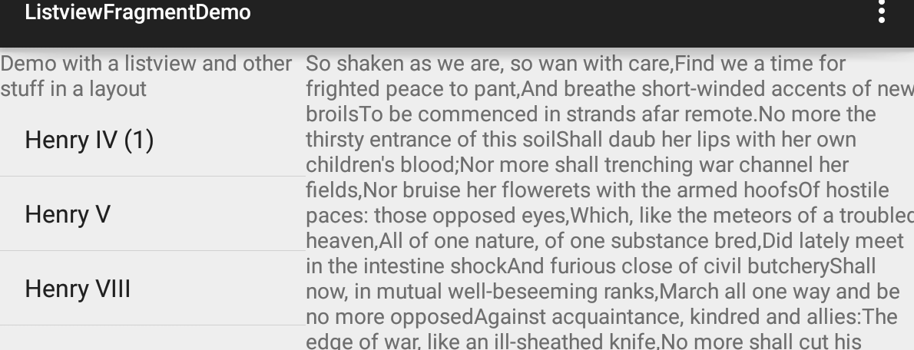
Frag com with listview.
Callback listener, via
the onItemClick methods
the Activity “sends” the information to the text fragment

Slide 26
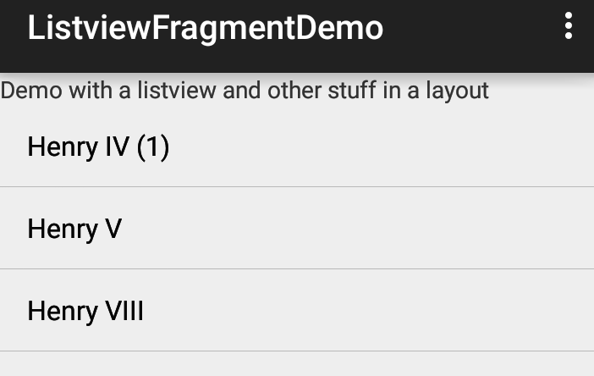
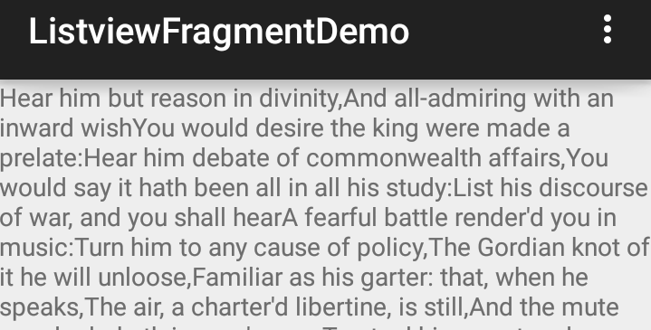
Frag com with listview (2)
Callback listener, via
the onItemClick methods
Since the text fragment is not on the screen, it adds it and sets the arguments to the fragment.
The fragment reads the position via
Get arguments, in the onStart()
method.
It then displays the correct info.
Pressing the back button, return to
listview again.

Slide 27
Later on.
We will come back and see more of this callbacks in the listview and recyclerview and fragment lectures
Note, we are going to confuse and simplify this all of this with modelview and architecture navigation next time.

Slide 28
Learn more
Intents and Intent Filters (API Guide)
Intent (API Reference)
Navigation

Slide 29
Q
A
&

