Slide 1
COSC 5/4730
Layouts and screen size.

Slide 2
Screen size

Slide 3
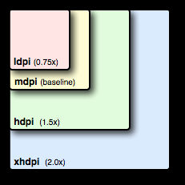
Screen Size
In the android directories, there is a res/
drawable/ and mipmap/
This deals with the screen density of pixels.
The configuration qualifiers you can use for density-specific resources are ldpi (low), mdpi (medium which is the baseline), hdpi (high), and xhdpi (extra high). For example, bitmaps for high-density screens should go in drawable-hdpi/.

Slide 4
Screen Size and layouts
Scaling: medium is the baseline
Small = mdpi*.75, high=mdpi*1.5 and xhigh=mdpi*2.0
Pixels: Small=36, medium=48, high=72, and xhigh=96
Note, if images will be rescaled for different sizes, if you don’t provide one. The default is the mdpi directory.
For density there are to more
nodpi
Resources for all densities. These are density-independent resources. The system does not scale resources tagged with this qualifier, regardless of the current screen's density.
tvdpi
Which is for TVs and google’s own doc’s say not to use it and use xhdpi instead.
Except the new Nexus 7” tablet is a tvdpi device.
1.33*mdpi or 100px image should be 133px

Slide 5
Screen Size and layouts (2)
layout/
This is deals with the screen size.
Layout/ is the default
We can have small (~ 426dp x 320dp), normal (470dp x 320 dp) which is the baseline, large (640dp x 480dp), and xlarge (960dp x 720dp)
We can also add land (landscape) and port (portrait) orientation.
res/layout/my_layout.xml // layout for normal screen size ("default")
res/layout-small/my_layout.xml // layout for small screen size
res/layout-large/my_layout.xml // layout for large screen size
res/layout-xlarge/my_layout.xml // layout for extra large screen size
res/layout-xlarge-land/my_layout.xml // layout for extra large in landscape orientation

Slide 6
Screen Size and layouts (3)
As of v3.2 (api 13), the size groups are deprecated for a new method.
This is the problem: 7” tablet is actually in the 5” phone group, which is the large group.
Provides a smallestWidth (independent of orientation) and Width (which is also takes into account orientation)
layout-sw<N>dp and layout-w<N>dp
Where N is the density of pixels.

Slide 7
Screen Size and layouts (4)
Typical configuration:
320dp: a typical phone screen (240x320 ldpi, 320x480 mdpi, 480x800 hdpi, etc).
480dp: a tweener tablet like the Streak (480x800 mdpi).
600dp: a 7” tablet (600x1024 mdpi).
720dp: a 10” tablet (720x1280 mdpi, 800x1280 mdpi, etc).
Smallest width (no orientation)
res/layout/main_activity.xml # For handsets (smaller than 600dp available width)
res/layout-sw600dp/main_activity.xml # For 7” tablets (600dp wide and bigger)
res/layout-sw720dp/main_activity.xml # For 10” tablets (720dp wide and bigger)
Using just width and taking orientation into account
res/layout/main_activity.xml # For handsets (smaller than 600dp available width)
res/layout-w600dp/main_activity.xml # Multi-pane (any screen with 600dp available width or more)
More information: http://developer.android.com/guide/practices/screens_support.html

Slide 8
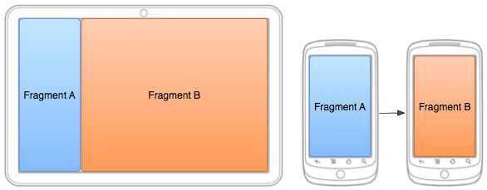
Fragments and screen size
Fragments are also used to deal with different screen sizes.
Based on the size, we have different layouts to display the fragments.
On a smaller screen, code in the app will display fragment B as it is needed.

Slide 9
Layouts

Slide 10
Layouts (briefly)
The layout is used the xml to set how the widgets are displayed
LinearLayout
either horizontally in a single column or vertically in a single row.
RelativeLayout
Set widgets up to be say above another widget. At the bottom of the screen for example.
ConstraintLayout (default layout now)
Via the support library, allows you position and size widgets in a "flexible" way. This can be very complex. Also works with different screen sizes and adapts to them.
Note, sometimes, it easier to use a the relativelayout or even a linearlayout, depends on need.
https://developer.android.com/training/constraint-layout/index.html

Slide 11
Layout "managers"
Most of the time you need more then one view. So you use a layout to control how the widgets are shown on the screen.
LinearLayout is very simple
<LinearLayout android:id="@+id/LinearLayout01" android:layout_width="fill_parent" android:layout_height="fill_parent"
android:orientation="vertical">
Orientation controls placement of the next widget:
vertical: next line
horizontal: to the right of the previous widget
Normally you use several layouts to control how everything is displayed.

Slide 12
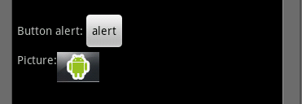
multiple Layout example
For presentation reasons lots of info was left off.
<?xml version="1.0" encoding="utf-8"?>
<LinearLayout android:id="@+id/LinearLayout01"
android:layout_width="fill_parent"
android:layout_height="fill_parent"
android:orientation="vertical">
<LinearLayout android:id="@+id/LinearLayout02"android:orientation="horizontal">
<TextView ></TextView>
<Button ></Button>
</LinearLayout>
<LinearLayout android:id="@+id/LinearLayout02" android:orientation="horizontal">
<TextView ></TextView>
<ImageView></ImageView>
</LinearLayout>
</LinearLayout>

Slide 13
Layout Settings
Weight
Inside a layout, then each Widget can use Layout_Weight
This determines, which gets more space
Setting them all to 1, means they share the space equally.
Setting widget1 to 1 and widget2 to 2, means widget2 gets twice as much space as widget1

Slide 14
Layout Settings Weight
Visual example:

Slide 15
Layout Settings (2)
Gravity
A nice way of saying alignment, which is flush on the left side of the screen
Layout_gravity: (Vertical)
left (default) flush on the left side of the screen
center_horizontal center
right is flush on the right side of the screen.
Horizontal layout
Center_vertical Center vertical, instead of on the "baseline" (bottom).

Slide 16
Layout Settings (3)
Padding
how much in pixels space between the widget and the side of the screen/next widget
android:padding="15dp" is about 15 “pixels” all around
Also paddingLeft, paddingRight, paddingTop, and paddingBottom

Slide 17
Relative Layout
More complex and widgets placed based on the previously placed widgets
Except the first one (no other widget yet)
layout_above, layout_below, layout_toLeftOf, layout_toRightOf
With the above, these can be used layout_alignTop, layout_alignBottom, layout_alignLeft, layout_alignRight, layout_alignBaseline
Or placed relative to the container itself
layout_alignParentTop, layout_ParentBottom, layout_alignParentLeft, layout_parentRight, layout_centerHorizontal, layout_centerVertical, layout_CenterInParent
Settings are placed in the Widgets

Slide 18
Relative Example
<RelativeLayout android:id="@+id/RelativeLayout01" android:layout_width="fill_parent" android:layout_height="fill_parent" android:padding="5px">
<TextView android:text="Some Text " android:id="@+id/TextView01"
android:layout_alignParentBottom="true" >
</TextView>
<Button android:text="alert" android:id="@+id/Button01"
android:layout_above="@id/TextView01" >
</Button>
</RelativeLayout>
NOTE : Button uses @id/TextView01, no + sign. + sign only needed for the id, when referencing it somewhere, just @id/name

Slide 19
Relative Example (2)
<TextView
android:id="@+id/headingValue"
android:layout_width="wrap_content"
android:layout_height="wrap_content"
android:layout_alignBaseline="@+id/headingLabel"
android:layout_alignBottom="@+id/headingLabel"
android:layout_alignLeft="@+id/zAxisValue"
android:text="Nothing..." />

Slide 20
Relative Example (3)
Views over the top of each other. This can easy be done with the relative layout. Like the previous example:
<ImageView
android:id="@+id/ImgV" android:layout_width="fill_parent"
android:layout_height="fill_parent" android:src="@drawable/ic_launcher"/>
<TextView
android:id="@+id/xAxisLabel"
android:layout_width="wrap_content"
android:layout_height="wrap_content"
android:layout_alignParentLeft="true“ this aligns to the top of the “screen”,
android:layout_alignParentTop="true“ since no id was chosen.
android:layout_marginLeft="18dp"
android:layout_marginTop="15dp"
android:text="xAxis" />

Slide 21
Relative and Linear Layouts.
The problem with a relative layout maybe the screen size. The previous example can be redone with a Relative layout and then linear layouts to create the “table” of values. It can then resize as needed.
But it’s also possible you don’t want that behavior.

Slide 22
ConstraintLayout
The constraint layout should fix the problems with the linear and relative layouts.
You can use studio's UI to position the widgets and how you want everything to look.
This can be very time consuming and missed click with somethings mess everything up (remember the back button when then happens).
https://developer.android.com/training/constraint-layout/index.html
https://developer.android.com/studio/write/layout-editor.html

Slide 23
Constraints Rundown
Constraints are what is used to define a view’s position relative to it’s siblings and parent.
They represent a connection or alignment to other another view or to the parent layout or some other invisible guideline.
Each view must have at least one horizontal and one vertical constraint, but adding more is possible and often necessary.
Notes:
Give example of poor constraints

Slide 25
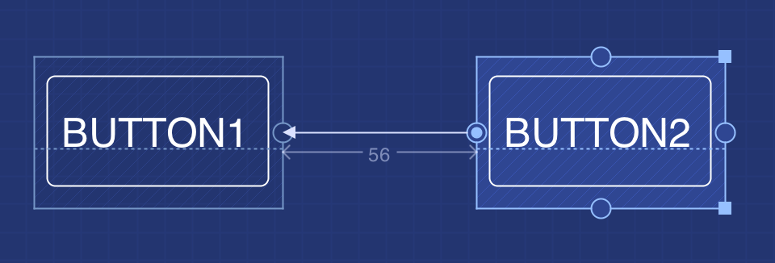
Adding a Constraint
In the design editor simply drag and drop a view from the palette into the blueprint of your layout.
Then use the constraint handles on the view to drag and drop a constraint to an anchor point on another view or to the parent layout.
Conversely, remove a constraint by clicking it’s handle or by selecting the Remove all constraints button below the view.
Constraint
Anchor point
Constraint handle
Notes:
Demonstrate:
How to add constraints
How to remove one constraint
How to remove all constraints
Remember the following rules:
Every view must have at least two constraints: one horizontal and one vertical.
You can create constraints only between a constraint handle and an anchor point that share the same plane. So a vertical plane (the left and right sides) of a view can be constrained only to another vertical plane; and baselines can constrain only to other baselines.
Each constraint handle can be used for just one constraint, but you can create multiple constraints (from different views) to the same anchor point.

Slide 26
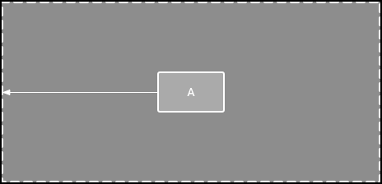
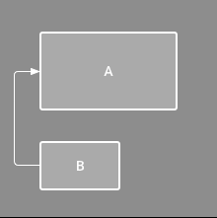
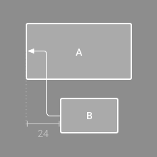
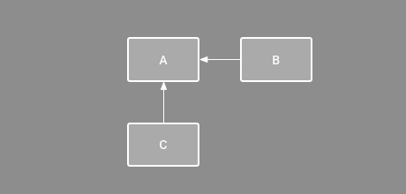
Layout behaviors
1. Parent position
3. Alignment
2. Order position

Slide 27
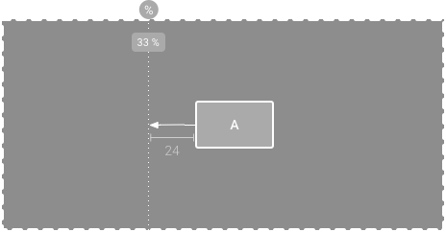
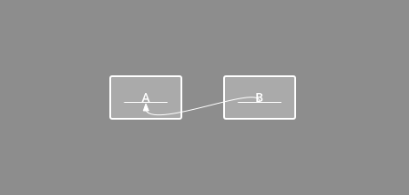
More behaviors
4. Baseline Alignment
(Can be set by selecting the baseline button below a view)
5. Constraint to guideline
(Can be set by selecting Guidelines in the toolbar)

Slide 28
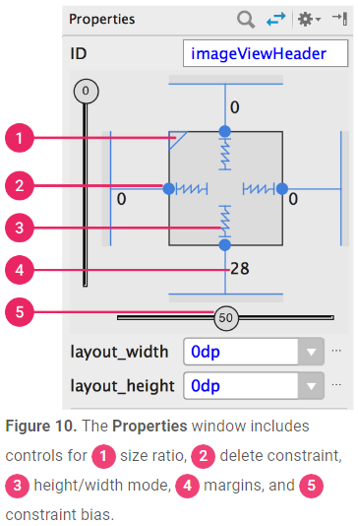
Properties
A view’s spatial occupancy can be entirely edited in the Properties window.
If at least one view dimension is set to match constraint then a size ratio can be set.
Constraint bias give a view weight within a constraint set.

Slide 29
Other Layouts
TableLayout works like html tables (with all the complications like spanning rows)
TableRow is used with it for row layouts
Scrollview work is just like linearLayout, except you get a vertical scrollbars as needed or HorizontalScrollView.
It takes one widget, which is likely a LinearLayout.
There is also a GridView, which items are inserted to the layout via a ListAdapter
We come back to the listAdapter later on (with ListViews)

Slide 30
Q
A
&

