Slide 1
Cosc 5/4730
Android: Preferences and user settings data

Slide 2
Preferences
It’s normally a good idea to allow a user to setup some preferences for an application
Example: Username
It’s saved data between runs about how the application should run.
This adds a level of professionalism as well to the app, since the preferences are handle just same as preferences for the rest of device, including look and feel.
Android provides a preferenceActivity and PreferenceFragment to do this
now androidx.preference it's PreferenceFragmentCompat. there is no prefenceActivity

Slide 3
Preferences (2)
The bulk of the work is in the xml document
The preferenceActivity and preference fragment only provide a place to show the xml document.
The preferenceActivity is deprecated at API 13+
So we use an activity and preferenceFragment.

Slide 4
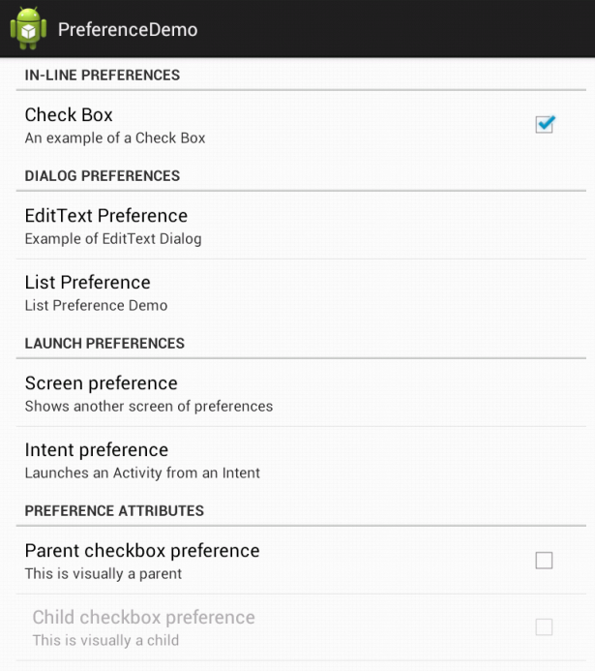
PreferenceFragment
The code is basically the same, but in a fragment.
public class PrefFrag extends PreferenceFragment {
@Override
public void onCreate(Bundle savedInstanceState) {
super.onCreate(savedInstanceState);
addPreferencesFromResource(
R.xml.preferences);
}
}

Slide 5
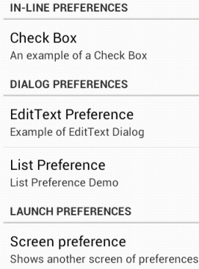
Preferences xml
You need to create an xml for the preferences
Preferences are kept be application sessions by default.
<PreferenceScreen …>
<PreferenceCategory …>
… in-line preference
</PreferenceCategory>
<PreferenceCategory …>
… </PreferenceCategory>
</PreferenceScreen>

Slide 6
CheckBoxPerference
On (true) or off (false)
<CheckBoxPreference
android:key="checkbox_preference“
key used by application to find out the value.
android:title="Check Box"
android:summary="An example of a Check Box" />
Also, you can also set a default value as well.
android:defaultValue="false" Ie off by default

Slide 7
EditTextPreference
<EditTextPreference
android:key="edittext_preference"
android:title="EditText Preference“
android:defaultValue=""
android:summary="Example of EditText Dialog"
android:dialogTitle="Enter your Name" />

Slide 8
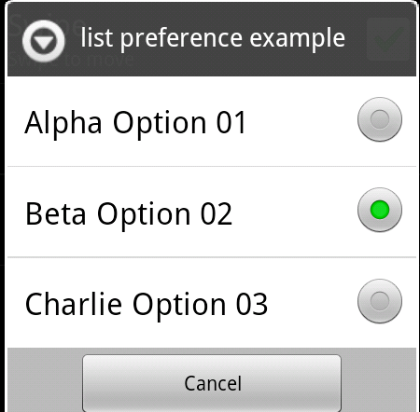
ListPreference
<ListPreference
android:entries="@array/entries_list_preference"
android:entryValues="@array/entryvalues_list_preference"
android:dialogTitle="list preference example“
android:summary="List preference demo"
android:key="list_preference"
android:title="list perference"
/>

Slide 9
Arrays and xml
In the values directory
created a file called “arrays.xml”
<resources>
<string-array name="entries_list_preference">
<item>Alpha Option 01</item>
<item>Beta Option 02</item>
item>Charlie Option 03</item>
</string-array>
<string-array name= "entryvalues_list_preference">
<item>alpha</item>
<item>beta</item>
<item>charlie</item>
</string-array>
</resources>

Slide 10
Switch preference
It's a toggle
<SwitchPreference android:key="switch_key" android:title="switch Preference" android:defaultValue="true" />
Note this is available in androidx, but in v7 is switchprefencecompat

Slide 11
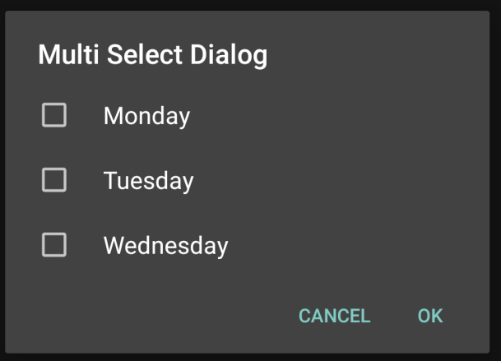
Multiselect
<MultiSelectListPreference
android:dialogTitle="Multi Select Dialog"
android:key="multiselect_key"
android:summary="Does this show?"
android:title="Multi Select Title"
android:entries="@array/weekdays"
android:entryValues= "@array/weekdays_values"
android:defaultValue= "@array/empty_array"
/>
Arrays.xml file
<string-array name="weekdays">
<item>Monday</item>
<item>Tuesday</item>
<item>Wednesday</item>
</string-array>
<string-array name="weekdays_values">
<item>Mon</item>
<item>Tue</item>
<item>Wed</item>
</string-array>
<string-array name="empty_array">
</string-array>

Slide 12
Next screen
Create a separation of settings, but using the same xml doc.
<PreferenceScreen
android:key="screen_preference"
android:summary="Check here for another Preference Screen"
android:title="Next Preference Screen">
You can place more preferences here that will be shown on the next screen.
<CheckBoxPreference
android:key= "next_screen_checkbox_preference"
android:summary="Next Screen Check Box Demo, but in the same xml"
android:title="Next Screen Check Box" />
… more preferences here
</PreferenceScreen>

Slide 13
Access the preference
In your java code, likely in onResume(…)
onResume is called when you app gets the screen back from the preferences screen!
Also called when the application starts.
code look something like this:
SharedPreferences prefs = PreferenceManager.getDefaultSharedPreferences (getBaseContext());
Now you get the preferences with
abstract Map<String, ?> getAll() OR
getBoolean(key, defaultvalue), getInt(key,defvalue), getString(key, defaultvalue), …

Slide 14
preference example
prefs is declared on last slide
boolean useSensor = prefs.getBoolean(“sensorPref” , false);
get the sensorPref key, if not found, default is false.
string text = prefs.getString(“textPref”, “”);
string list = prefs.getString(“list_preference”,””);
Note, if you had set integer or floats as the entryValues, then you want to get them as getInt or getFloat.

Slide 15
MultiSelectList preference values.
Getting the values from a multiselectListPreference.
mMultiSelectListPreference = (MultiSelectListPreference) getPreferenceScreen().findPreference("multiselect_key");
This returns a Set<String> with the name listed which were selected.
Note, you can't guarantee order in the set.
This will create a simple string, for the summary.
String list = ""; Set<String> selections = mMultiSelectListPreference.getSharedPreferences() .getStringSet("multiselect_key", null); for(String s: selections) { list += s + " "; } mMultiSelectListPreference.setSummary("selection is " + list );

Slide 16
Compatibility (without fragments)
getSupportFragmentManager().beginTransaction().replace(android.R.id.content, new PrefFrag()).commit();
android.R.id.content allows you to display the fragment even if you are not using fragments.

Slide 17
Example code
The PreferenceDemo has the code from all in.
myPreferenceFragment shows everything covered so far.
PreferenceupdateFragment show the next stuff
Where we have "live" updates of the data.

Slide 18
Preferences android:summary
It maybe that instead of you want a the current value listed, instead of the descriptions as I have listed here.
You will need to implement a listener in PreferenceFragment called OnSharedPreferenceChangeListener
See the dialog example for how to implement the code.

Slide 19
Code
Setup some variables in onCreate(…) of the fragment.
// Get a reference to the preferences, so we can dynamically update the preference screen summary info.
Example from the code example:
mEditTextPreference = (EditTextPreference)getPreferenceScreen().findPreference("textPref");
mListPreference = (ListPreference)getPreferenceScreen().findPreference("list_preference");
Implement the OnSharedPreferenceChangeListener in the fragment
@Override
public void onSharedPreferenceChanged(SharedPreferences sharedPreferences, String key) {
if (key.equals("textPref")) { //where textPref is the key used in the xml.
mEditTextPreference.setSummary( "Text is " + sharedPreferences.getString("textPref", "Default"));
} else if (key.equals("list_prefrence")) {
mListPreference.setSummary("Current value is " + sharedPreferences.getString(key, "Default"));
}
}

Slide 20
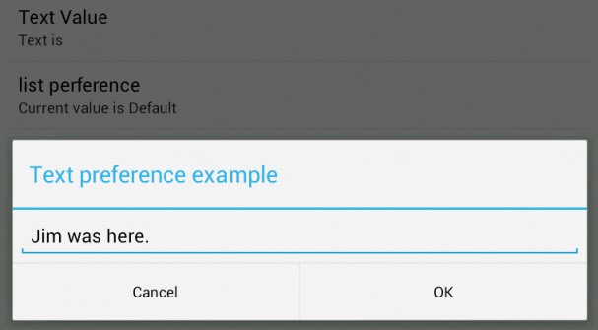
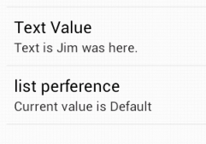
Code (2)
Setup to read and setup the summary fields in the onResume() and setup the listener.
Remove the listener in the onPause()

Slide 21
preferences xml
Only covered a good subset of the preferences xml, but this is not a complete list.
see http://developer.android.com/reference/android/preference/Preference.html for more information.

Slide 22
androidx library

Slide 23
A note
The support preference libraries were setup so api 8+ would support all the new preferences that happened in API 14.
Initially, androidx preferences were put in the legacy group as well.
But it was moved out of legacy and new features are being added the androidx.preference library (and added to jetpack as well!)
https://developer.android.com/guide/topics/ui/settings
it appears the androidx library is diverging from the "standard" preferences.
Declaring nested hierarchies within the same XML resource using a nested <PreferenceScreen> is no longer supported. You should use nested Fragment objects instead.
https://developer.android.com/guide/topics/ui/settings

Slide 24
Support preference
Support preference setup
implementation 'androidx.preference:preference:1.1.1'
Almost everything works the same.
in the xml, change it to <androidx.preference.PreferenceScreen
You also need to add theme to the style.xml or it will force close.
<item name="preferenceTheme">@style/PreferenceThemeOverlay</item>

Slide 25
Major change (1)
One major difference
"Next" screen preferences are no longer allowed. ie, <preferencescreen …> as subs.
So separate your preferences into separate xml files and PreferenceFragmentCompat fragments to load them.
In the "main" xml preference, where you want the sub screen to show, add a new preference object
example: (red is the name of the fragment).
<Preference
app:title="Advanced Support Preferences"
app:summary="Sample preferences with advanced attributes"
app:fragment="edu.cs4730.supportprefencedemo.AdvancedPreferenceFragment"/>

Slide 26
Major change (2)
@Override
public boolean onPreferenceStartFragment(PreferenceFragmentCompat caller, Preference pref) {
// Instantiate the new Fragment
final Bundle args = pref.getExtras();
final Fragment fragment = getSupportFragmentManager().getFragmentFactory().instantiate(
getClassLoader(),
pref.getFragment());
fragment.setArguments(args);
fragment.setTargetFragment(caller, 0);
// Replace the existing Fragment with the new Fragment
getSupportFragmentManager().beginTransaction()
.replace(R.id.settings_container, fragment)
.addToBackStack(null)
.commit();
return true;
}
In the activity (likely main), you need to add a callback for the preference callback change.
Not sure how this interacts with arch.navigation or if you can call preferencefragment via arch.navigation.
… implements PreferenceFragmentCompat.OnPreferenceStartFragmentCallback {
...

Slide 27
example code

Slide 28
supportPreferenceDemo
Demos a all the same as the preferenceDemo.
myPreferenceActivity and myPreferenceFragment are preferenceFragmentCompat
With the onpreferencestartscreen callbacks
PreferenceupdateFragment has the summary code in the fragment
Note the example will use myPreferenceFragment in the MainActivity and the myPreferenceActivity to show how just use them without a framelayout.

Slide 29
References
https://developer.android.com/jetpack/androidx/releases/preference
https://developer.android.com/guide/topics/ui/settings
http://developer.android.com/reference/android/preference/PreferenceActivity.html
http://developer.android.com/reference/android/preference/PreferenceFragment.html
older and maybe less useful now.
http://stackoverflow.com/questions/7112706/preferencefragment-alternative-for-the-android-compatibility-api
http://android-er.blogspot.com/2012/07/example-of-using-preferencefragment.html
http://gmariotti.blogspot.com/2013/01/preferenceactivity-preferencefragment.html
http://www.cs.dartmouth.edu/~campbell/cs65/lecture12/lecture12.html
https://stackoverflow.com/questions/32487206/inner-preferencescreen-not-opens-with-preferencefragmentcompat and the github example code at https://github.com/madlymad/PreferenceApp

Slide 30
Q
A
&

