Slide 1
Cosc 4730
google's Location SDK
play-services-location

Slide 2
play-services-location
Where you are services
  Places API, GeoFencing, Fused Location provider API (previously covered)
What you're doing
  Google Fit (depreciated), Activity Recognition API, Sensors API, Sleep API
What's Nearby
  Nearby Messages (depreciated), nearby Connections, NearBy Notifications (depreciated)
Combined?
  Awareness API
https://developers.google.com/location-context/

Slide 3
permissions.
Depending on what you are doing, you may need all or some or only 1
  android.permission.ACTIVITY_RECOGNITION
    any of the What you're doing ones, except sensors.
  ACCESS_COARSE_LOCATION, ACCESS_FINE_LOCATION
  And INTERNET as well.

Slide 4
Activity recognition

Slide 5
Activity Recognition
Google has released a set of APIs two allow an application to attempt figure out what activity the user is doing, based on the movement of the device (ie phone).
  IN_VEHICLE The device is in a vehicle, such as a car.
  ON_BICYCLE The device is on a bicycle.
  ON_FOOT The device is on a user who is walking or running.
  RUNNING The device is on a user who is running.
  STILL The device is still (not moving).
  TILTING The device angle relative to gravity changed significantly.
  UNKNOWN Unable to detect the current activity.
  WALKING The device is on a user who is walking.
  As note, a user can be in_vehicle and walking. Ie walking on a bus.
    In 2016 the said they would add more as they could, but as of Nov 2024, the list is the same.

Slide 6
What can we do with this info?
Google’s short video on it:
  https://youtu.be/S8sugXgUVEI
Basically, the app can react to whatever the person is doing.
  Well, what the phone is doing or not doing.

Slide 7
Includes
Need to add app module file a compile directive
In the dependencies section add
  implementation("com.google.android.gms:play-services-location:21.3.0")
  implementation("com.google.android.gms:play-services-base:18.5.0")
  or newer versions.

Slide 8
Setup
Setup the Client for the API
  older version required a client first.
Now you get the client at the same time
  ActivityRecognition.getClient(this).

Slide 9
Request Activity Updates
Build the request
  ActivityRecognition.getClient(this ).requestActivityUpdates(DETECTION_INTERVAL_IN_MILLISECONDS, getActivityDetectionPendingIntent());
    where get ActivityDetecitonPendingIntent returns a pending Intent.
addSuccessListener and/or addOnFailureListener tell you updates have started
An update of zero milliseconds will detect as fast as possible, but impact battery life.

Slide 10
PendingIntent
Instead of having this in a service (which can be battery drain), it’s all down with a PendingIntent
  You specify what is supposed to get the data
    A service (or intent service), broadcast receiver, or an activity.
For my example code, I wanted it to go the activity I was using, so
Intent intent = new Intent(this, MainActivity.class);
  I wanted to use the current running Activity and not start a new one, so Also add android:launchMode="singleTop“ to activity in Manifest file as well.
intent.addFlags(Intent.FLAG_ACTIVITY_SINGLE_TOP);
And recreate the pending Intent.
return PendingIntent.getActivity(this, 0, intent, PendingIntent.FLAG_UPDATE_CURRENT);
To start a service, it would look like this
Intent intent = new Intent(this, DetectedActivitiesIntentService.class);
return PendingIntent.getService(this, 0, intent, PendingIntent.FLAG_UPDATE_CURRENT);
OR
use a broadcast receiver in your activity, which simples the activity intent and doesn't need a service
return PendingIntent.getBroadcast(MainActivity.this, 0, intent, PendingIntent.FLAG_MUTABLE);
then declare a boardcastReceiver in your MainActivity. this what the AcitivityRecognitionDemo does.

Slide 11
Result intent
Now the app receives the intent to the spot specified and get the info.
    In my example to an override onNewIntent
  ActivityRecognitionResult result = ActivityRecognitionResult.extractResult(intent);
Now the app can get a list of the activity and/or the most probablyActivity as well as the probably of the activity.
  The doc’s differ, but between 50 and 75 probably is very likely. Under 50, it is not sure at all.
    And note, two activities maybe over 75% such as in_vehicle and walking.

Slide 12
Result intent (2)
Get most probable
  DetectedActivity probably = result.getMostProbableActivity();
  Probably.getConfidence() >= 50 //or 75
    Then the device is likely “doing that” activity.
  Probably.getType() returns a constant value
    Use DetectedActivity.IN_VEHICLE, DetectedActivity.ON_BICYCLE, DetectedActivity.ON_FOOT, DetectedActivity.RUNNING, DetectedActivity.STILL, DetectedActivity.TILTING, DetectedActivity.UNKNOWN, DetectedActivity.WALKING to determine which one

Slide 13
So again
What can the app do with info?
  Or set of info…
    What does it mean when the activity goes from Driving to Still?
      And is that enough info?
    The phone tilted is this useful information?
      From the Documentation: The device angle relative to gravity changed significantly. This often occurs when a device is picked up from a desk or a user who is sitting stands up.
    User started running, launch a mapping app?
      How would we go about doing this?

Slide 14
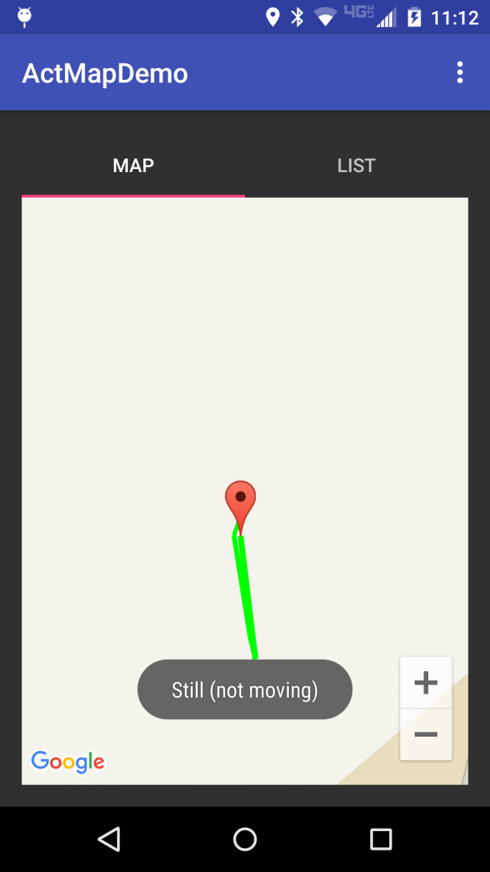
Combining a few things.
This app will use the ActivityRecogntion, plus locationAware to map out the user activities
  While the app is running.
  The list will show the shows the text information that is mapped on the map view.
  It adds Markers to the map for start and end, plus each mile as well.

Slide 15
References
https://developers.google.com/android/reference/com/google/android/gms/location/ActivityRecognition
https://developers.google.com/android/reference/com/google/android/gms/location/ActivityRecognitionResult
https://developers.google.com/android/reference/com/google/android/gms/location/DetectedActivity
https://github.com/googlesamples/android-play-location/tree/master/ActivityRecognition which is google example code.

Slide 16
Sleep API

Slide 17
Sleep API
starts in API 29.
The sleeping information is reported in two ways:
  A "sleep confidence", which is reported at a regular interval (up to 10 minutes)
  A daily sleep segment which is reported after a wakeup is detected

Slide 18
How it works.
Your app will subscribe to the sleep updates
  which (very likely) requires a broadcast receiver
    Since these are long term data, starting at system boot, you want to a broadcast receiver, instead of sending the data to the activity
  Process the data as needed.
As needed, unsubscribe.
You may also want to boot receiver, so start receiving sleep data when the phone starts.

Slide 19
subscribe
You need a pendingintent and then use the get client to subscribe to both
PendingIntent pi = PendingIntent.getBroadcast(
getApplicationContext(), 0, new Intent(getApplicationContext(), SleepReceiver.class), PendingIntent.FLAG_CANCEL_CURRENT);
ActivityRecognition.getClient(getApplicationContext()). requestSleepSegmentUpdates(
pi, SleepSegmentRequest.getDefaultSleepSegmentRequest())
.addOnSuccessListener(new OnSuccessListener<Void>() {
@Override
public void onSuccess(Void aVoid) {
//you are subscribed.
}
).addOnFailureListener(new OnFailureListener() {
@Override
public void onFailure(@NonNull Exception e) {
//failed to subscribe
}
});

Slide 20
the Data
SleepSegmentEvent
  returns a start and stop time. and status
    If the status code is STATUS_SUCCESSFUL or STATUS_MISSING_DATA, then an instance of this class contains a detected sleep start time and a detected sleep end time.
SleepCassifyEvent (returns data at set intervals, like 10 minutes)
  getConfidence() between 0 and 100
    Higher values indicate that the user is more likely sleeping
  getLight ()
    range from 1 to 6, higher value is brighter surrounding
  getMotion()
    range from 1 to 6, higher indicates more movement of the device
  also timestamps.

Slide 21
Receiver
via a broadcast receiver:
public void onReceive(Context context, Intent intent) {
if (SleepSegmentEvent.hasEvents(intent)) {
List<SleepSegmentEvent> sleepSegmentEvents = SleepSegmentEvent.extractEvents(intent);
for (SleepSegmentEvent event : sleepSegmentEvents) {
//now deal with the data.
}
} else if (SleepClassifyEvent.hasEvents(intent)) {
List<SleepClassifyEvent> sleepClassifyEvents = SleepClassifyEvent.extractEvents(intent);
for (SleepClassifyEvent event : sleepClassifyEvents) {
//now deal with the data.
}

Slide 22
Now what?
Likely the receiver will store the data in a database (room?) and then the data can be displayed/processed when the user opens the app.

Slide 23
Demo code
The demo is very simple.
  it has a subscribe and unsubscribe button and the broadcast receiver prints the data to the logcat.
  remember to unsubscribe when you are done (or uninstall). it will continue to sleep data if you leave it subscribed.

Slide 24
References
https://android-developers.googleblog.com/2021/02/low-power-sleep-tracking-on-android.html
https://developers.google.com/location-context/sleep

Slide 25
Device orientation

Slide 26
Device Orientation
There is no official documentation, except the methods documentation.
  The "sensors" documentation that the site points too, says it was all depreciated (api 8) and to you should use some very complex math and points to a paper that google published on it.
  But since we know how to use the locationAPI pieces, it was easy to figure out.
  No permission are currently needed.

Slide 27
How
get the client,
setup the settings, (how often you want updates)
setup a listener for the updates
and it needs a thread.

Slide 28
Code
mFusedOrientationProviderClient.requestOrientationUpdates(
request, executors, mDeviceOrientationListener
).addOnSuccessListener(new OnSuccessListener<Void>() {
@Override
public void onSuccess(Void unused) {
}
}).addOnFailureListener(new OnFailureListener() {
@Override
public void onFailure(@NonNull Exception e) {
}
});

Slide 29
Request and thread
DeviceOrientationRequest request = new DeviceOrientationRequest.Builder(DeviceOrientationRequest.OUTPUT_PERIOD_DEFAULT).build();
  20 secons
  OUTPUT_PERIOD_FAST is 5 seconds
  OUTPUT_PERIOD_MEDIUM is 10 seconds.
Executors are just fancy threads
  ExecutorService executors = Executors.newSingleThreadExecutor();

Slide 30
DeviceOrientationListener
the listener returns an orientation variable
getHeadingDegrees() The estimated heading of the device in degrees between [0, 360).
mDeviceOrientationListener = new DeviceOrientationListener() {
@Override
public void onDeviceOrientationChanged(@NonNull DeviceOrientation deviceOrientation) {
//use deviceOrientation variable.
}
}
rotation = rotationInfo();
if (rotation == Surface.ROTATION_0 || rotation == Surface.ROTATION_180) { //holding it portrait mode
msg = "Y axis (0 to 360 degrees): " + deviceOrientation.getHeadingDegrees();
} else if (rotation == Surface.ROTATION_90 || rotation == Surface.ROTATION_270) { //holding it landscape
msg = "X axis (0 to 360 degrees): " + deviceOrientation.getHeadingDegrees();
}

Slide 31
Azimuth, Pitch, and roll
//get the information
SensorManager.getRotationMatrixFromVector(rotationMatrix, deviceOrientation.getAttitude());
// got a good rotation matrix
SensorManager.getOrientation(rotationMatrix, prefValues);
mAzimuth = (float) Math.toDegrees(prefValues[0]);
if (mAzimuth < 0) {
mAzimuth += 360.0f;
}
//mPitch = 180.0 + Math.toDegrees(prefValues[1]); //so it goes from 0 to 360, instead of -180 to 180
mPitch = Math.toDegrees(prefValues[1]);
//roll
mRoll = Math.toDegrees(prefValues[2]));

Slide 32
Q
A
&

