Slide 1
Cosc 4735
Google Play Services
Overview

Slide 2
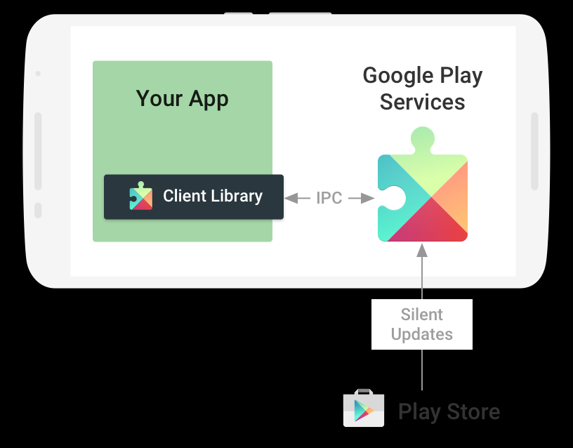
Google Play Services
With Google Play services, your app can take advantage of the latest, Google-powered features such as Maps, etc.

Slide 3
Google Play Services
There are a number of Google APIs for Android
Most can be easily added to your app without even needing a API key.
maps needs a API key for example, but most do not.
We setup a connection and then can call on the services.
We may need to login.
They may also need user login a account as well.
Example would be Fit. The user needed to login to their Fit account.
And many of these service can be accessed via ReST APIs as well, from web, IOS, and other systems.

Slide 4
Build Setup
App build.gradle file
implementation 'com.google.android.gms:play-services-base:Version'
Then the service(s) we need to use. Example wear OS.
implementation 'com.google.android.gms:play-services-wearable:17.0.0'
See https://developers.google.com/android/guides/setup that should will be updated as new ones are added.

Slide 5
A note
As of v10, it will no longer support 2.3.3 and below
You will have to use 9.8.0 versions to support 2.3.3
10.0.x to 11.6.X
googleApi Requires a login for anything work, so networking is a must.
11.8.0+ for all services.
client
Remove the login requirement

Slide 6
Build Setup (2)
Google Account Login com.google.android.gms:play-services-auth:19.0.0
Google Actions, Base Client Library com.google.android.gms:play-services-base:17.5.0
Google Sign In com.google.android.gms:play-services-identity:17.0.0
Google Analytics com.google.android.gms:play-services-analytics:17.0.0 (moved to firebase.)
Google Awareness com.google.android.gms:play-services-awareness:18.0.1
Google Cast com.google.android.gms:play-services-cast:19.0.0
Google Cloud Messaging com.google.android.gms:play-services-gcm:17.0.0 (fully deprecated, use Firebase.)
Google Drive com.google.android.gms:play-services-drive:17.0.0
Google Fit com.google.android.gms:play-services-fitness:20.0.0
Google Location and Activity Recognition com.google.android.gms:play-services-location:17.1.0
Google Maps v2 com.google.android.gms:play-services-maps:16.0.0 (not listed in for 17, but 17.0.0 in android studio)
Google Mobile Ads com.google.android.gms:play-services-ads:19.6.0 (and firebase)
Mobile Vision com.google.android.gms:play-services-vision:20.1.3 (integrated into firebase as well)
Google Nearby com.google.android.gms:play-services-nearby:17.0.0 (many parts are now deprecated)
Google Panorama Viewer com.google.android.gms:play-services-panorama:17.0.0 (not updated in a while)
Google Play Game services com.google.android.gms:play-services-games:21.0.0
SafetyNet com.google.android.gms:play-services-safetynet:17.0.0
Google Pay com.google.android.gms:play-services-wallet:18.1.1
Wear OS by Google com.google.android.gms:play-services-wearable:17.0.0 (also not updated in a while)
https://developers.google.com/android/guides/setup

Slide 7
Deprecated as of 11.8.0+ for all services. Works from 10.0.x to 11.6.X
Included, because a lot of example code is still for the apiclient.

Slide 8
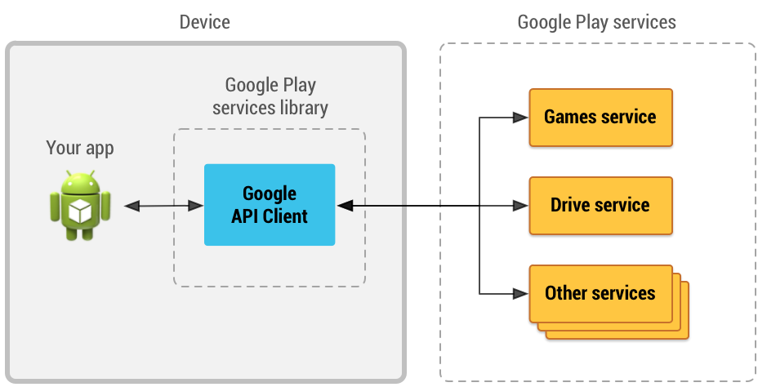
Java code
To access the services
Create an instance of the GoogleApiClient ("Google API Client").

Slide 9
Create the googleAPIClient
addApi with the ones want to use in this app
You can add more then one at a time
addScope as needed.
Add callbacks for connected and failed.
Example:
mGoogleApiClient = new GoogleApiClient.Builder(this)
.addConnectionCallbacks(this)
.addOnConnectionFailedListener(this)
.addApi(LocationServices.API) //which APIs you want to use.
.build();
And we need the three methods that were implemented
Implements GoogleApiClient.ConnectionCallbacks, GoogleApiClient.OnConnectionFailedListener
public void onConnectionSuspended(int i)
public void onConnectionFailed(ConnectionResult connectionResult)
public void onConnected(Bundle bundle)

Slide 10
Start/stop
Lastly override onStart and onStop
@Override
protected void onStart() {
super.onStart();
mGoogleApiClient.connect();
}
@Override
protected void onStop() {
super.onStop();
mGoogleApiClient.disconnect();
}

Slide 11
"client" access methods as of 11.8.0+

Slide 12
Client
Each service is now connected individually.
Example with google Drive.
Note use must login first.
GoogleSignInAccount account = GoogleSignIn.getLastSignedInAccount(this);
Now get the "client"
DriveResourceClient client = Drive.getDriveResourceClient(this, account);
Where this is the context or activity context.
Now use the client for an action (via a task)
client.getAppFolder()
.addOnCompleteListener(this, new OnCompleteListener<DriveFolder>() {
@Override
public void onComplete(@NonNull Task<DriveFolder>() {
// ...
}
});
A simple example of googleloginDemo is in the googleplayAPI repo

Slide 13
Uses the new Job Scheduler tasks
Each of the Google APIs now have a Client method to access the API
With listeners and tasks
Example:
Old calls, used the ActivityNameApi (googleApiClient) *
New calls, uses the ActivityNameClient
We'll look at them as we cover each of the APIs.

Slide 14
Reference
https://developers.google.com/android/guides/setup
https://developers.google.com/android/guides/api-client (11.8.0+)
https://developers.google.com/android/guides/google-api-client (deprecated)

Slide 15
Q
A
&

