Slide 1
Cosc 4735
LocationAware API

Slide 2
Previous on …
Before we looked at GPS location.
http://www.cs.uwyo.edu/~seker/courses/4730/and-gpslocation.pptx
While this works, it’s actually not the “Google/ android” recommended method.
“If you are currently using the Android framework location APIs, you are strongly encouraged to switch to the Google Play services location APIs as soon as possible.” --Android Developer site.

Slide 3
Google Play services location APIs
Provides
GPS, cell tower, and Wifi aggregated information as single “device”
Based on permissions.
the current location, get periodic location updates, look up addresses, and geofences.
Note, Geofences is not covered here
Possible student project.

Slide 4
Permissions.
The permissions you ask for, will determine the accuracy.
So
<uses-permission android:name="android.permission.ACCESS_COARSE_LOCATION"/>
<uses-permission android:name="android.permission.ACCESS_FINE_LOCATION"/>
If you ask for only coarse location, then it will not be as accurate.
And don’t forget you need code to ask for the permissions from the user as well.

Slide 5
setup
Need to add app module file a compile directive
In the dependencies section add
Base plus the location
implementation 'com.google.android.gms:play-services-location:21.0.0'
Where 21.0.0 was the current version

Slide 6
Setup the Client
We need the Location Services API, so
FusedLocationClient client = LocationServices.getFusedLocationProviderClient(this);
Where this is the activity
Full example code is googleplayAPI repo, locationAwareDemo

Slide 7
Last Location
Getting last location is very easy
Use the client and set a success listener.
client.getLastLocation()
.addOnSuccessListener(this, new OnSuccessListener<Location>() {
@Override
public void onSuccess(Location location) {
//we have a location object.
}
})
.addOnFailureListener(this, new OnFailureListener() {
@Override
public void onFailure(@NonNull Exception e) {
Log.w(TAG, "getLastLocation:onFailure", e);
}
});

Slide 8
Location object
Location object provides
getLatitude(), getLongitude(), getAltitude(), getSpeed(), etc.
Also boolean hasAltitude(), hasSpeed(), etc
http://developer.android.com/reference/android/location/Location.html

Slide 9
A note on "client"
In previous slide, client has addOnSucessorListener and adonFailureListener
You can also be done via the return
Task<Void> task = client.get…
task.addOnSuccessListener …
task.addOnFailureListener …
There is also a AddOnCompleteListener that combines the success and failure. But then you have to sort out what happened.
task.addOnCompleteListener…

Slide 10
Location Updates
We need a locationsettings request
On success we need a location request and callback.
Then make the location request and receive updates.

Slide 11
Location Updates (2)
A simple settings request
LocationSettingsRequest.Builder builder = new LocationSettingsRequest.Builder(10000); //10 second interval.
builder.addLocationRequest(mLocationRequest);
mLocationSettingsRequest = builder.build();
Then check locationsettings, if successful, now we can request updates.
client.checkLocationSettings(mLocationSettingsRequest)
.addOnSuccessListener(this, new OnSuccessListener<LocationSettingsResponse>() {
@Override
public void onSuccess(LocationSettingsResponse locationSettingsResponse) {
//success make the update request
mFusedLocationClient.requestLocationUpdates(mLocationRequest,
mLocationCallback, Looper.myLooper());
}
})
.addOnFailureListener(this, new OnFailureListener() {
@Override
public void onFailure(@NonNull Exception e) {
//failed… we can't get updates
…

Slide 12
Location Updates (3)
The Location Request
We need to define the update interval and “fastest update interval” in milliseconds, plus priority
Priority: PRIORITY_BALANCED_POWER_ACCURACY, PRIORITY_HIGH_ACCURACY, PRIORITY_LOW_POWER, or PRIORITY_NO_POWER
Example:
LocationRequest mLocationRequest = = LocationRequest.create(10000) //10 seconds
.setMinUpdateIntervalMillis(5000) //5 seconds
.setPriority(LocationRequest.PRIORITY_HIGH_ACCURACY) //use GPS location.
.setWaitForAccurateLocation(true) //waits a couple of second initially
.setMaxWaitTime(20000); //max of 20 seconds.
.build();

Slide 13
Location Updates (4)
The callback is pretty simple:
mLocationCallback = new LocationCallback() {
@Override
public void onLocationResult(LocationResult locationResult) {
super.onLocationResult(locationResult);
location = locationResult.getLastLocation();
//we have location, do something with it.
}
};

Slide 14
Addresses
To be Human readable, we need to convert from a Latitude/longitude location to an address
Using the Geocoder class
Reverse geocoding: geographic coordinates to address
Geocoding: address to geographic coordinates
This process can take a little time and should not be done on the UI thread.
In the example code, it uses a worker
you can't do on the main UI thread, since it requires internet and could lock up the main thread.
For display here, I’m just showing how to get the address.

Slide 15
Setup geocoder
Geocoder geocoder = new Geocoder(Context, Locale.getDefault());
We want locale information for how numbers, dates are represented.
We can ask for the address based on the Lat/Long and it will return a list of addresses
We can specify how many, in our case 1 is fine.
List<Address> addresses = geocoder.getFromLocation( location.getLatitude(), location.getLongitude(), 1);
It must be in a try catch to deal with errors of ioException where the service is no available and IllegalArgumentException where Lat or Long is invalid.

Slide 16
Address
Now that we have a response,
If the addresses variable is not null then we have at least 1 address in the List
Address mAddress = addresses.get(0);
There maybe a lot of information associated with it.
http://developer.android.com/reference/android/location/Address.html
We are interested in the getAddressLine(int index), where we are pulling the address together.
ArrayList<String> addressFragments = new ArrayList<String>();
for(int i = 0; i < mAddress.getMaxAddressLineIndex(); i++)
addressFragments.add(mAddress.getAddressLine(i));
String FullAddress = TextUtils.join(System.getProperty("line.separator"), addressFragments));

Slide 17
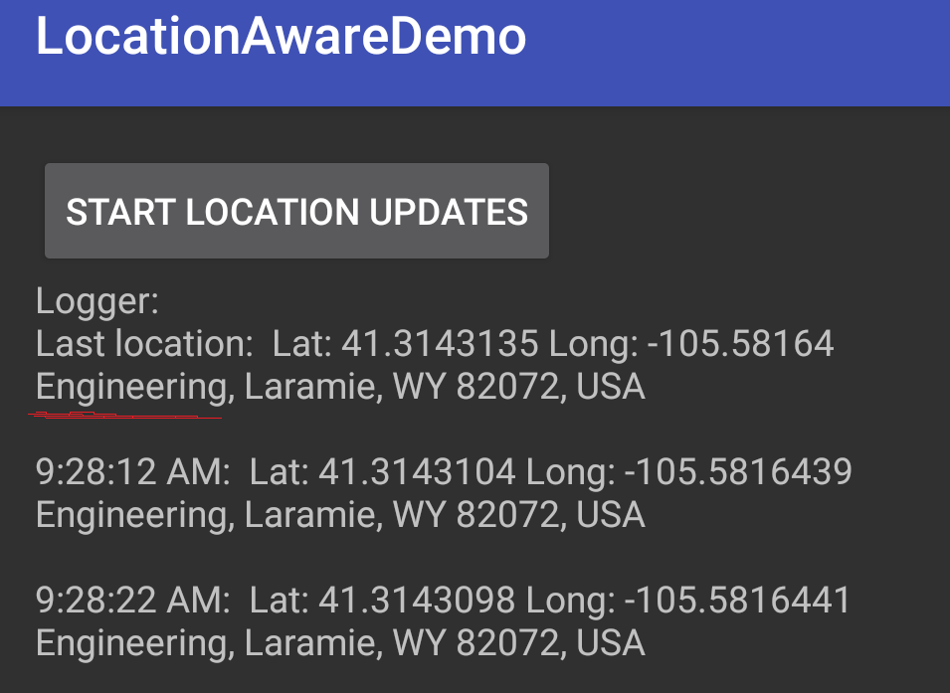
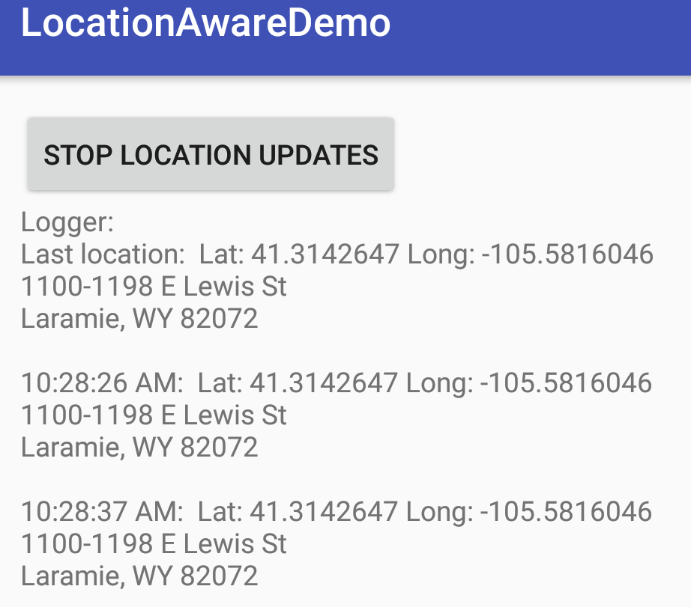
Result
January 2019 (v21.0.0)
Jan 2018 (v11.8.0)

Slide 18
References
http://developer.android.com/training/location/index.html

Slide 19
Q
A
&

